Slide 2
WRDS Classroom
Link
Classroom tab
https://wrds-classroom.wharton.upenn.edu
Muk Rao
WRDS Advanced Initiatives
Product Manager
mvrao@wharton.upenn.edu

Slide 3
WRDS Classroom

Slide 4
~ 70 Teaching Tools

Slide 5
What are You Teaching this Term?
Introduction to WRDS
Investments
Accounting
Fixed Income
Macroeconomics
Text Analytics

Slide 6
Introduction to WRDS

Slide 7
Investments

Slide 8
Accounting

Slide 9
Fixed Income

Slide 10
Macroeconomics

Slide 11
Text Analytics

Slide 12
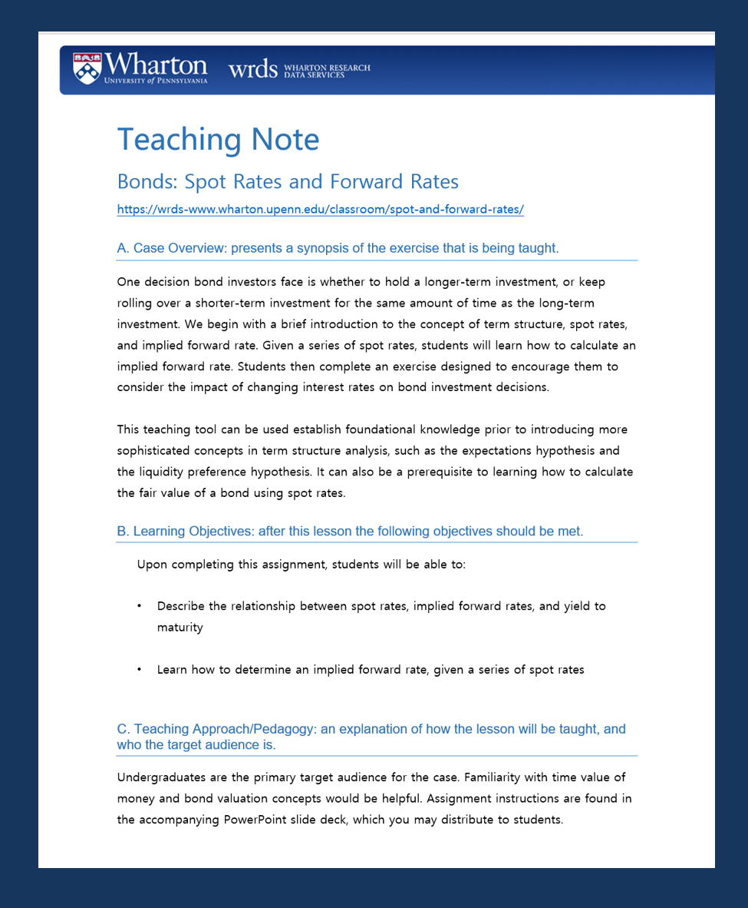
What Makes up a Teaching Tool?
Teaching Note
Provides background information, learning objectives, and information on the intended audience
Can include questions for class discussion

Slide 13
What Makes up a Teaching Tool? (cont).
II. Slide deck
Introduces topic and provide context
Can be customized to your lesson
Can be used as class presentation
Can be used for student’s self-directed learning prior to class

Slide 14
Sample Slide Deck

Slide 15
What Makes up a Teaching Tool? (cont.)
III. Interactive Exercise!
Data queries AND visualizations developed for use in the classroom
Case studies with real-world data to illustrate financial topics
valuable for individual use, classroom demonstration of topics, or group lab session
Promote hands-on, practical instruction

Slide 16
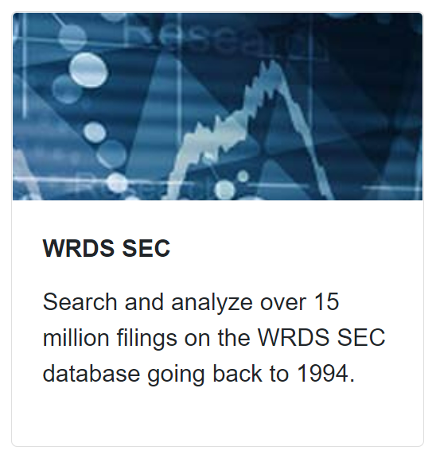
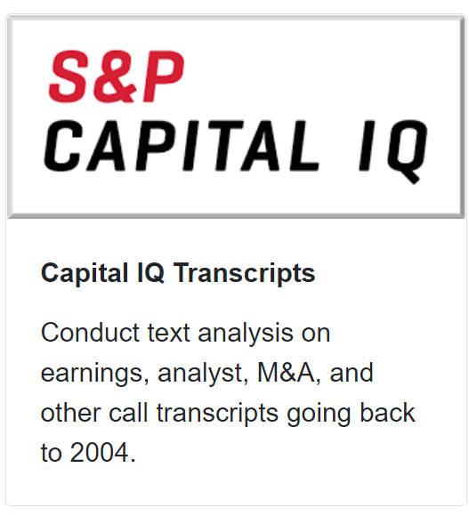
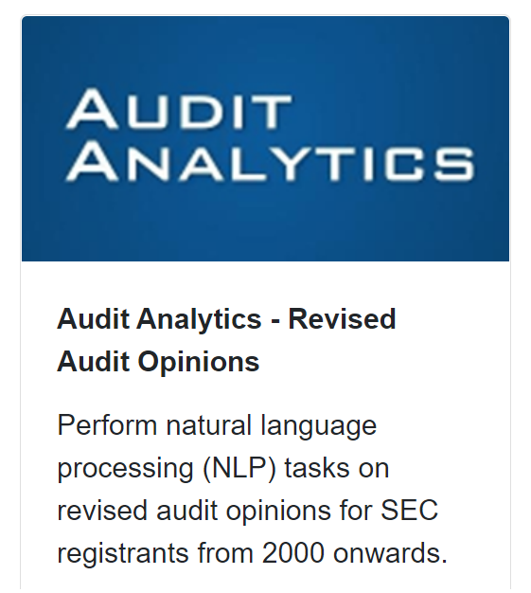
Jupyter Notebook Workflow
Data Visualizations
Results Files

