Slide 1
Introduction to WRDS 13F Holdings Data

Slide 2
13F Holdings Data on WRDS
Thomson/Refinitiv Institutional (13f) Holdings - S34
Stock holdings
1980 - present
Factset Ownership v5 - 13F Historical Institutional Holdings
Stock holdings
1993 - present
WRDS 13F Holdings
All holdings, including bonds and options if reported
“As filed”, 2002 - present
“Complete” since 2013 June
The SEC began requiring institutional investment managers to file their 13F reports in XML format in 2013. Prior to that, the reports were filed in a text-based format.

Slide 3
Example: WRDS 13F Holdings
WRDS SEC Analytics Suite - 13F Holdings Data
13F holdings itemized holdings
Example: GE, CIK=40545
WRDS SEC Analytics Suite - 13F Summary Data
13F holdings summary at holding company level
Example: GE, CIK=40545
https://www.sec.gov/edgar/browse/?CIK=40545&owner=exclude
https://www.sec.gov/Archives/edgar/data/40545/000004054522000033/xslForm13F_X02/primary_doc.xml

Slide 4
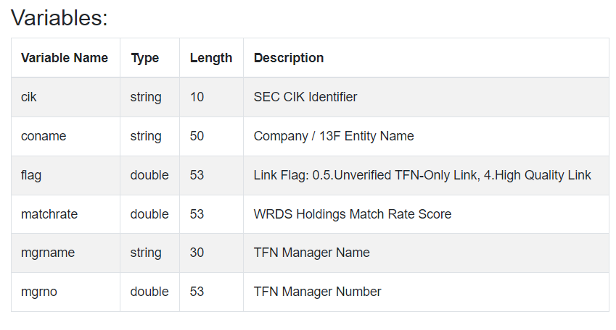
WRDS 13F Linking to Other 13F Data
WRDS 13F CIK-MGRNO Link (wrds_13f_link)
/wrds/sec/sasdata/wrds_13f_link
https://wrds-www.wharton.upenn.edu/data-dictionary/wrdssec_all/wrds_13f_link/

Slide 5
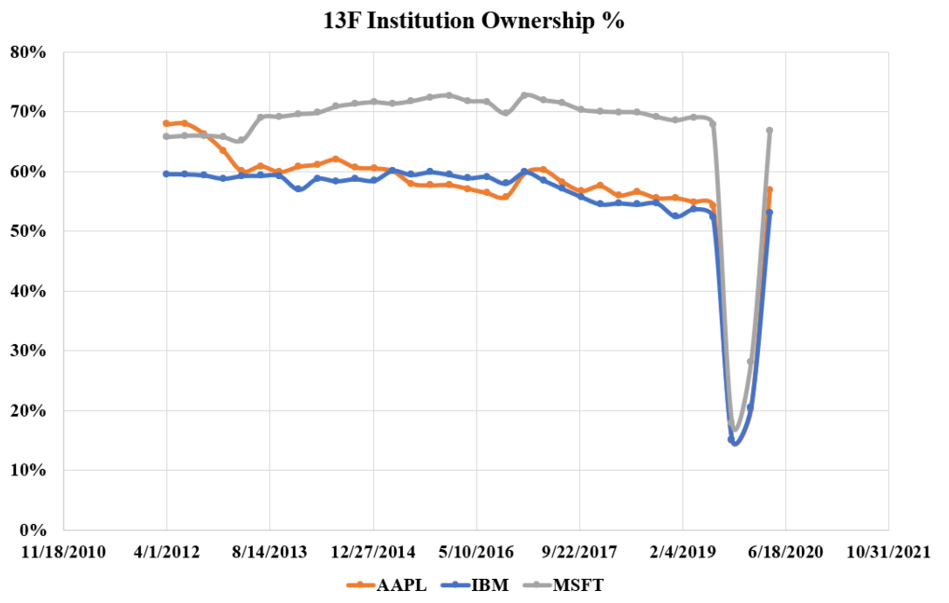
Recent Thomson 13F Data Issues
Faculty report missing
Thomson/ Refinitiv
13F holdings 60%-70%
in 2019Q3Q4
Present
Day
2022 March

Slide 6
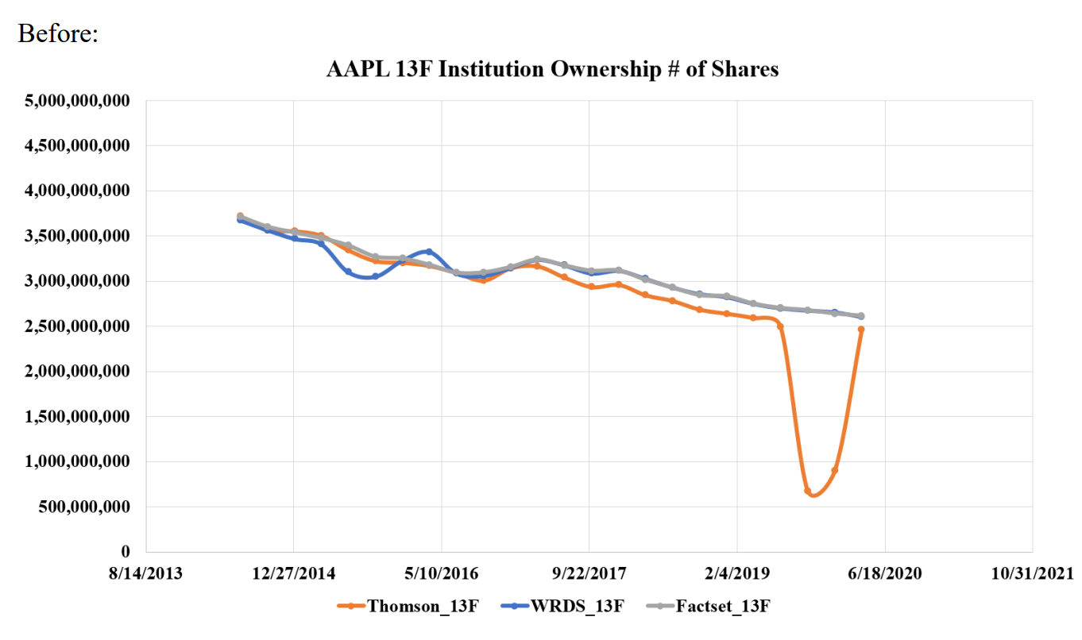
Recent Thomson 13F Data Issues
Thomson patched
S34 Data for 2019Q3Q4
Present
Day
2022 March
April

Slide 7
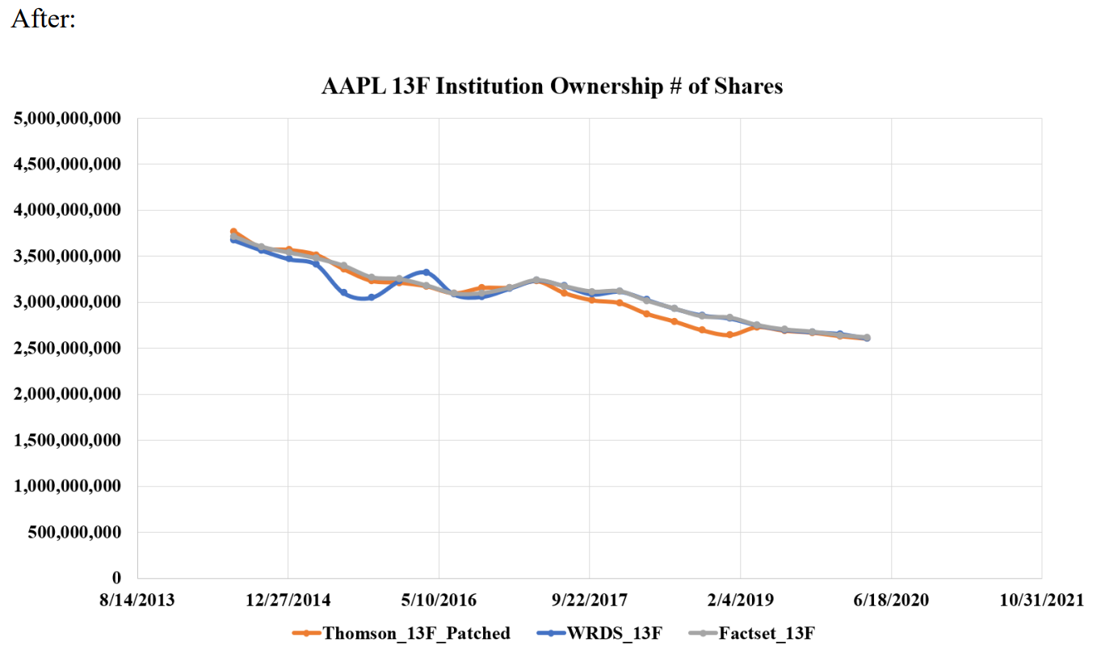
Recent Thomson 13F Data Issues
Thomson patched
S34 Data for 2019Q3Q4
Present
Day
2022 March
April

Slide 8
Thank You!

