Slide 2
5. Portfolio Formation

Slide 3
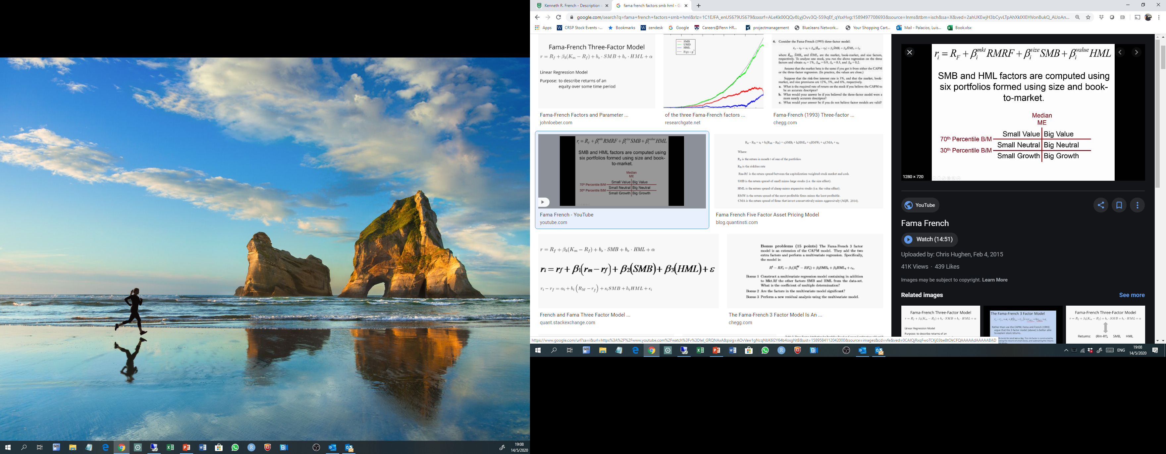
Portfolio Breakpoints at June Year t
NYSE size breakpoints and book-to-market breakpoints.
Assign Stocks at June in those portfolios.
Notes:
For the purpose of this procedure we used CRSP monthly data (users can extend this calculation to daily data). The first step in working with CRSP was to merge CRSP "event" and "time-series" files. CRSP event files contain historical information on the exchange code (crucial to identify firms listed in NYSE), share codes (to identify common stocks) and delisting returns. CRSP time-series files (as CRSP.MSF) contain information such as prices, returns and shares outstanding. We merged both files using a macro program (named ‘crspmerge').
Second, we added delisting returns (to reduce any bias in portfolio returns) and calculated Market Capitalization (ME) for each CRSP security (abs(prc)*shrout). There were cases when the same firm (permco) had two or more securities (permno) on the same date. For the purpose of ME for the firm, we aggregated all ME for a given permco, date. This aggregated ME was assigned to the CRSP permno that has the largest ME. Finally, ME at June and December were flagged since (1) December ME will be used to create Book-to-Market ratio (BEME) and (2) June ME has to be positive in order to be part of the portfolio.

Slide 4
Portfolio Breakpoints at June
SAS Code

Slide 5
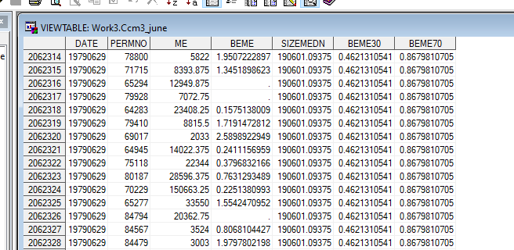
Portfolio Breakpoints at June

Slide 6
Portfolio Assignment at June
SAS Code

Slide 7
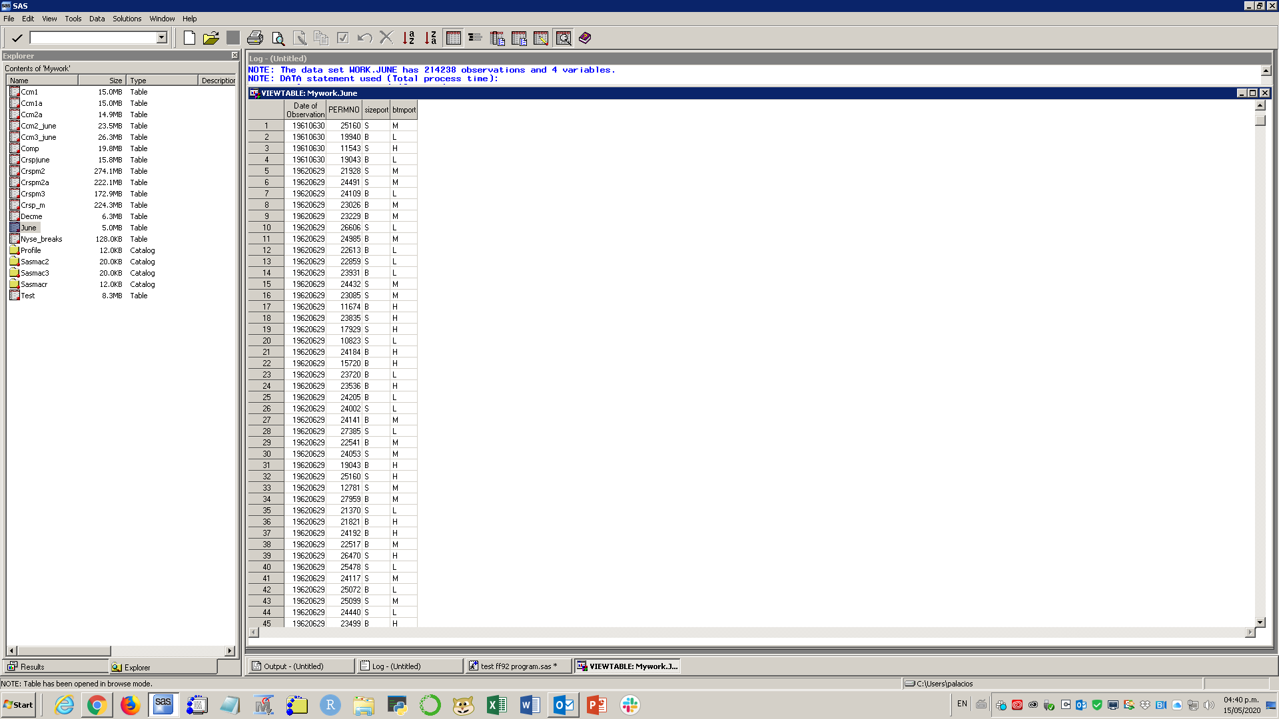
Portfolio Assignment at June

Slide 8
Monthly returns for Each Portfolio …
We have our List of Securities as of June.
Now we need to capture their security monthly returns the next 12 months from July year t to June year t+1.
Notes:
For the purpose of this procedure we used CRSP monthly data (users can extend this calculation to daily data). The first step in working with CRSP was to merge CRSP "event" and "time-series" files. CRSP event files contain historical information on the exchange code (crucial to identify firms listed in NYSE), share codes (to identify common stocks) and delisting returns. CRSP time-series files (as CRSP.MSF) contain information such as prices, returns and shares outstanding. We merged both files using a macro program (named ‘crspmerge').
Second, we added delisting returns (to reduce any bias in portfolio returns) and calculated Market Capitalization (ME) for each CRSP security (abs(prc)*shrout). There were cases when the same firm (permco) had two or more securities (permno) on the same date. For the purpose of ME for the firm, we aggregated all ME for a given permco, date. This aggregated ME was assigned to the CRSP permno that has the largest ME. Finally, ME at June and December were flagged since (1) December ME will be used to create Book-to-Market ratio (BEME) and (2) June ME has to be positive in order to be part of the portfolio.

Slide 9
Monthly returns for Each Portfolio …
This is the SAS code …
Notes:
For the purpose of this procedure we used CRSP monthly data (users can extend this calculation to daily data). The first step in working with CRSP was to merge CRSP "event" and "time-series" files. CRSP event files contain historical information on the exchange code (crucial to identify firms listed in NYSE), share codes (to identify common stocks) and delisting returns. CRSP time-series files (as CRSP.MSF) contain information such as prices, returns and shares outstanding. We merged both files using a macro program (named ‘crspmerge').
Second, we added delisting returns (to reduce any bias in portfolio returns) and calculated Market Capitalization (ME) for each CRSP security (abs(prc)*shrout). There were cases when the same firm (permco) had two or more securities (permno) on the same date. For the purpose of ME for the firm, we aggregated all ME for a given permco, date. This aggregated ME was assigned to the CRSP permno that has the largest ME. Finally, ME at June and December were flagged since (1) December ME will be used to create Book-to-Market ratio (BEME) and (2) June ME has to be positive in order to be part of the portfolio.

