Slide 1
2. Book-Equity (Compustat)

Slide 2
Book Equity (Compustat)
Compustat XpressFeed (annual data).
Book Equity (book value of common shares) is defined as :
Book value of stockholders' equity
+ Balance sheet deferred taxes
+ Investment tax credit (if available)
- Book value of preferred stock.
Book value of preferred stock :
the redemption or
liquidation or
par value of preferred stock (in that order).
Notes:
We used Compustat XpressFeed (annual data) as the source of historical accounting data in order to calculate the value of Book Equity. Different from quarterly data, annual data is unrestated (ideal for backtesting). Book Equity is defined as the Compustat book value of stockholders' equity plus balance sheet deferred taxes and investment tax credit (if available) minus book value of preferred stock. We did not modify the original formula that adds deferred taxes and investment tax credit. According to Kenneth French's website (as of May 2018) , it had been changes to the treatment of deferred taxes described in FASB 109.
To estimate book value of preferred stock they use the redemption or liquidation or par value of preferred stock (in that order). Since Book Equity is almost missing for the whole sample during the 1950's, we constrained our sample to begin in 1960. Additionally, we created a variable that counts number of annual records in Compustat files.

Slide 3
Book Equity (Compustat)
SAS Code

Slide 4
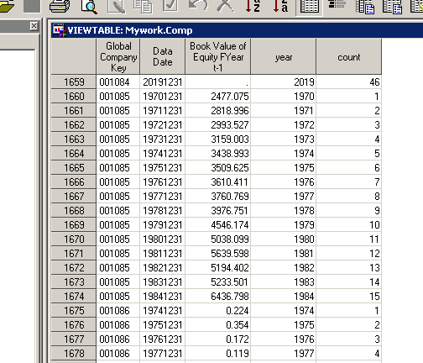
Book Equity (Compustat)

