Slide 1
Use SAS in Python: SASPy
WHARTON RESEARCH DATA SERVICES
Introduction (2)
Eunji Oh, PhD June 2020

Slide 2
Agenda
SASPy BASIC FUNCTIONS / Jupyter magic
1
SASPy Basic Functions
2
Jupyter Magic

Slide 3
SASPy - Basic Functions
Start SAS session
Session configuration
Submit SAS jobs in a Python session
Print SAS log
See ODS tables/graphics in a Python IDE
Jupyter Magic
Convert DataFrame to SAS dataset and vice versa
sd2df(method=’CSV’) or sd2df_CSV() for reducing memory consumption, and speed up the process
Transfer a python variable to SAS macro variable

Slide 4
Start SAS session
import saspy
#Connect to a default session, configuration from sascfg_personaly.py sas=saspy.SASsession(cfgname=‘default’ )
sas.assigned_librefs() # shows assigned libraries
sas.datasets(libref=‘library_name’) # equivalent to PROC DATASETS
Set session name and establish a connection
Set session configuration options. Leave it blank to see all available options, or set cfgname parameter for other configurations

Slide 5
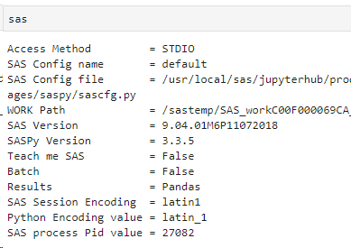
SAS session configuration check
Type the session name in interpreter prompt
Example: WRDS Jupyter Lab Default configuration
STDIO (connect to local SAS in Linux)
SAS session encoding: latin1
Python encoding: latin_1
Output results format: Pandas dataframe
Process pid number

Slide 6
SASPy SAS session default configuration
Windows PC
SAS windows, wlatin-1 as a default encoding type
Linux Desktop
SAS linux, latin-1 as a default encoding type
WRDS server
WRDS server (WRDS cloud, WRDS Jupyter hub, and etc.)
SAS linux, latin-1 as a default encoding type
SAS u8, utf-8 is also available

Slide 7
Accessing existing SAS library / datasets
sas.saslib(libref=‘home’, path=‘~’) # Set libref to home
hr = sas.sasdata(table=‘tablename’, libref='mylibref’)
hr.columnInfo() # Column-level metadata
hr.head() # First 5 observations shown
hr.sort(by=‘variable’, out=‘home.hr’) # SAS proc sort equivalent
hr_df = hr.to_df() # Convert to Pandas dataframe
Other methods: add_vars, append, describe, where, hist and etc. (https://sassoftware.github.io/saspy/api.html#sas-data-object)

Slide 8
Submit a SAS job
The connected SAS session name
from IPython.display import HTML
results = sas.submit(“your SAS code should be here”)
HTLM(results[‘LST’]) # Print Result (ODS output)
print(results[‘LOG’]) # Print SAS log
“submit” method runs a SAS job in the background (SAS batch mode – no real time logs)
Other methods:
submitLOG: submit a job and print LOG
submitLST: submit a job and show results (LST)

Slide 9
Converting Data Pandas ↔ SAS
For small datasets:
sd2df : SAS dataset to Pandas dataframe
df2sd: Pandas dataframe to SAS dataset
For large datasets:
sd2df_CSV: SAS to Pandas via CSV file
sd2df(method=“DISK”): SAS to Pandas via writing file
via
memory
via
Proc Export
read_csv()

Slide 10
Converting Data: SAS ↔ Pandas
Avoid converting a huge SAS dataset into a Pandas DataFrame, instead,
Run your SAS job behind the scene by using ‘submit’ API
Convert only the reasonable size of SAS dataset into Pandas Data Frame
When SAS dataset is huge, it is recommended to use ‘sd2df_CSV’ method
Be aware about encoding types
Generating a latin1 dataset from a utf8 source can raise a transcoding error
Currently, most WRDS SAS datasets have latin1 encoding

Slide 11
Converting Data: Encoding issue
How to resolve?
data mylib.mydata (encoding=latin1);
Or
libname latlib ‘~/mysasdata’ outencoding=latin1 inencoding=latin1;
More info: https://blogs.sas.com/content/sgf/2014/09/26/encoding-helping-sas-speak-your-language/

Slide 12
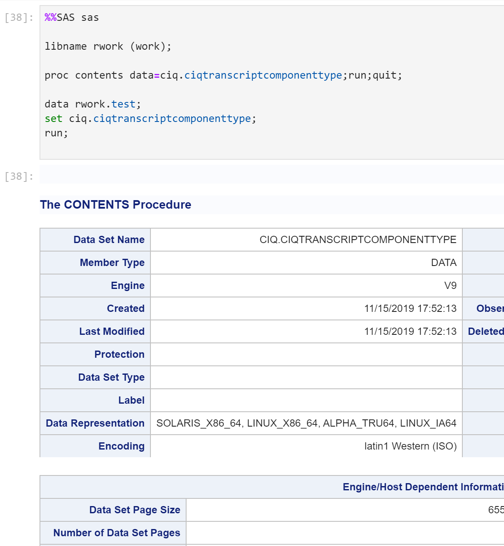
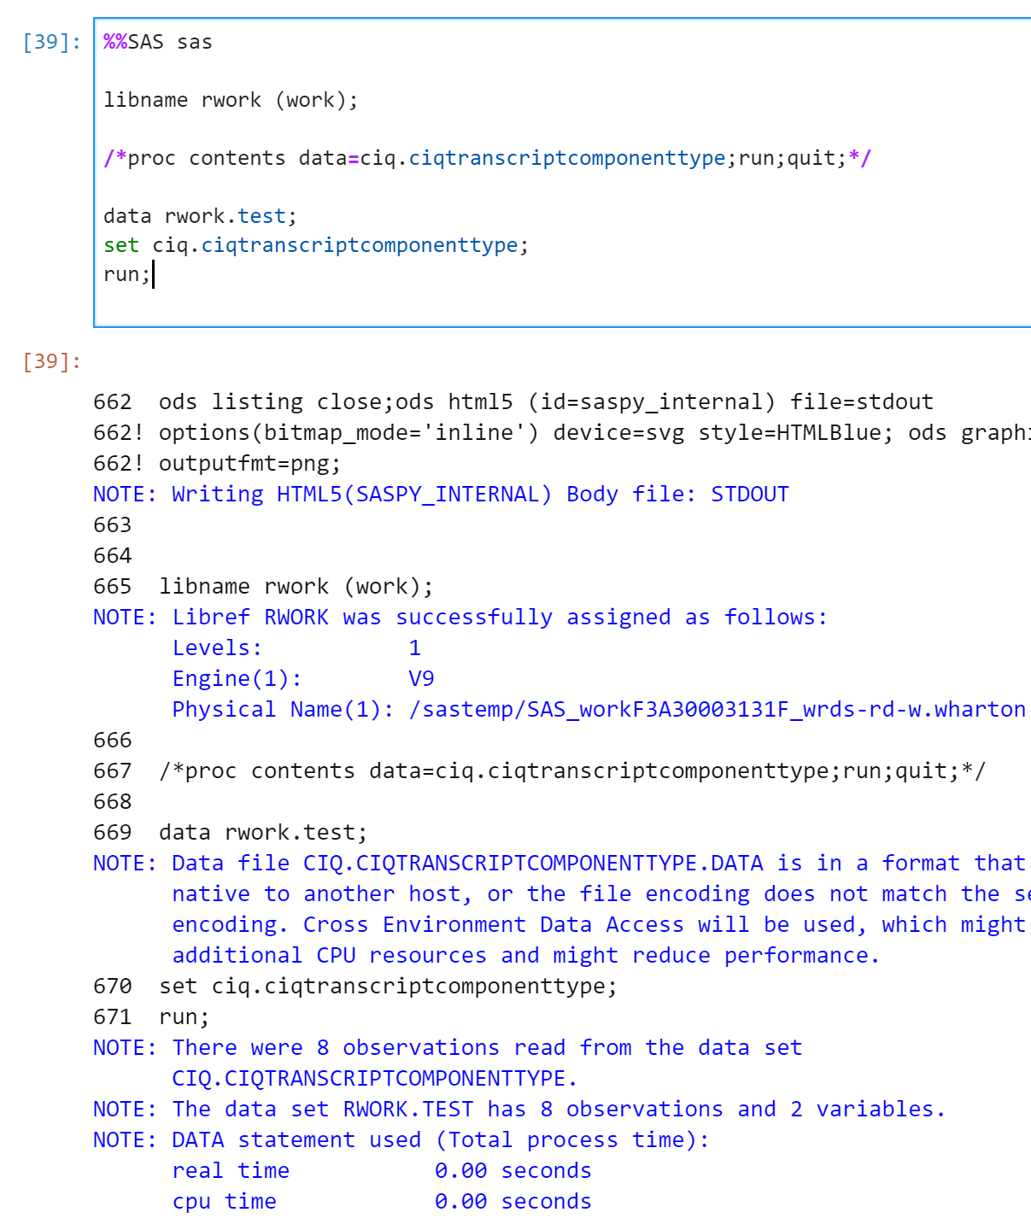
Jupyter Magic for SAS
The SAS session name
Jupyter Magic
ODS Outputs
SAS Log

Slide 13
Jupyter Magic for SAS
Import SASPy and establish SAS Connection
Start the code with %%SAS my_session
Write SAS code (not Python) in the same cell
The Jupyter Magic executes the code in the cell and returns SAS Log and Outputs

Slide 14
End session
my_session.endsas()
Works universally on any platform
Terminates the SAS subprocess
Make sure always run this method at the end of your SAS session

Slide 15
Summary
SASPy basic functions for data access and SAS job submission
Jupyter Magic provides SAS-friendly developing environment
Next video: An example SASPy application with WRDS data

