Slide 1
Using WRDS Insiders
WHARTON RESEARCH DATA SERVICES

Slide 2
Summary
Coverage
Compares favorably over same sample to 2iQ and Thomson Reuters
Matching problems & data issues
Transactions
Insider trading & executive compensation
Miscellaneous trades and footnotes
Indirect holdings
Symmetric trading
Form 5 prior to SOX, Form 4 after
Ecosystem
Rule 10b5-1
Blackout periods & firm trading policies
Power of Attorney signatories

Slide 3
1
Issues in the Coverage of WRDS Insiders
2
Issues with Transactions in Insider Trading
3
Issues in the Ecosystem of Insider Trading

Slide 4
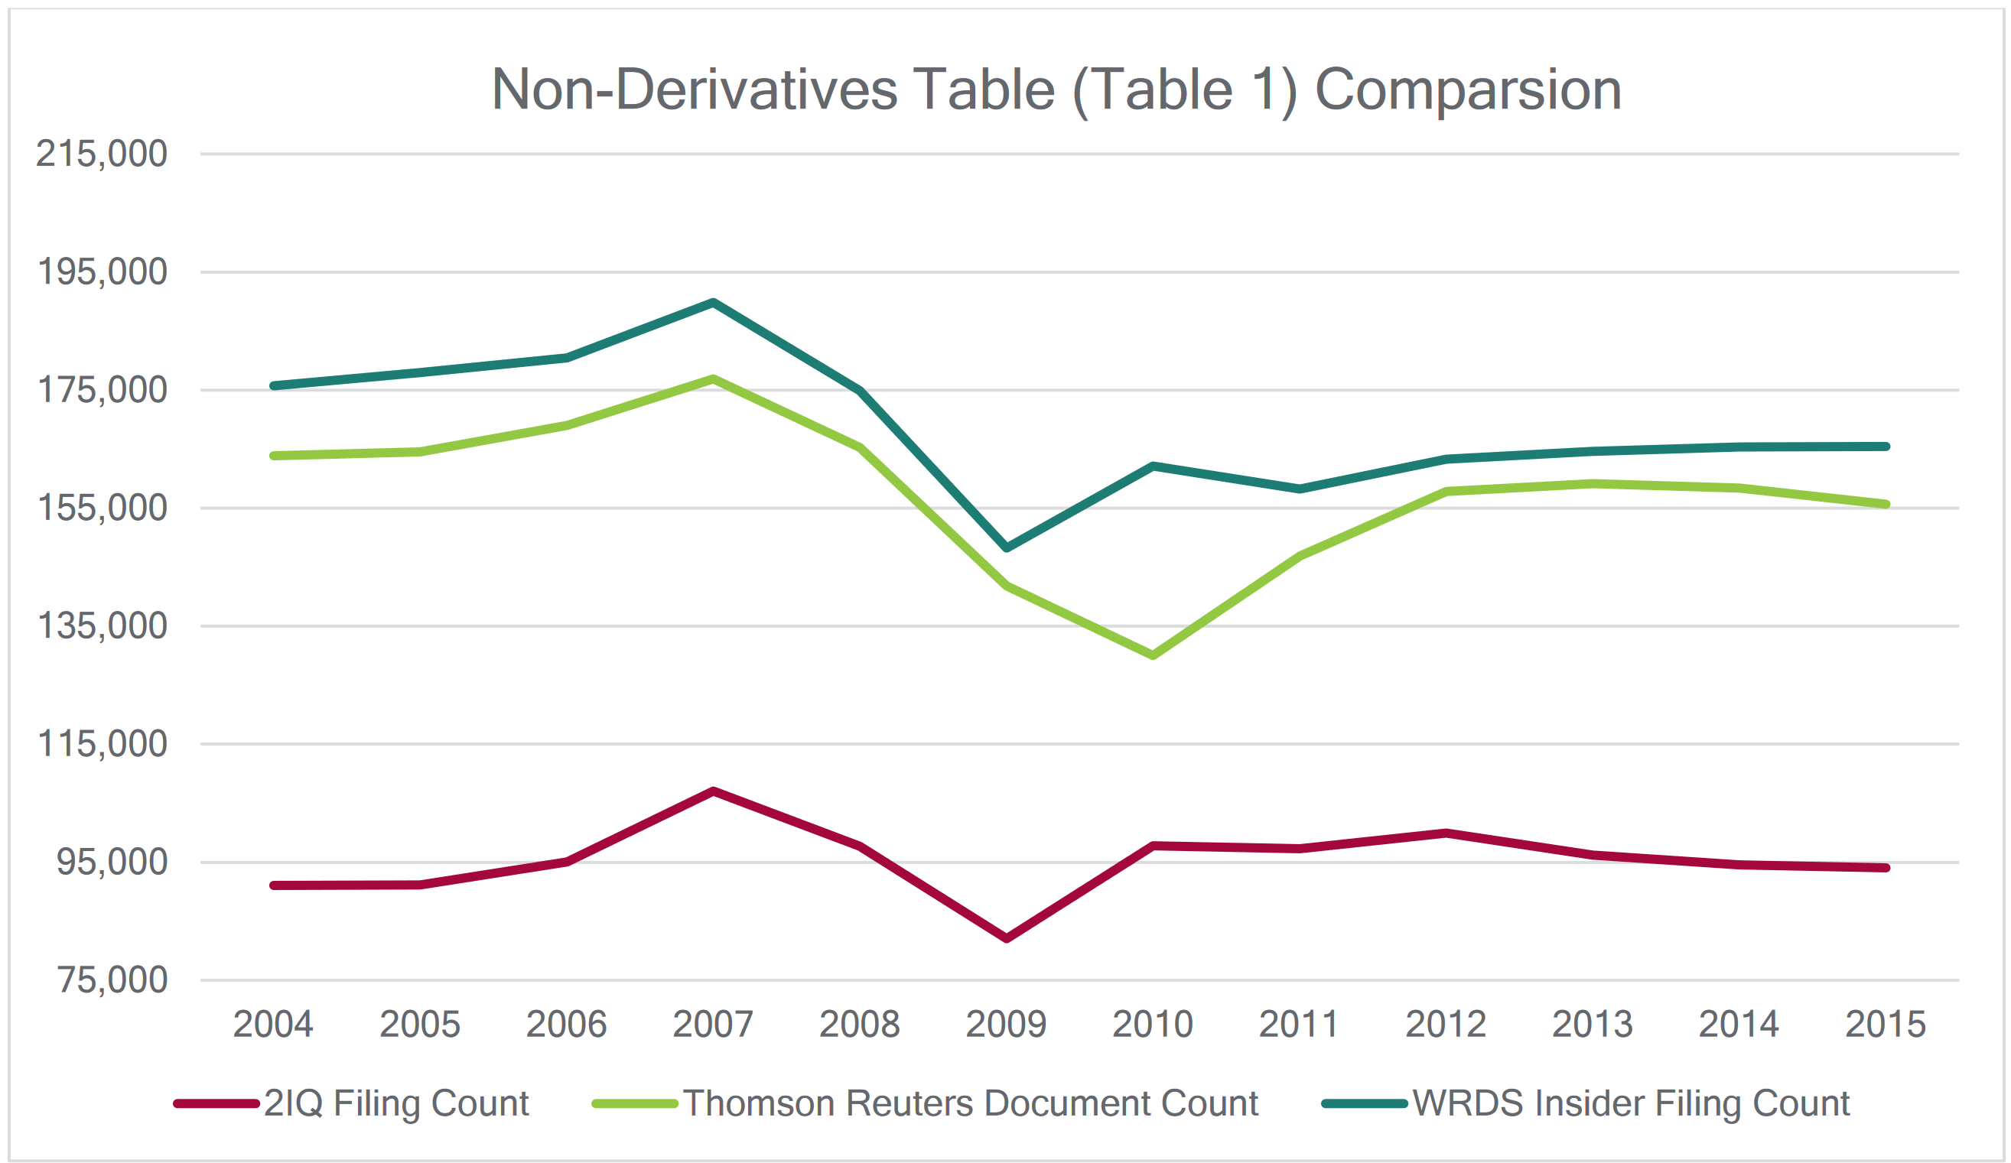
Coverage
Coverage more comprehensive than Thomson-Reuters and 2IQ Insider Trading products

Slide 5
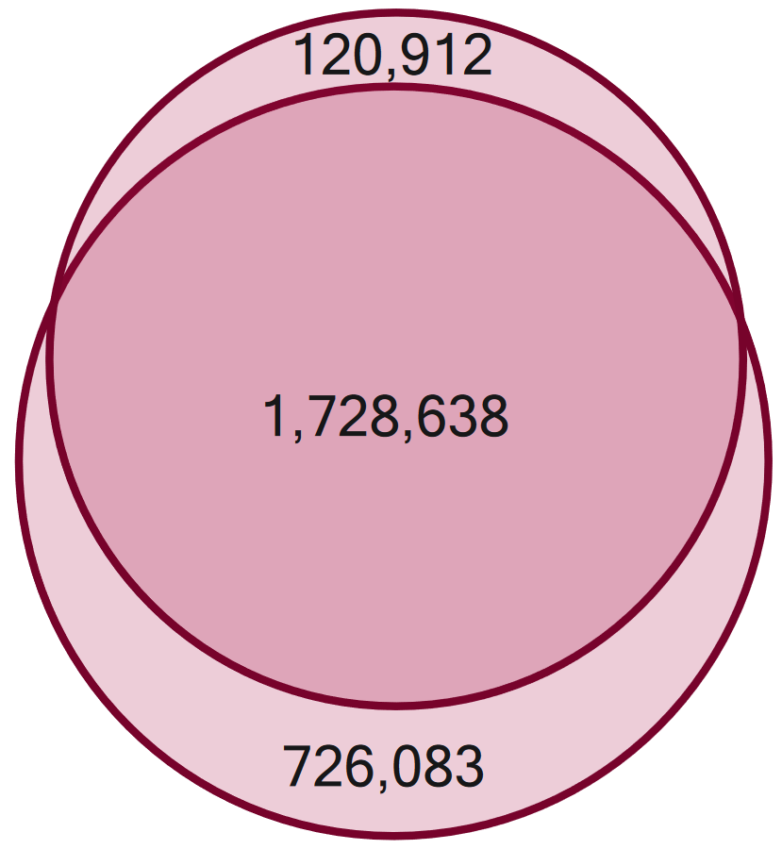
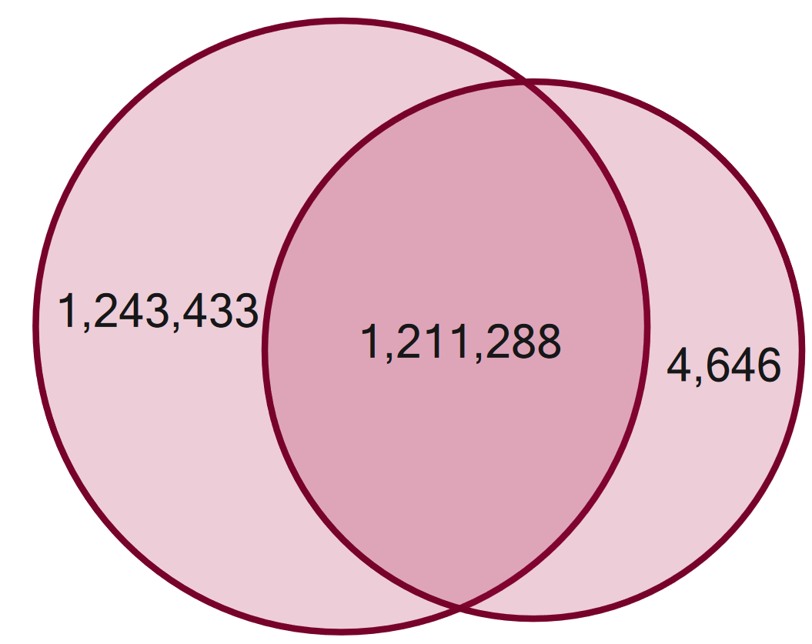
Coverage
Matching trades more difficult
Dates do not align with SEC filings
Prices and shares are adjusted in TR data
Still inaccurate (Yermack, 2009)
Date overlap with Thomson
Date overlap with 2iQ

Slide 6
1
Issues in the Coverage of WRDS Insiders
2
Issues with Transactions in Insider Trading
3
Issues in the Ecosystem of Insider Trading

Slide 7
Transactions
Insider trading & executive compensation
Equity and options portion of compensation risen from ~55% in 2006 to ~70% in 2018 (ExecuComp)

Slide 8
Transactions
Miscellaneous trades and footnotes

Slide 9
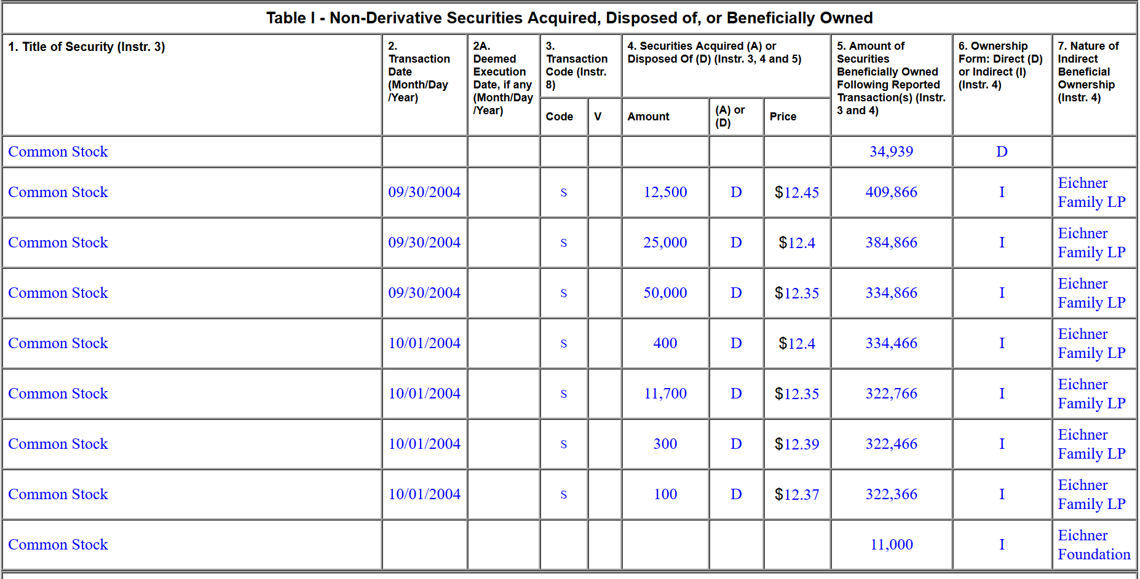
Transactions
Indirect holdings

Slide 10
Transactions
Symmetric trading
Form 5 prior to SOX, Form 4 post-SOX

Slide 11
1
Issues in the Coverage of WRDS Insiders
2
Issues with Transactions in Insider Trading
3
Issues in the Ecosystem of Insider Trading

Slide 12
Ecosystem
Rule 10b5-1
Insider trading plan

Slide 13
Ecosystem
Firm Trading Policies
Blackout periods
Exceptions
Special blackout periods

Slide 14
Ecosystem
Power of Attorney
Signatories

Slide 15
Summary
Coverage compares favorably to other insider trading databases
Insider trading transactions are related to
Compensation
Holdings of family and friends
Movement of funds/shares and option exercise
Miscellaneous trades
Insider trading data exists within a regulatory ecosystem
Including Rule 10b5-1, trading policies, blackout periods, and powers of attorney
Academic work meant to parse out informed trading among these issues

Slide 16
Thank You!

