Slide 1

WHARTON RESEARCH DATA SERVICES
OLS Regression in Python
Ted Donohue June, 2020
Notes:
1

Slide 2

1
Install required packages
2
Read data into python
3
Fit a model
4
Output from the model
2
Wharton Research Data Services

Slide 3
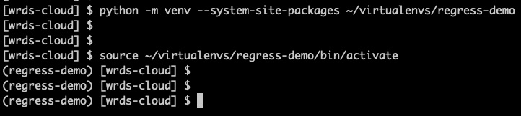
Activating your virtual environment
Login to wrds-cloud with your wrds credentials.
Activate your virtual environment as shown.
If you have not created a virtual environment you will need to do so first.
If you are not sure how to create a virtual environment, please see the Creating Python Virtual Environments on WRDS video.
3
Wharton Research Data Services

Slide 4


Install the required packages
The pip install wrds pandas statsmodels command will attempt to install all 3 packages into your environment.
As you can see on screen, if the package is already installed, as was the case for wrds and pandas, it will simply say "requirement already satisfied" and continue. In this case only statsmodels was installed.
4
Wharton Research Data Services

Slide 5
1
Install required packages
2
Read data into python
3
Fit a model
4
Output from the model
5
Wharton Research Data Services

Slide 6
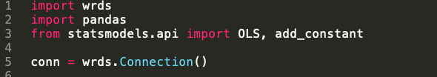
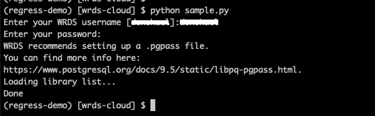
Reading data into python
As seen on the screen you will first need to establish a connection.
When the code is executed you will be prompted for your username and password (your WRDS credentials).
6
Wharton Research Data Services

Slide 7
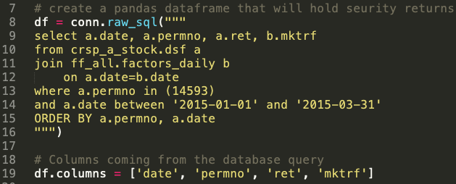
Reading data into python
Next, using the connection, we execute a SQL statement that, in this case, reads daily returns for Apple Inc. for a 3 month period, as well as the daily market return for the same period.
The columns statement gives intuitive names to the columns we have just read in.
7
Wharton Research Data Services

Slide 8
1
Install required packages
2
Read data into python
3
Fit a model
4
Output from the model
8
Wharton Research Data Services

Slide 9
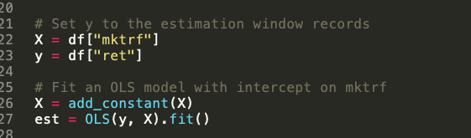
Fit a regression model
X is set to the “market return” column.
Y is set to the Apple “returns”.
The add_constant method in statsmodels can be used to add a constant to your model. However, as we will not be doing so, we add the column itself which creates a constant coefficient of 1.
Finally we use the fit method to fit a regression model.
9
Wharton Research Data Services

Slide 10
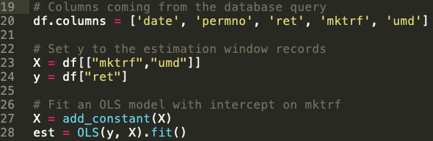
Fit a regression model
For multiple regression, simply add another independent variable.
X is now set to both “market return” and “momentum”.
Y is set to the Apple “returns”.
The rest remains the same.
10
Wharton Research Data Services

Slide 11
1
Install required packages
2
Read data into python
3
Fit a model
4
Output from the model
11
Wharton Research Data Services

Slide 12

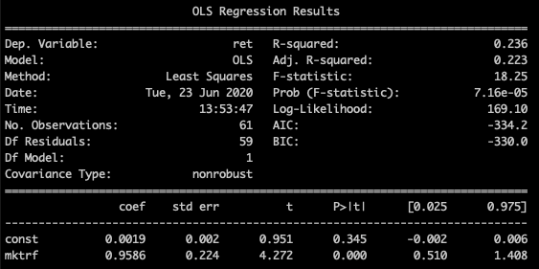
Output from the model
To see output similar to what you would see when using PROC REG in SAS, you can use the summary or summary2 method of the model (named est in our case).
12
Wharton Research Data Services

Slide 13

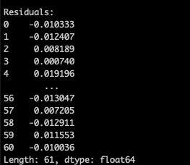
Output from the model
You can obtain the residuals with the resid attribute of the model.
Other methods and attributes are available through the fitted model: f_test, t_test, ssr (sum of squares), mse_model (mean squared error - model), mse_resid (mean squared error - residuals), rsquared.
13
Wharton Research Data Services

Slide 14

Thank You!
Notes:
14

