Slide 1
Introduction to WRDS Insiders
WHARTON RESEARCH DATA SERVICES

Slide 2
Summary
WRDS Insiders is a database covering insider transactions, beginning June 30, 2003
WRDS Insiders is generated from SEC Form 3, 4, and 5 filings
WRDS Insiders is structured as 6 distinct datasets

Slide 3
1
Coverage
2
Background
3
Structure

Slide 4
Coverage
WRDS Insiders includes all insider trades after the SEC mandated electronic disclosure
June 30, 2003 – present
Covers Forms 3, 4, and 5
Form 3: Insider’s initial holdings
Form 4: Ongoing transactions
Form 5: End of year summary

Slide 5
Coverage
For each filing
Transactions
Derivative, non-derivative, and footnotes
Document Metadata
Regulatory, issuing firm, and dates
Reporting Owners and Agents
Name, address, CIK, insider type, signatory

Slide 6
1
Coverage
2
Background
3
Structure

Slide 7
Background
Insider Trading
Exchange Act of 1934, Section 16
Form 3
Form 4
Form 5
Mandatory disclosure
Exchange Act of 1934 – Sarbanes-Oxley 2002
SOX – August 29, 2002
Electronic filing
June 30, 2003

Slide 8
Background
“Insider”
Any director, officer, or 10% shareholder in a firm
Relatives, others who “indirectly” hold shares
“Transaction”
Buy/Sell
Derivative exercise
Symmetric option exercise, shares sold
2 transactions
Miscellaneous
Gifts
Hedging transaction
Other w/ footnote

Slide 9
Background
Form 3
Form 4
Form 5
Initiating Statement of Beneficial Ownership
Holdings
Filed within 10 days of becoming an insider
Statement of Changes in Beneficial Ownership
Transactions
Filed within 2 business days of a transaction
Annual Statement of Beneficial Ownership
Holdings & Transactions (pre-SOX)
Filed within 45 days of Issuer’s fiscal year end

Slide 10
1
Coverage
2
Background
3
Structure

Slide 11
Structure
Document Info
Reporting Owners
Non-Derivatives
Derivatives
Signatures
Footnotes

Slide 12
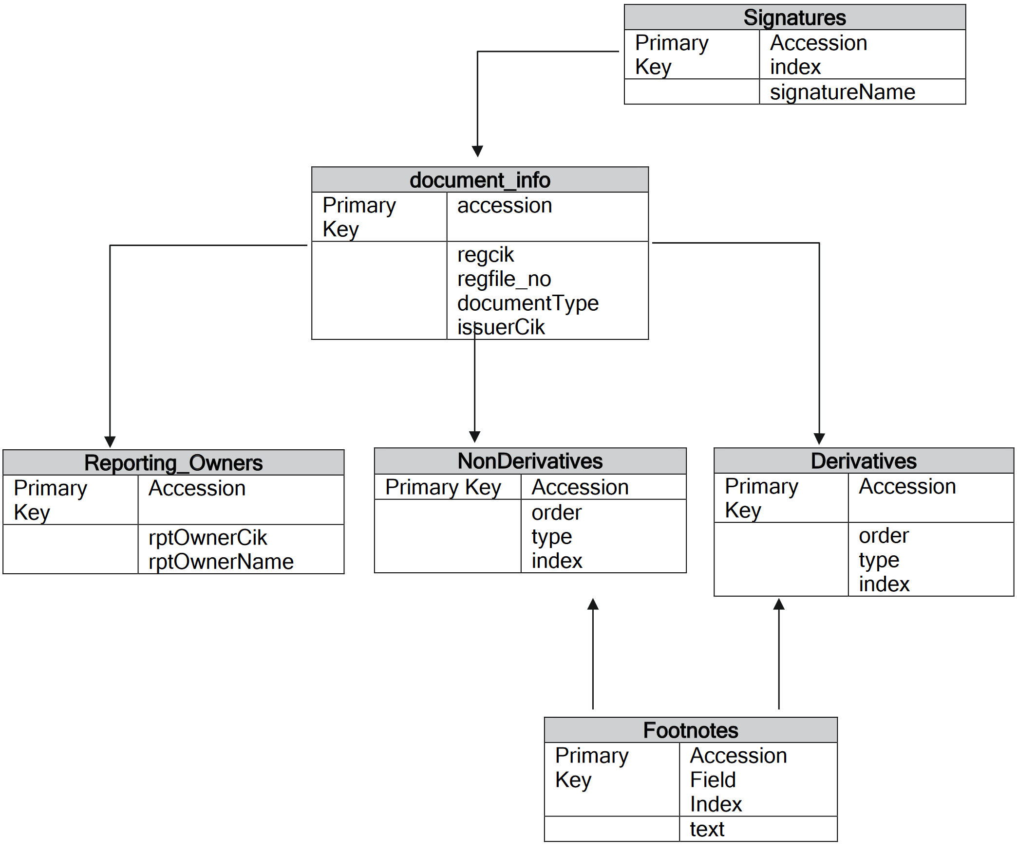
Structure

Slide 13
Summary
WRDS Insiders includes all insider trades and holdings in the electronic submission era
WRDS Insiders draws from 3 forms, mandated by law since 1934
WRDS Insiders can be consolidated by filing, trade, or owner

Slide 14
Thank You!

