Slide 1
Capital IQ Transcripts
WHARTON RESEARCH DATA SERVICES
Eunji Oh
April, 2020

Slide 2
Agenda
Overview of Capital IQ Transcripts Database
1
Coverage and Data Sources
2
Data Collection Methodology
3
Sample Data

Slide 3
Overview
Capital IQ Transcripts package provides historical conference call transcripts around the world covering approximately 8,000 public companies.
It covers not only earnings conference calls but other types of conference calls such as shareholder/analysts calls, M&A calls, or company conference presentations.

Slide 4
Overview
The calls spoken in English are covered.
Earliest conference call event was in the year 2002, but there are less than 5 transcripts in the database before the year 2004.
Transcripts before the year 2008 were backfilled several years later from the event date, while current data is relatively real-time.

Slide 5
Overview - Data Source
How is the data collected?
99% of calls are recorded by S&P
Two individuals are assigned for post-call processing
Automatic transcribing and then several stages of editing/auditing
They keep all the copies of a transcript in the Xpress feed database
Only conference calls in English are included due to this issue.
They also get copies from some of their vendors
Accuracy compared to original audio files
Preliminary = 88.46%, Edited = 97.93%, Proofed = 98.02%

Slide 6
Overview – Package Structure Detail
The CIQ Transcript Package on WRDS:
Metadata of conference calls in connection with CIQ Key Developments/Events
Transcript details – version, delay reason, audio length, creation time
Associated key development event, event type, announced date, event date, headline
Associated company id
Speaker details (name, company, type)
Full text components
Component-level full text

Slide 7
Conference Call Type Breakdown

Slide 8
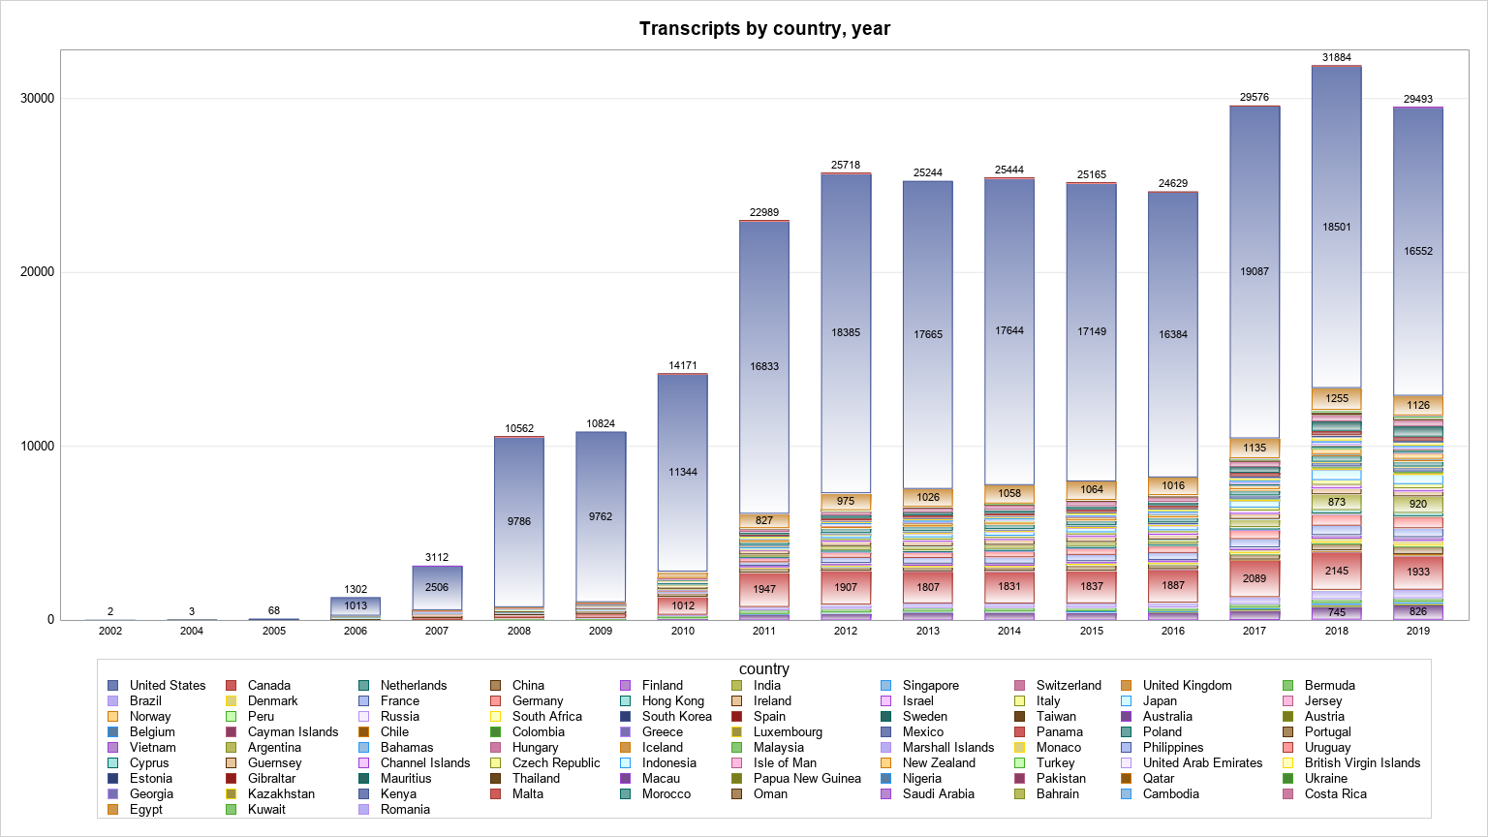
Transcripts Breakdown by country and year
* Count only latest copies of transcripts

Slide 9
Companies Covered
18.5 % of transcripts belongs to Fortune 500 companies
Number of unique CIQ companyid: 13,819 (100%)
Number of companyIds with gvkey: 11,616 (84.1%)
Number of companyIds with North American gvkey: 8,238 (59.6%)
41 % of Compustat NA unique gvkey (2004 – 2019)
Notes:
41% of comp: 23,170 (2004 – 2019)

Slide 10
Data Tables
ciqTranscript
ciqTranscriptCollectionType
ciqTranscriptDelayReason
ciqTranscriptDelayReasonType
ciqKeyDevelopment
ciqTranscriptPresentationType
ciqTranscriptPerson
ciqTranscriptSpeakerType
ciqTranscriptComponentType
ciqTranscriptComponent
wrds_transcript_detail
wrds_transcript_person
Full text search / Json files / PostgreSQL

Slide 11
wrds_transcript_detail.sas7bdat
Transcript-level metadata + Some useful Key Development metadata
Company ID, Most Important Date UTC, Event Headline , Key Development Type ID, Key Development Type Name are from Capital IQ Key Developments package

Slide 12
wrds_transcript_person.sas7bdat
Transcript component-level metadata + WRDS custom variables
Component Text Preview: 200-character preview of the full-text data
Word count: The number of words of the full-text data

Slide 13
Full-text sample (search tool)

Slide 14
Summary
Overview of Capital IQ Transcripts Database
Coverage and Data Sources
Data Collection Methodology
Sample Data

