Slide 1

Capital IQ – How to use
WHARTON RESEARCH DATA SERVICES
Eunji Oh
April, 2020

Slide 2
Agenda
in this video, we are going to learn
How to use Capital IQ data with WRDS
1
Capital IQ Library Structure
2
Example: Pull Data from Capital IQ Transcripts

Slide 3
Capital IQ libraries: PC – SAS / SAS Studio
Capital IQ library (libref=‘ciq’) includes all SAS datasets under:
/wrds/capitaliq/sasdata
/capstructure
/keydev
/pplintel
/transactions
/transcripts
/helper

Slide 4
Capital IQ libraries: Python
ciq: All tables of all Capital IQ products
ciq_capstrct: Capital Structure only
ciq_keydev: Key Development only
ciq_pplintel: People Intelligence only
ciq_transactions: Transactions only
ciq_transcripts: Transcripts only
ciq_common: helper directory

Slide 5
WRDS Custom Tables
Product | WRDS custom tables
Capital Structure | wrds_debt wrds_equity wrds_summary
People Intelligence | wrds_compensation wrds_compensationdetails wrds_professional
Key Developments | wrds_keydev
Transactions | wrds_consideration_financials wrds_offerings wrds_offerings_advisors wrds_offerings_proceeds wrds_offerings_registration wrds_offerings_rel | wrds_transactions wrds_trans_advisors wrds_trans_conditions wrds_trans_considerations wrds_trans_features
Transcripts | wrds_transcript_detail wrds_transcript_person

Slide 6
Example: Capital IQ Transcripts

Slide 7
Capital IQ Transcripts
Metadata (web query & WRDS cloud)
  Capital IQ tables
  WRDS custom tables
Full-text search (web search)
  Full text search
  Downloadable JSON files
Full-text bulk data (WRDS cloud)
  PostgreSql
  Python

Slide 8
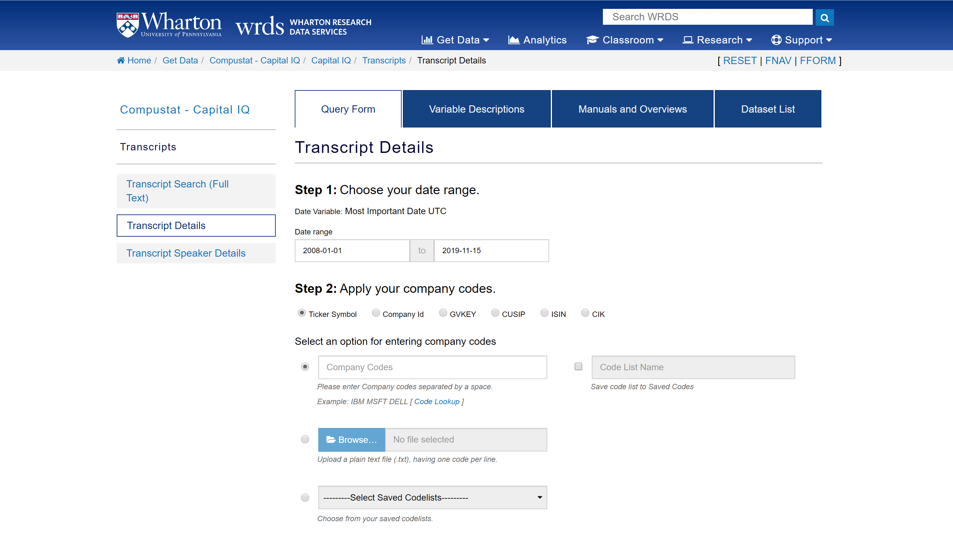
Web Access – Web Query

Slide 9
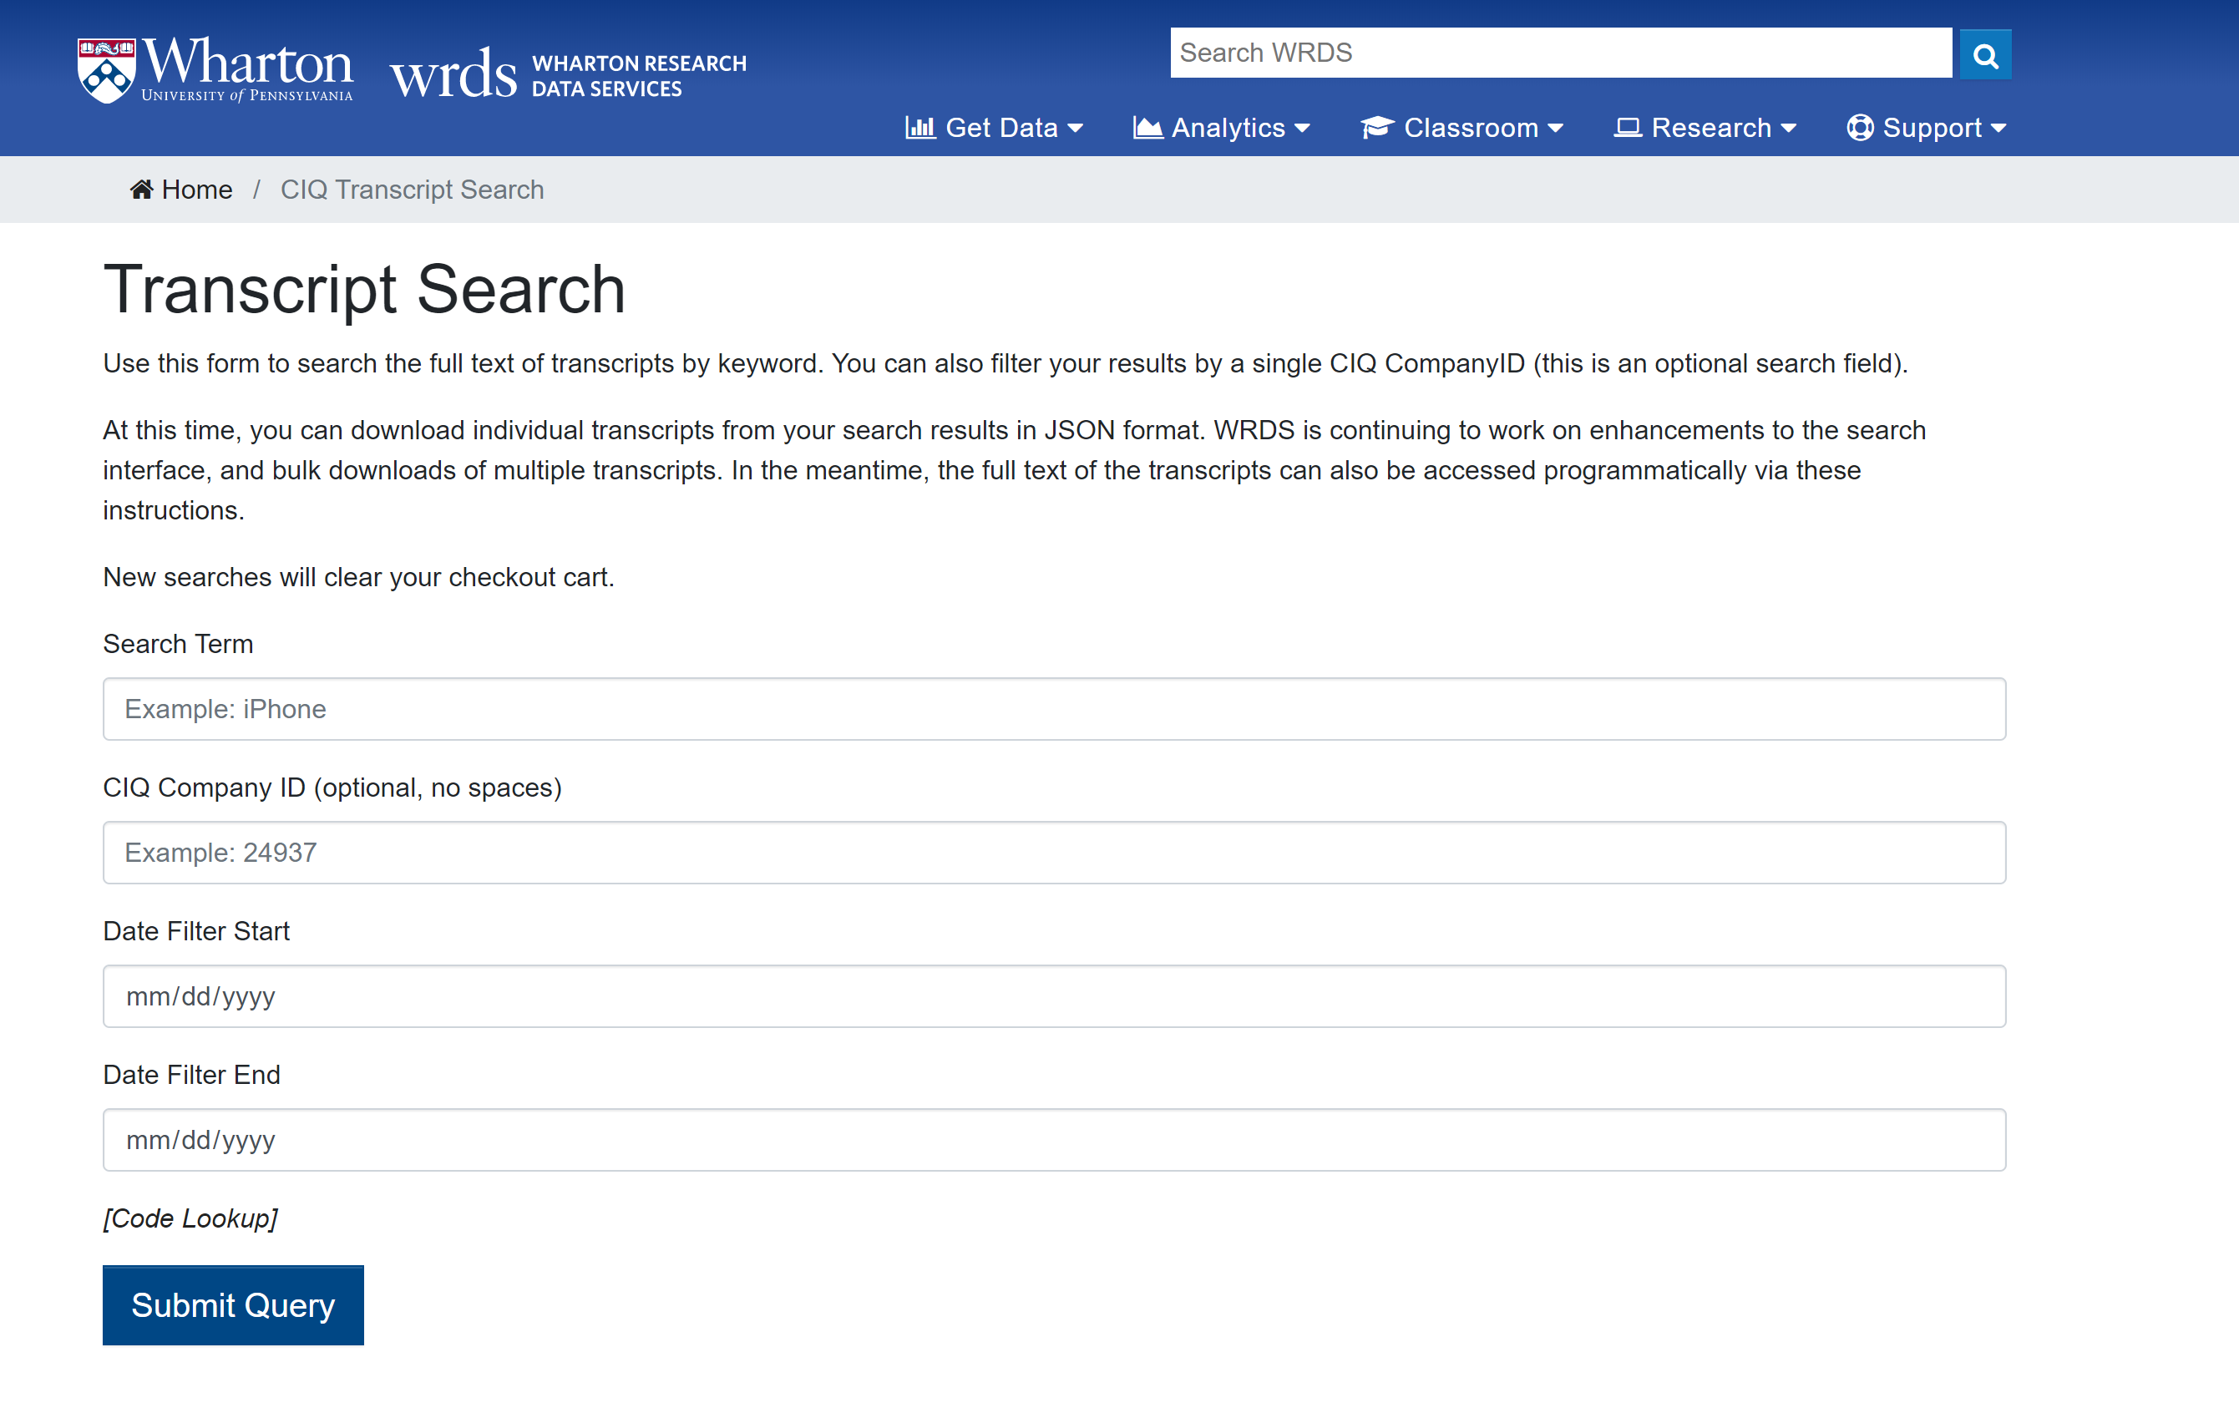
Web Access – Full text search

Slide 10
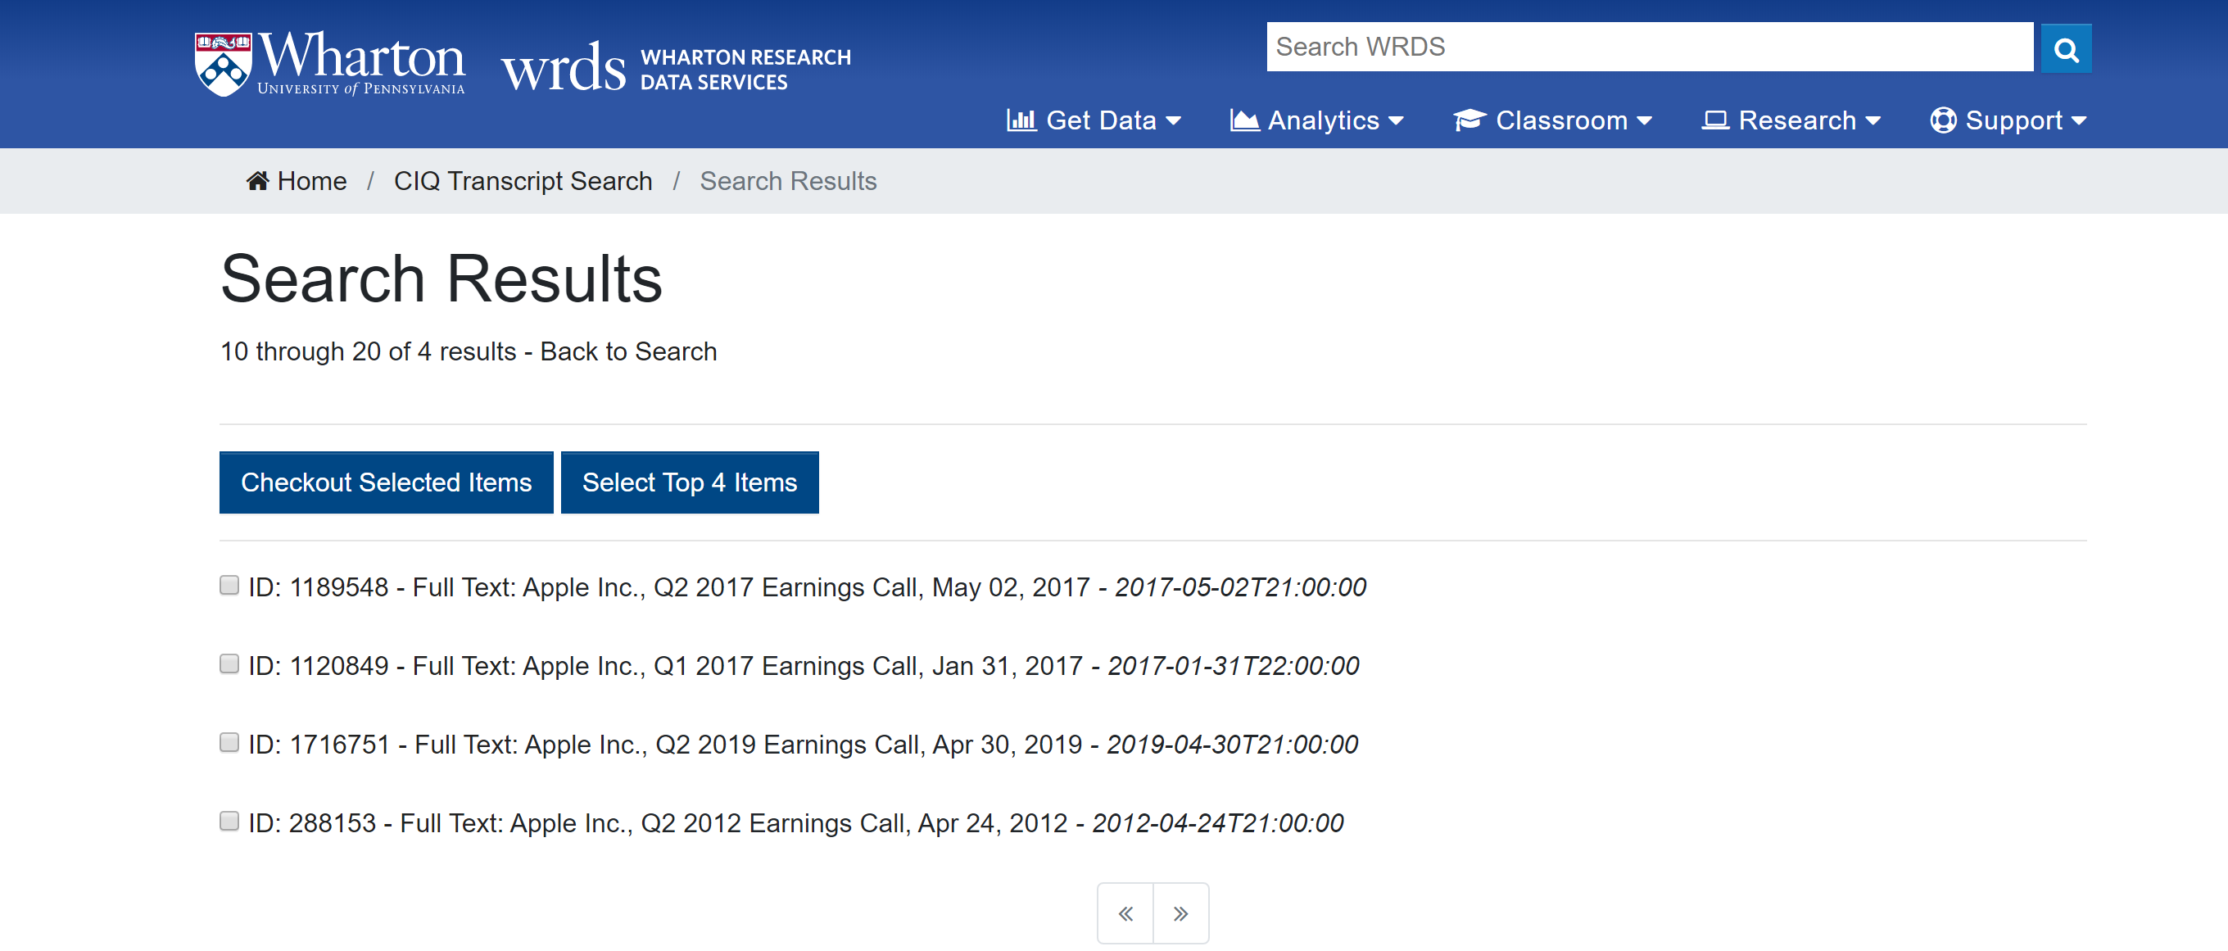
Web Access – Full text search
Keyword: Qualcomm
Company ID: 24937 (Apple Inc.)

Slide 11
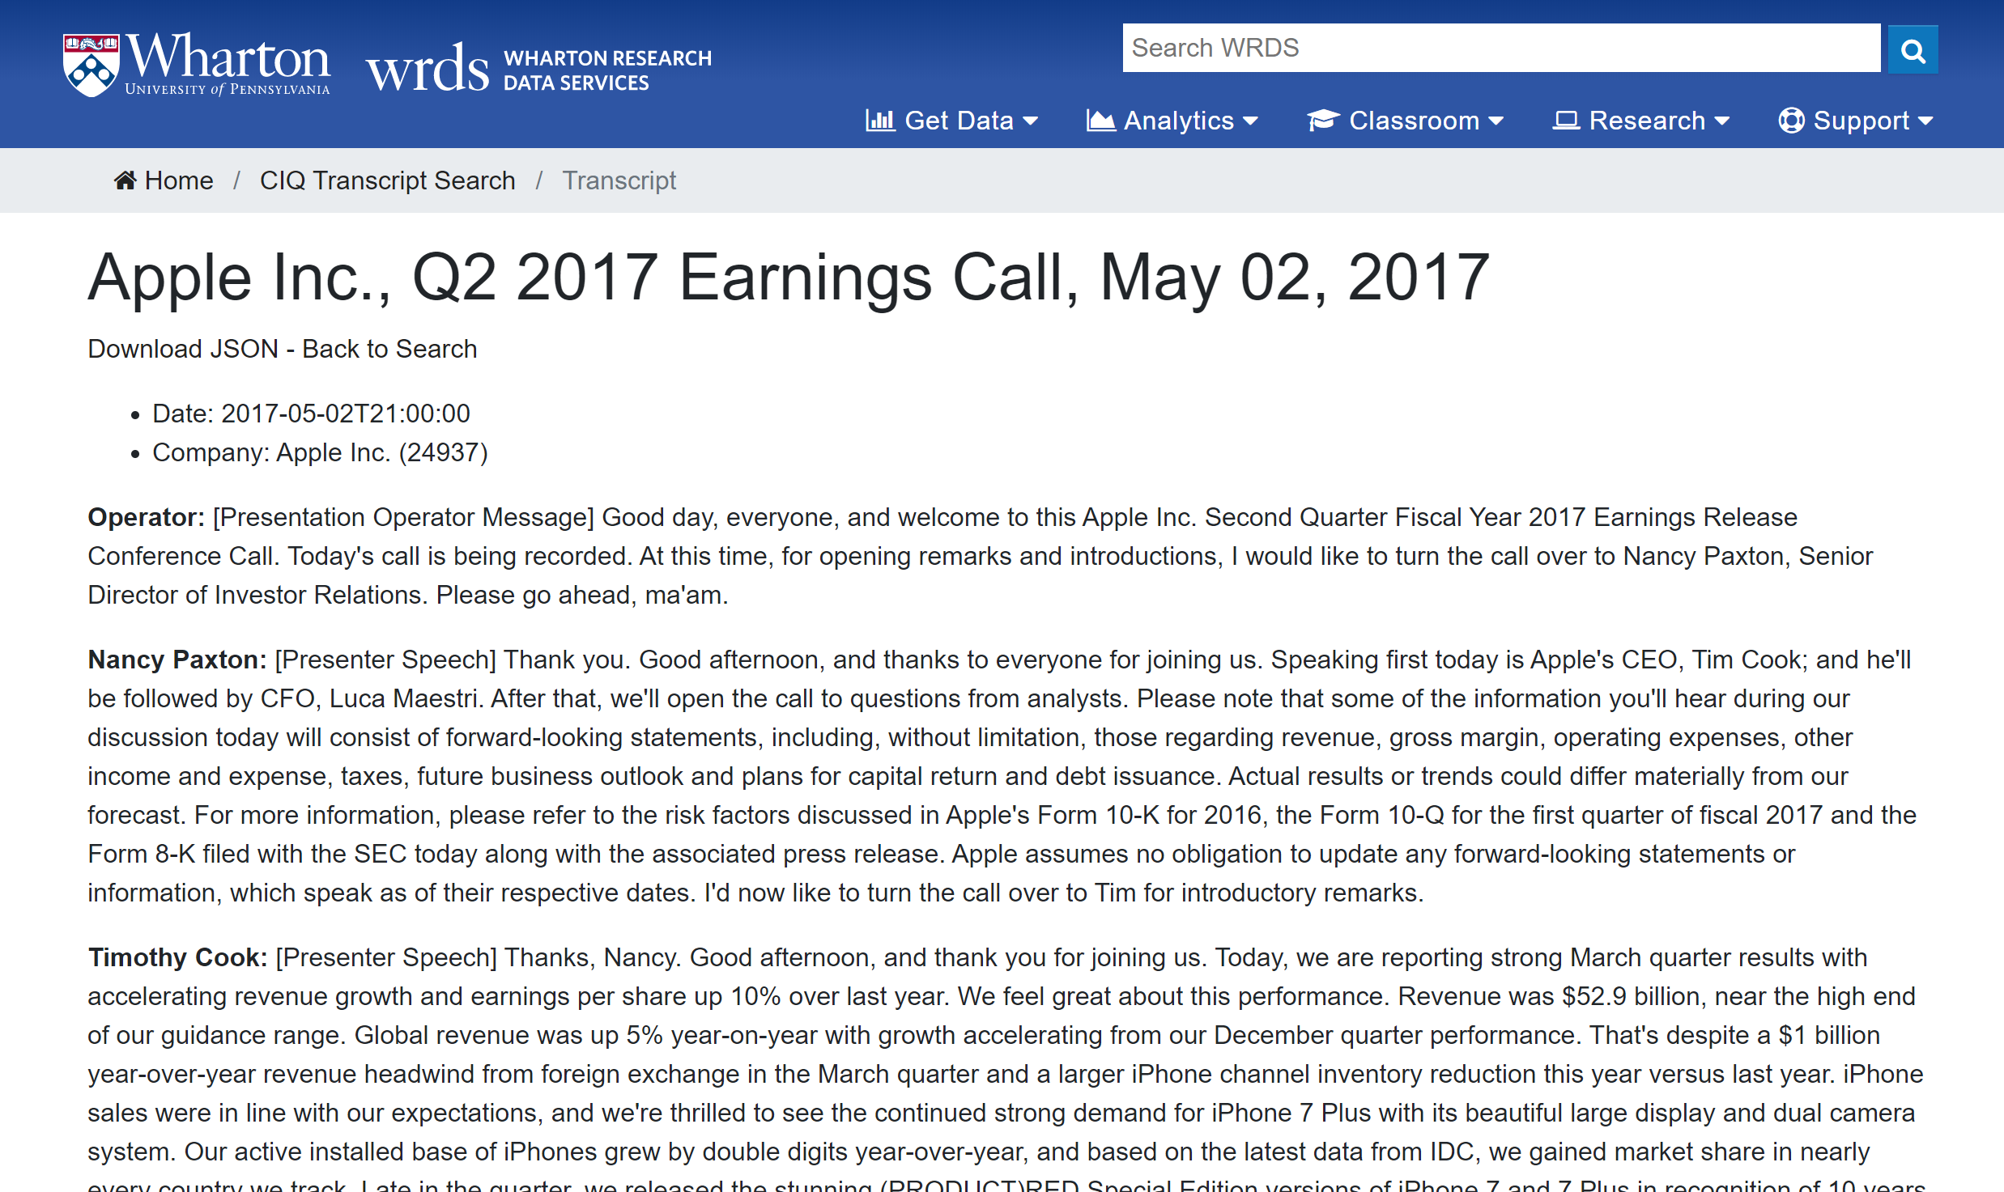
Web Access - Full text search
Click to download JSON file

Slide 12
WRDS Cloud
Data tables in Transcripts
wrds_transcript_detail
wrds_transcript_speaker
ciqtranscript
ciqtranscriptcomponent
ciqtranscriptdelayreasontype
ciqtranscriptcollectiontype
ciqtranscriptpresentationtype
ciqtranscriptdelayreason
ciqtranscriptspeakertype
ciqtranscriptperson
ciqtranscriptcomponenttype
ciqtranscriptcollectiontype

Slide 13
WRDS Cloud
Data tables in Transcripts
wrds_transcript_detail
wrds_transcript_speaker
ciqtranscript
ciqtranscriptcomponent
ciqtranscriptdelayreasontype
ciqtranscriptcollectiontype
ciqtranscriptpresentationtype
ciqtranscriptdelayreason
ciqtranscriptspeakertype,
ciqtranscriptperson
ciqtranscriptcomponenttype
ciqtranscriptcollectiontype

Slide 14
Example job: Pull Apple’s 2015 Earnings call transcripts
PC – SAS connect
  - Metadata & Full-text preview
Python
  - Metadata & Full-text
PostgreSql
  - Metadata & Full-text

Slide 15
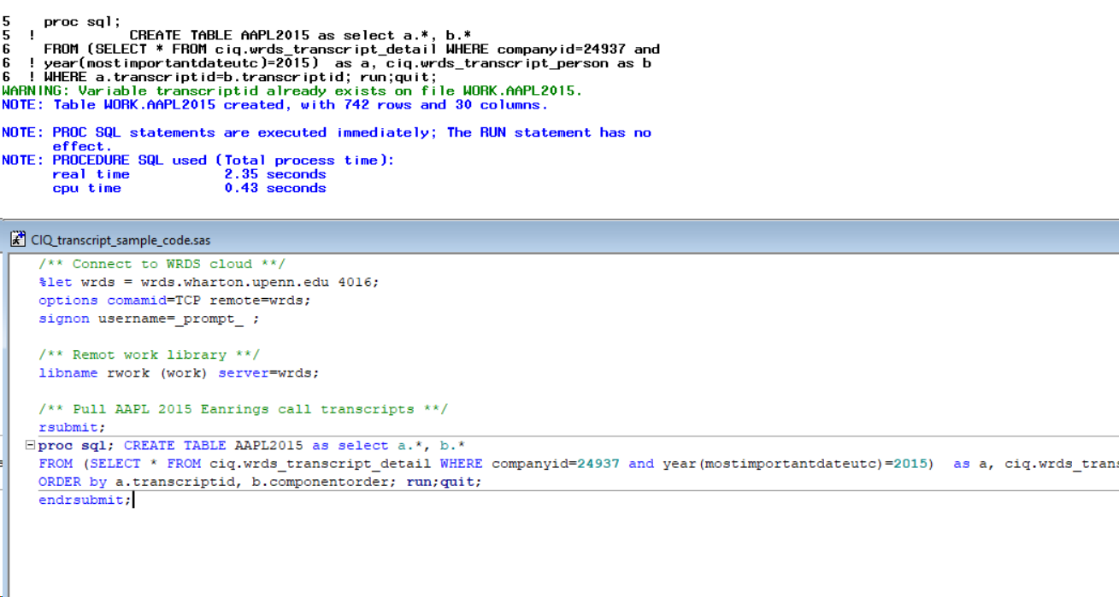
PC – SAS connect
/** Connect to WRDS cloud **/
%let wrds = wrds.wharton.upenn.edu 4016;
options comamid=TCP remote=wrds;
signon username=_prompt_ ;
/** Remot work library **/
libname rwork (work) server=wrds;
/** Pull AAPL 2015 Earnings call transcripts **/
rsubmit;
proc sql; CREATE TABLE AAPL2015 as SELECT a.*, b.*
FROM (SELECT * FROM ciq.wrds_transcript_detail WHERE companyid=24937 and year(mostimportantdateutc)=2015) as a, ciq.wrds_transcript_person as b WHERE a.transcriptid=b.transcriptid
ORDER by a.transcriptid, b.componentorder; run;quit;
endrsubmit;

Slide 16
Python
# Connect to WRDS server
import wrds
db = wrds.Connection()
# Create a sql query string
sql_query = '''SELECT a.*, b.*, c.componenttext
FROM (SELECT * FROM ciq.wrds_transcript_detail WHERE companyid=24937 and date_part('year',mostimportantdateutc)=2015) as a, ciq.wrds_transcript_person as b, ciq.ciqtranscriptcomponent as c WHERE a.transcriptid=b.transcriptid and b.transcriptcomponentid=c.transcriptcomponentid
ORDER by a.transcriptid, b.componentorder'''
print(sql_query)
# Run query, result in Pandas dataframe format
data = db.raw_sql(sql_query)

Slide 17
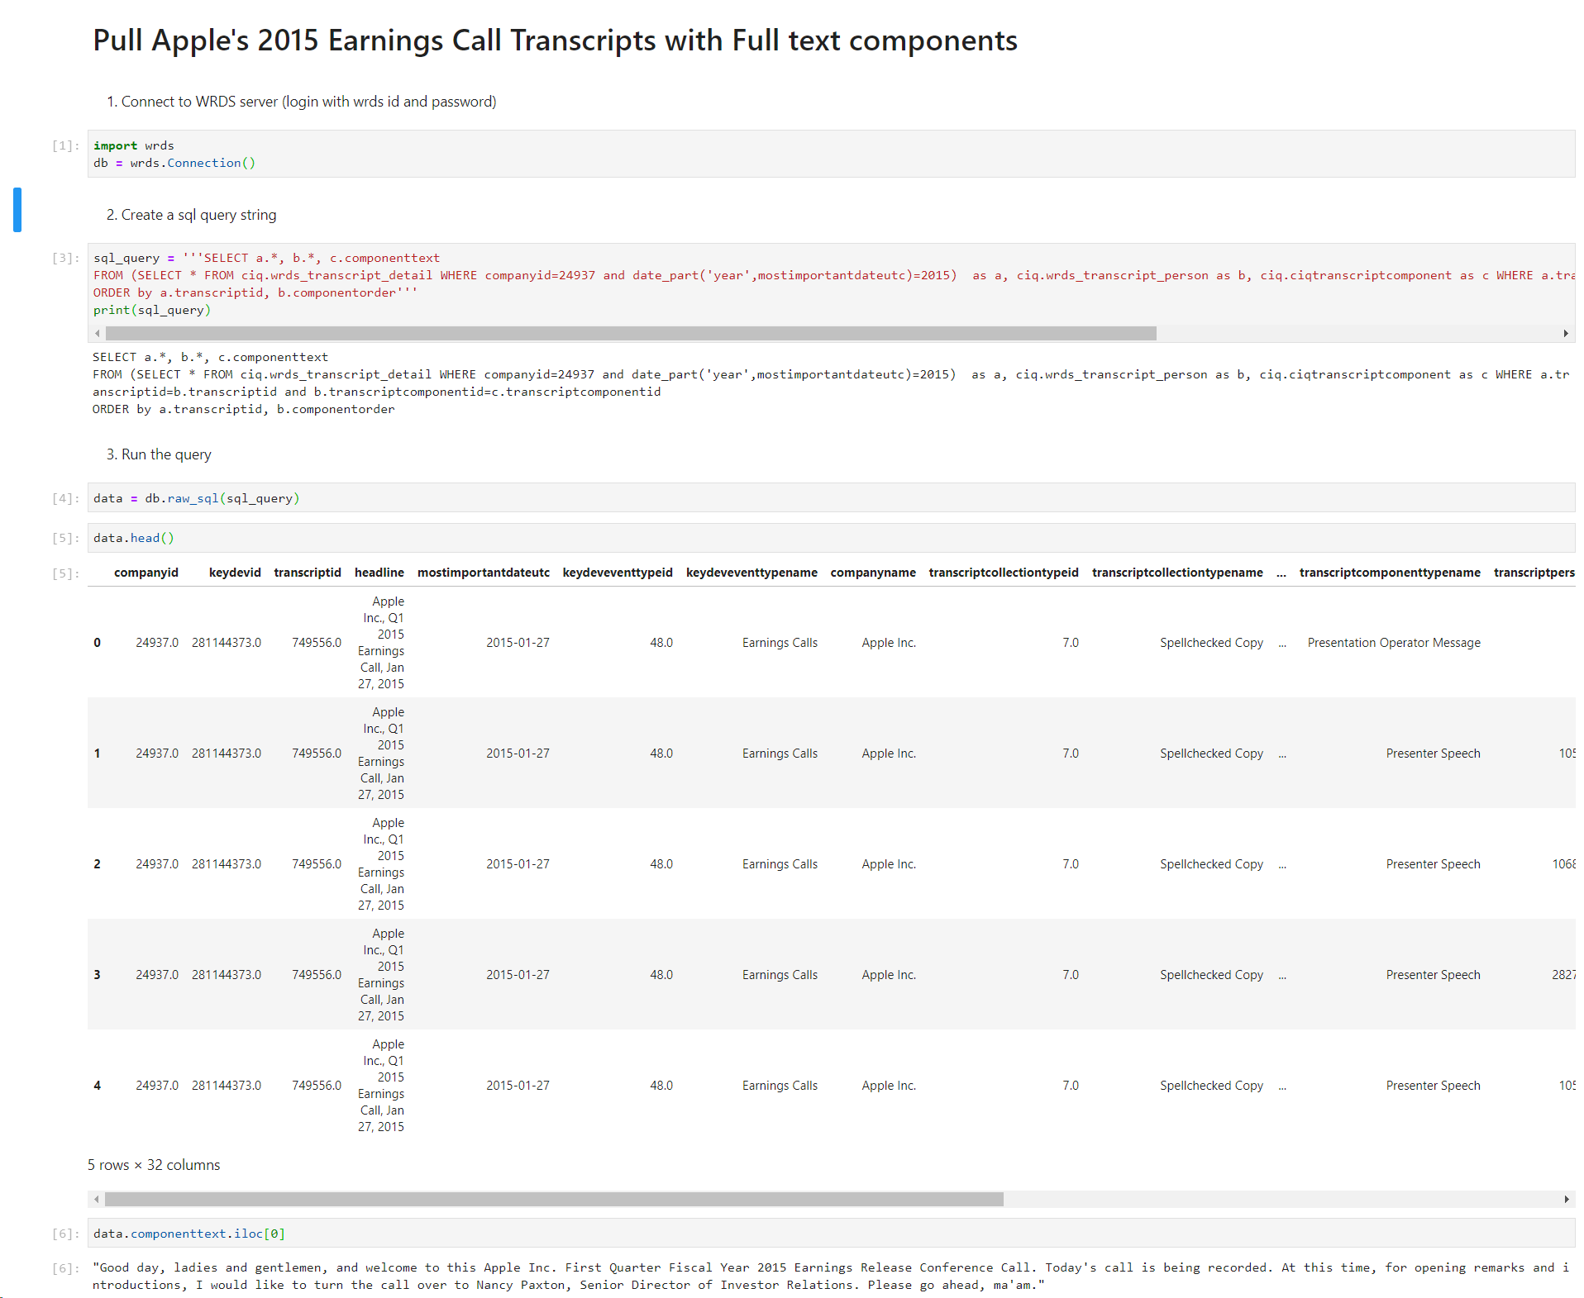
Python

Slide 18
PostgreSql
SQL example query on SSH terminal window (Mobaxterm)
Step1: Access PostgreSQL from the command line
[yourusername]@wrds-cloud-login2-h ~]$ psql -h wrds-pgdata -p 9737 wrds
Step2: Copy processed data to home directory
\copy (SELECT a.*, b.componentorder, b. componenttext FROM ciq_transcripts.wrds_transcript_detail as a, ciq_transcripts.ciqtranscriptcomponent as b WHERE a.transcriptid= 884719 and b.transcriptid= 884719 ORDER BY b.componentorder) to '/home/wrds/your_wrds_username/filename.csv' with csv;
For more information: https://wrds-www.wharton.upenn.edu/pages/support/programming-wrds/wrds-data-postgresql/wrds-data-in-postgresql/

Slide 19
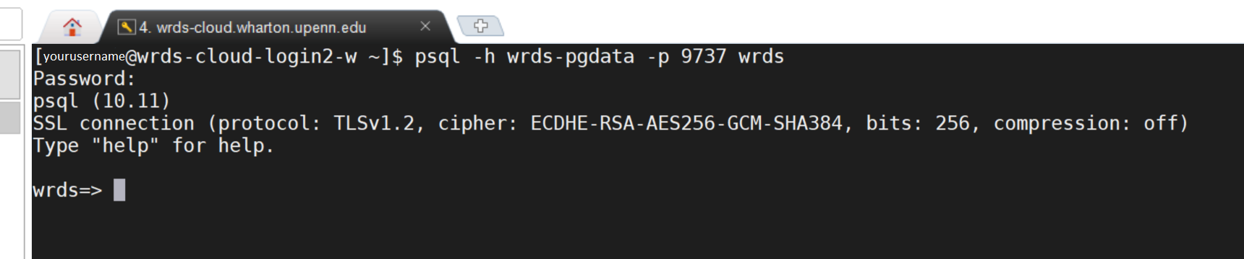
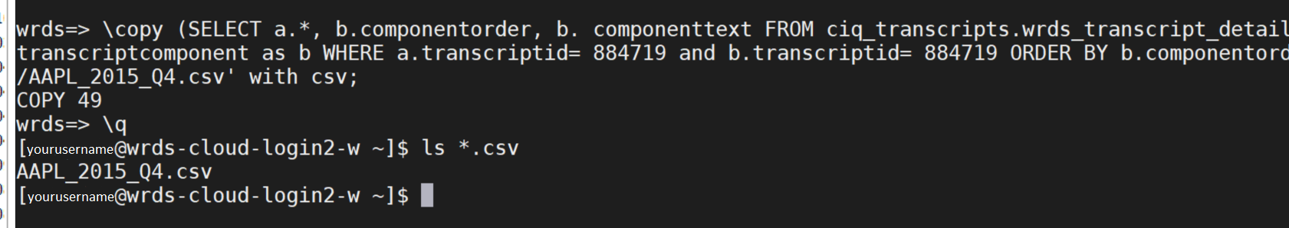
PostgreSql
Type your password and press Enter
Type the query here
The number of data rows copied
The csv file successfully created

Slide 20


