Slide 1

Compustat Execucomp: The Basics
WHARTON RESEARCH DATA SERVICES
May, 2020

Slide 2
Agenda
1
Data Universe
2
Compensation Items
3
How to track Executives
4
ExecuComp documentation and Support

Slide 3
Data Overview
Executive compensation data for US companies :
  salary, bonus, options and stock awards, non-equity incentive plans, pensions and other compensation items
  detailed compensation data under the old reporting rules (pre 2006) for those researching historical compensation trends.
Firms are identified with GVKEY -- Link to Compustat accounting and pricing data.
Connect compensation to firm characteristics: profitability, accruals, leverage…
CUSIP – allows to connect to other database such as 13F for ownership

Slide 4
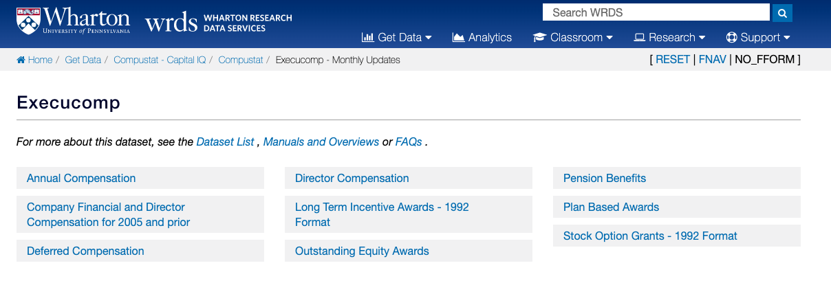
ExecuComp Datasets
Aggregate information on total value of options granted
Info at grant level: grant number, date, exercise price…

Slide 5
Introduction

Slide 6

What Companies are in ExecuComp?
In 1992-1993, the data was primarily comprised of the S&P 500.
1994 onward, began including the full S&P 1500.
Plus companies that were once part of the 1500 index are still trading, and some of the largest.
2,500 firms per year.
S&P 1500
S&P 500
1992
1993
1994

Slide 7
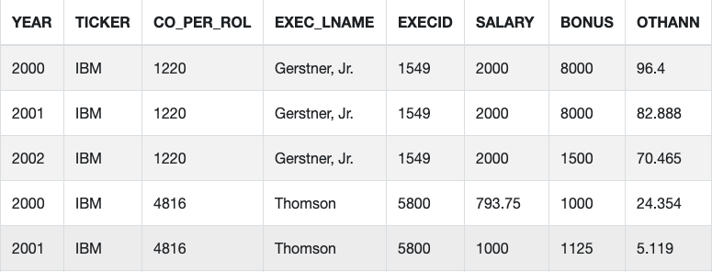
How many Executives?
Top five executive officers within a Company (some up to 9)
  Collected directly from each company’s annual proxy (DEF14A SEC form www.sec.gov). More than 29,600 executives
Executive Indentifier: EXECID – permanent id for each executive, it stays the same throughout her career.
CO_PER_ROL is different id: for executive/company combination.

Slide 8
Compenstation pre- and post-2006
In 2006 accounting standard changed to FAS 123R, causing some variables to be discontinued and others to appear.
Main compensation item TDC1 TOTAL compensation has continuity.
Under this new reporting regime:
  Cost of all employee stock options and other equity-based comp. based on the estimated fair value of the awards.
  Prior to this time, the burden was on the researcher to determine a fair value.
The document Execucomp Data Definitions explains these and other variables in detail.

Slide 9
Compenstation pre- and post-2006
Since 2006, Execucomp data is delivered in 6 main tables, mapping the “original” tables in the annual proxy.
  AnnComp – Summary compensation data + other.
  PlanBasedAwards – Contains data on awarded options and stock grants during the filled fiscal year.
  OutstandingAwards – Describes the outstanding stock options and unvested stock awards held by officers as of the end of fiscal year.
  DeferredComp – Contains deferred compensation.
  Pension – Contains all details on pension benefits.
  DirectorComp – Contains new details on the director compensation.
Two additional tables from pre-FAS123 are provided:
  Stgrttab – Contains details on Stock Options Grants Pre-FAS123.
  Ltawdtab – Contains Long Term Incentive Plan Awards Pre-FAS123.

Slide 10
Compustat ExecuComp Compensation:
Total Compensation Including Option Grant Variable Name = TDC1
  Total compensation for the individual year, comprised of the following: Salary, Bonus, Other Annual, Total Value of Restricted Stock Granted, Total Value of Stock Options Granted (using Black-Scholes), Long-Term Incentive Payouts, and All Other Total.
Cash Compensation
Salary Variable Name = SALARY
  The dollar value of the base salary (cash and non-cash) earned by the named executive officer during the fiscal year.
Bonus Variable Name = BONUS
Other Total Variable Name = OTHCOMP
Stock & Options Compensation
Total Value of Restricted Stock Granted Variable Name = STOCK_AWARDS
Total Value of Stock Options Granted Variable Name = OPTION_AWARDS

Slide 11
Fiscal Year Information
“Year” in Execucomp is based on fiscal year. Compustat defines a fiscal year based on the FYR value.
  Compustat North America provides the variable FYR which represents the month on which the fiscal year ends (e.g. FYR = 3 means that fiscal year ends on March).
  For a fiscal year ending in January through May (e.g. FYR = 1 through 5), then the fiscal year is one less than the year in which the fiscal year ends.
  For example, for a fiscal year ending in Feb, 2002, the fiscal year assigned would be 2001. The same is true for a fiscal year ending as late as May 31, 2002, FYR2001.

Slide 12
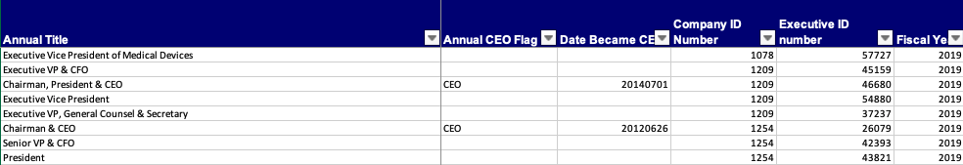
Tracking CEOs
To identify the CEO at year t, use CEOANN -- which is a historic variable.
Some discrepancies with the variable BECAMECEO -- when the executive became the CEO –. In these cases, there is valuable information in the variable COMMENT.
If executives have positions in parent and subsidiary, total compensation reflects the combined total for all services.

Slide 13
Identifying Board Members that are CEOs
EXECDIR = "TRUE" indicates that the named executive officer served as director during the indicated fiscal year.
  This does not necessarily indicate Chairmanship of the Board of Directors, and there is no ExecuComp variable that indicates this directly.
The best way to get this information is to use either the TITLE or TITLEANN variable and search for the character strings "chairman" or "chmn."

Slide 14
Reaching ExecuComp Wrds Support Materials

Slide 15
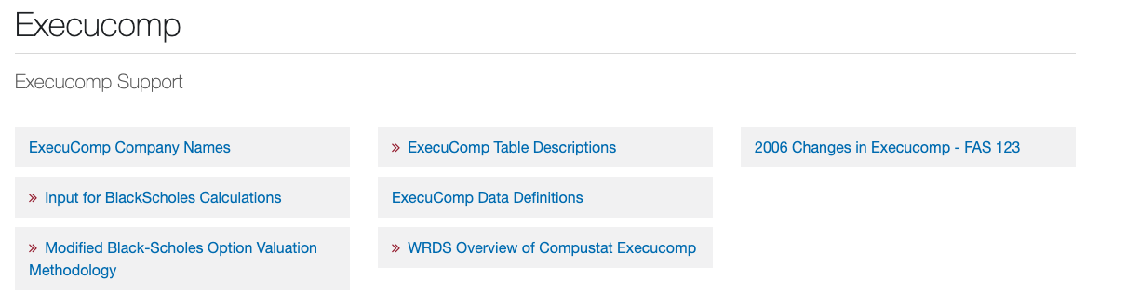
how Execucomp Support looks like:

Slide 16


