Slide 1
CRSP Coverage
WHARTON RESEARCH DATA SERVICES
April 15, 2020
Notes:
Welcome to this WRDS Presentation about Coverage of CRSP Stock data…

Slide 2
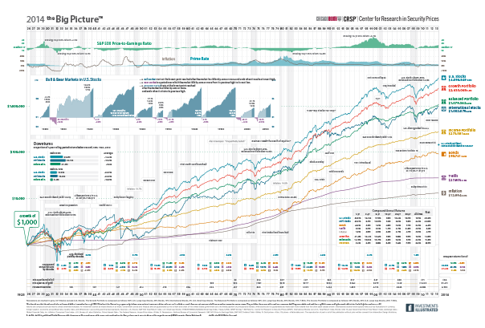
CRSP in WRDS: The Coverage
What is included and what is not.
Common stocks, ADRs and ETFs coverage
Stock Exchanges.
Compare CRSP coverage with Compustat Fundamentals
Notes:
We’ll cover 4 topics.
Which securities are included and what are not. Coverage by specific types of securities.
Coverage by Stock Exchanges
Compare CRSP coverage vs Compustat coverage

Slide 3
1. What is included and what is not

Slide 4
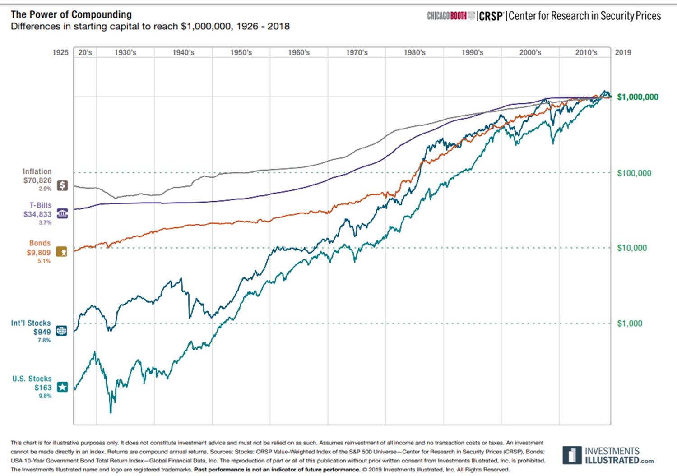
The most important securities available in CRSP are:
Common Stocks
ADRs
ETFs
Closed-End Mutual Funds
REITs (Real Estate Investment Trusts).
What securities are not in CRSP?
Rights and warrants.
Preferred shares.
Over the Counter (OTC) Bulletin Board Issues.
When Issued Trading securities.

Slide 5
2. Common Stocks, ADRs and ETFs coverage

Slide 6
US Common Stocks (share code = 10 and 11)
Notes:
US Common stocks are identified by share code 10 or 11
At the beginning of the sample, 1926, there were around 600 securities in CRSP. In 1962, there is a significant jump in coverage due to the addition of stocks trading in the AMERICAN stock exchange.
Then in 1972, there is a more significant increase in the number of common stocks in CRSP by the addition of NASDAQ stock exchange. In this case, there was a significant addition of small firms.
The maximum the number of common stocks happened in 1998 before the DOT-COM bubble burst

Slide 7
ADRs (share code = 31)
ETFs (share code = 73)
Notes:
In the chart on the left you can see the number of ADRs in CRSP per date . They are identified by shares code 31.
There are different types of ADRs. Some of them are in WRDS. The other ones are traded over the counter (OTC) and are not in WRDS. So researchers complement ADRs in CRSP with other sources such as DataStream or Compustat.
The chart on the right shows the number of ETFs in CRSP. Identified by share code 73.
The red line. They are traded basically in two exchanges: ARCA and BATS.
As you can see, at the end of the sample the number of etfs are more than 2 thousand.
Being close to the number of common stocks (blue line).

Slide 8
3. Coverage by Stock Exchanges.

Slide 9
CRSP Coverage by Stock Exchange
Notes:
In this slide, you can see the timeline of CRSP coverage.
NYSE was from the beginning.
American Stock exchange securities were added in 1962. First significant jump in coverage.
NASDAQ securities were added in 1972. Second significant jump in coverage.
Arca and Bats were added in the later years. 2006 and 2012, respectively.
Arca and Bats TRADES are basically for ETFs.

Slide 10
4. Coverage CRSP vs Compustat

Slide 11
CRSP vs Compustat Coverage
Notes:
Here you see the number of uniques companies in CRSP.
shrcd in (10,11)
Common stocks
No adrs,
No incorporated outside the US
Securities are Listed in major stock exchanges. CRSP exchanges are NYSE, AMEX (NYSE mkt), NASDAQ, Arca and BATs.
No other exchanges. No OTC securities.
CRSP keeps historical exchange codes at any point in time so universe is very well define.

Slide 12
CRSP vs Compustat Coverage
Notes:
Here we added the time series of uniques companies in Compustat. The blue line.
It was extracted from Annual Compustat NorthAmerica database.
To be part of this sample, the company has to have valid data (total assets gt 0) and traded stock ( price>0). We also added to be close to CRSP coverage definition :
FIC=USA
However, Compustat NA does not provide historical exchange codes:
So this sample include Compustat firms whose stock trades in exchanges different than CRSP exchanges. And more important, it could include companies that trade OTC (not in WRDS).

Slide 13
CRSP vs Compustat Coverage
Notes:
Here you see the number of uniques companies that has both prices and accounting data in CRSP and in Compustat.
The CCM coverage is a lil lower than CRSP coverage. What we were told is that , to be included in Compustat, the stock of the firm has to have some liquidity.

Slide 14
Summary
What is included and what is not.
Common stocks coverage
ADRs coverage
ETFs coverage
Coverage by Stock Exchanges.
Compare CRSP coverage with Compustat Fundamentals

