Slide 1
Introduction to Compustat
North America - 2
April 2020
Qingyi (Freda) Song Drechsler

Slide 2
Compustat – North America
1
Compustat Data Structure on WRDS
2
How to Access the Data
3
How to Link with Other Databases

Slide 3
Data Structure on WRDS
Product | Unix Location
NA – monthly update | /wrds/comp/sasdata/nam
NA – annual update | /wrds/comp/sasdata/naa
NA – monthly update (non-historical) | /wrds/comp/sasdata/nam_current
Most datasets are Compustat Native
WRDS also created datasets for easy access (e.g. FUNDA/FUNDQ)
Default SAS Libname / SQL DB name: COMP

Slide 4
Compustat – North America
1
Compustat Data Structure on WRDS
2
How to Access the Data
3
How to Link with Other Databases

Slide 5
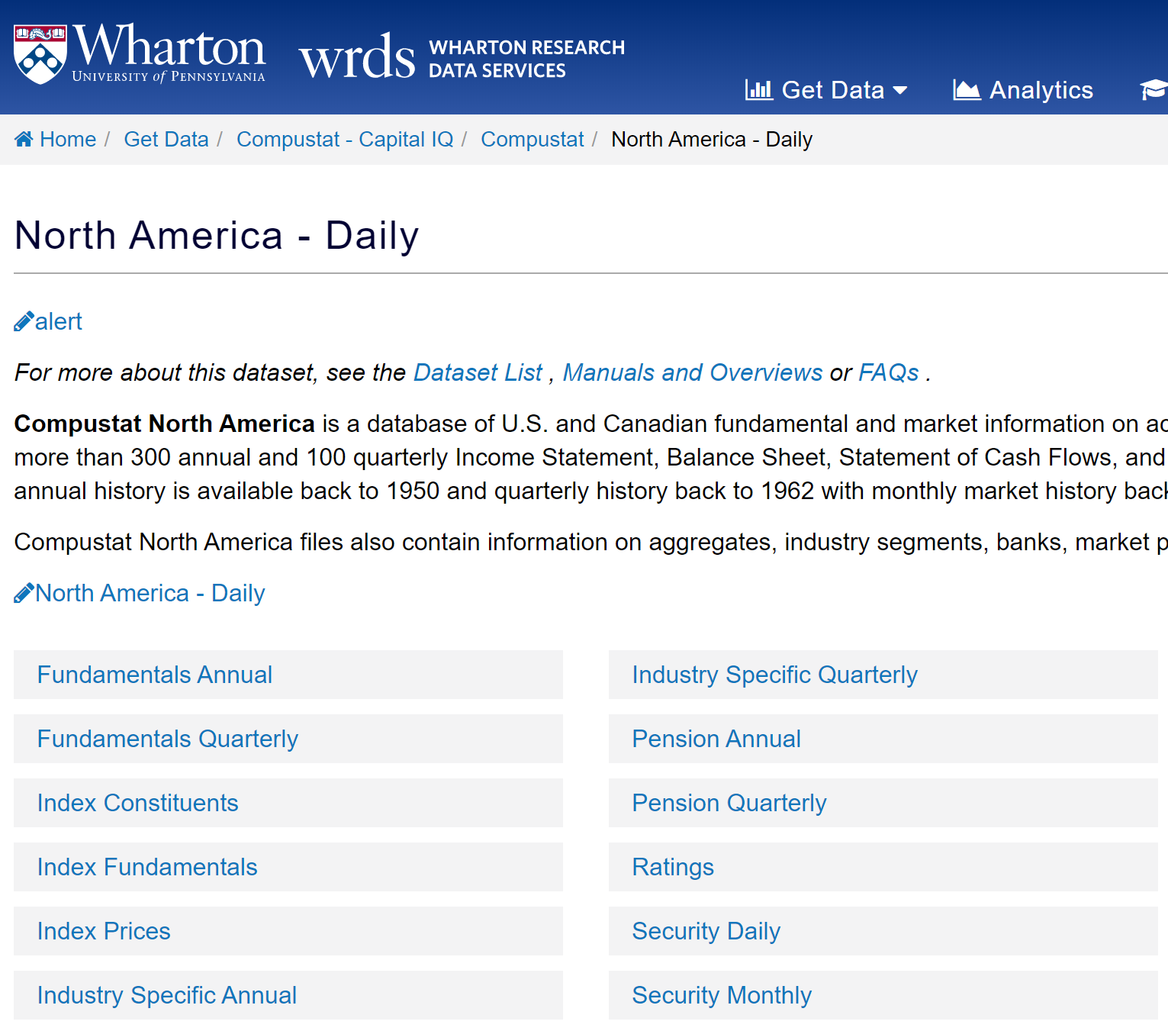
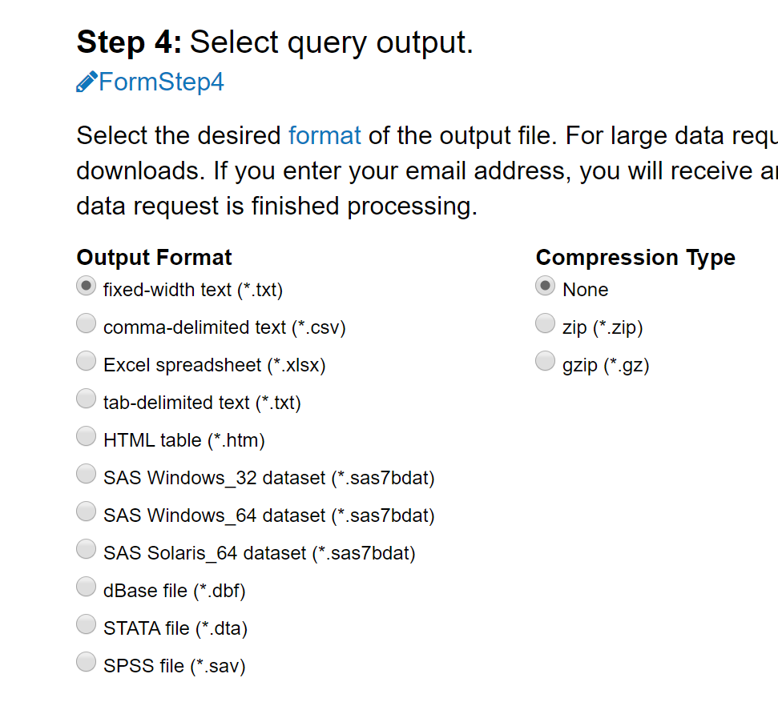
Accessing Through Web Query
Most straightforward
Only requires a browser
Flexible output format
txt
csv
xlsx
sas
dta

Slide 6
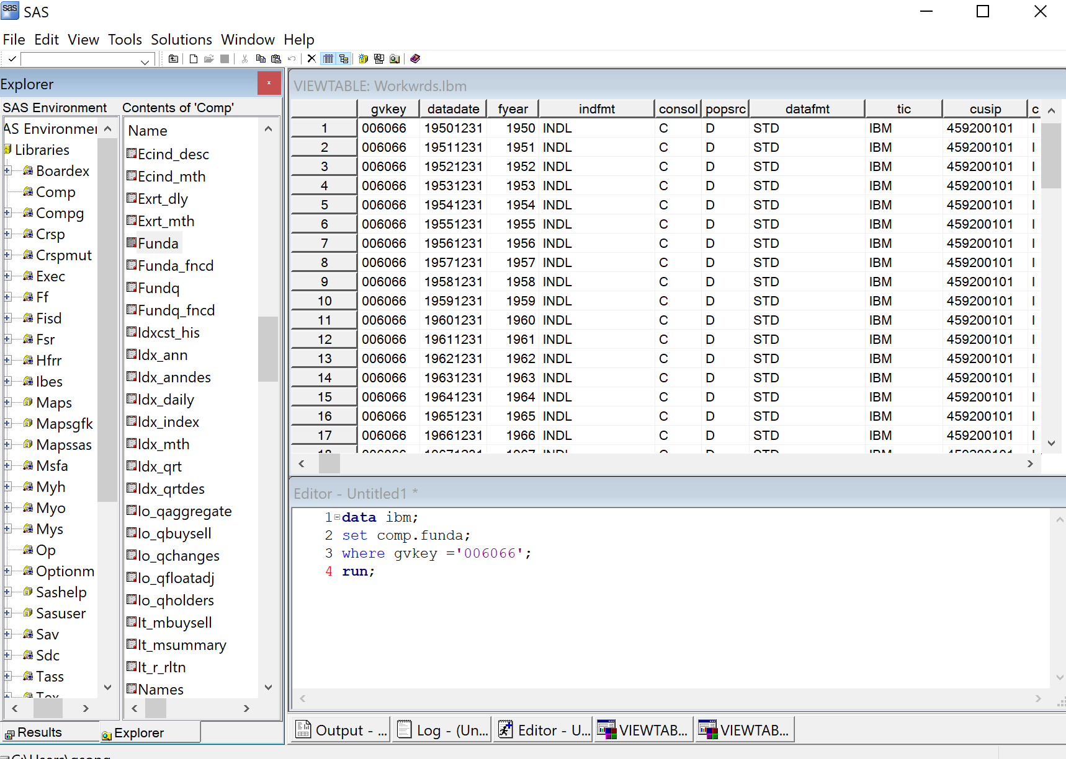
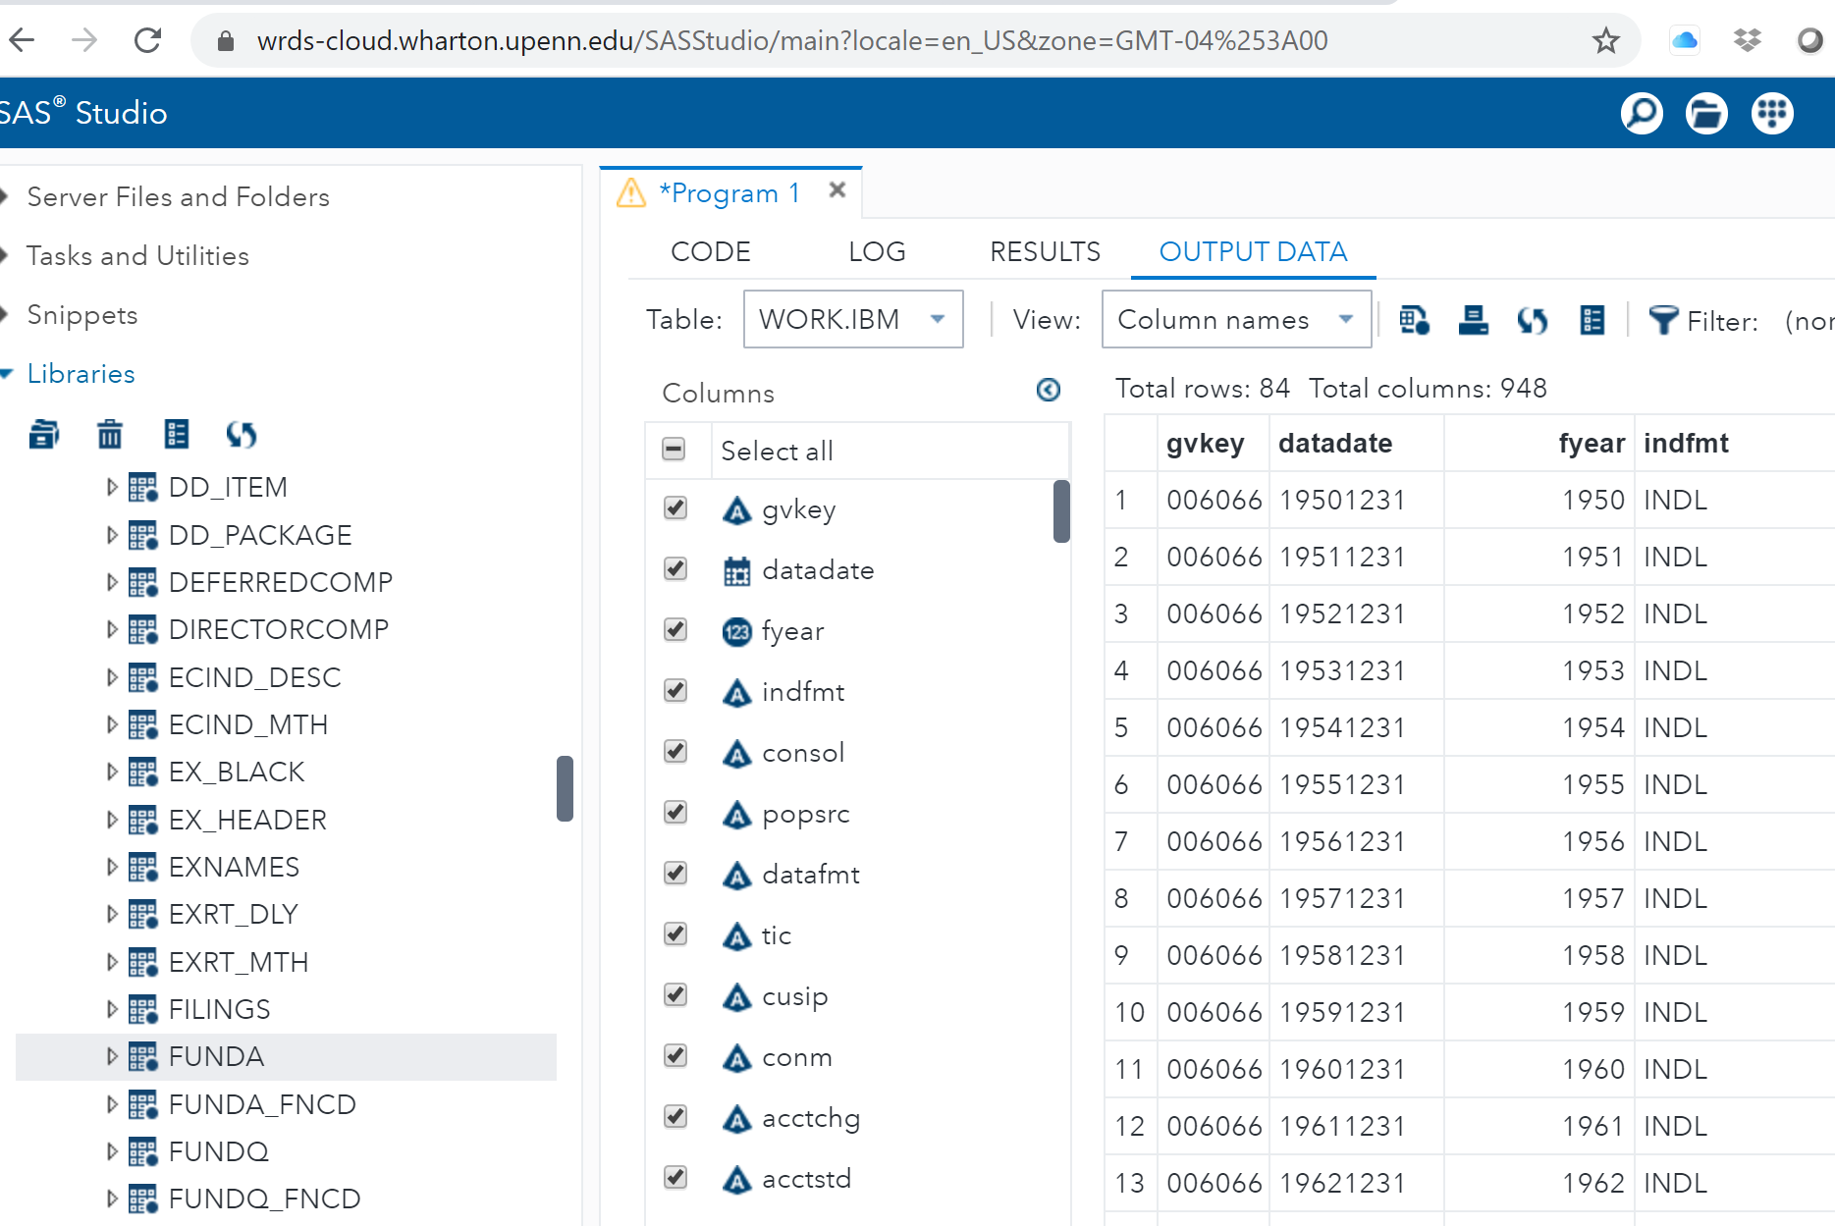
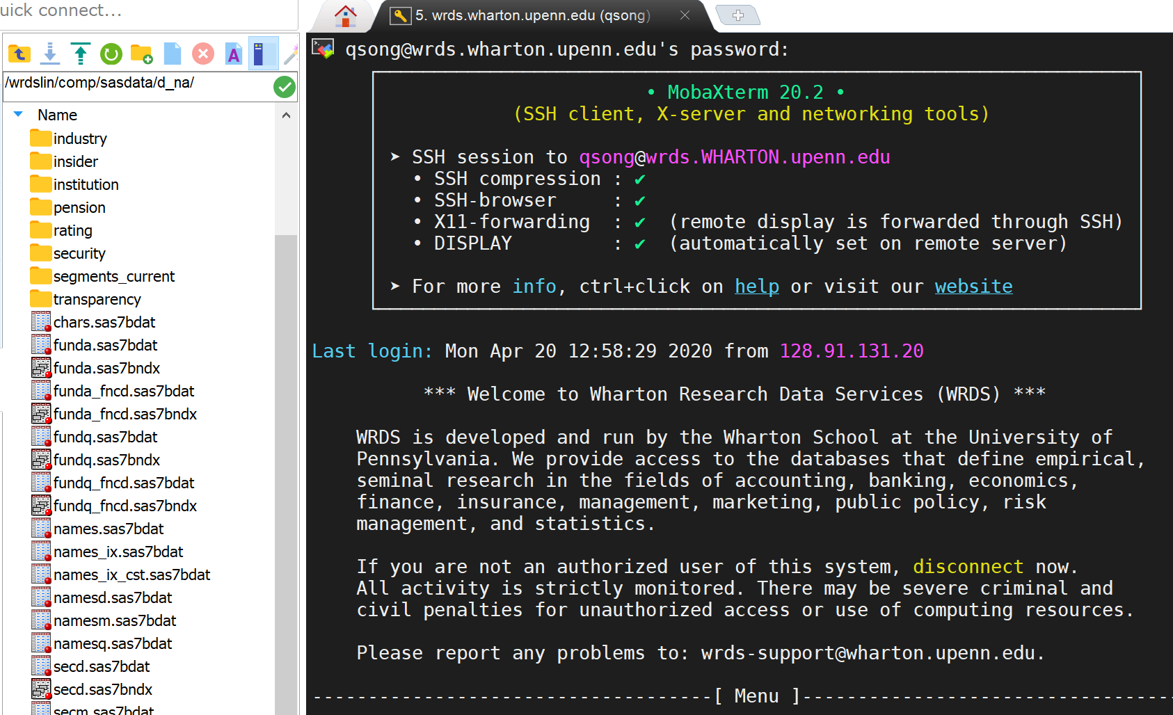
Accessing Through SAS
For more advanced researchers
Accommodates:
PC-SAS
SAS Studio
Unix

Slide 7
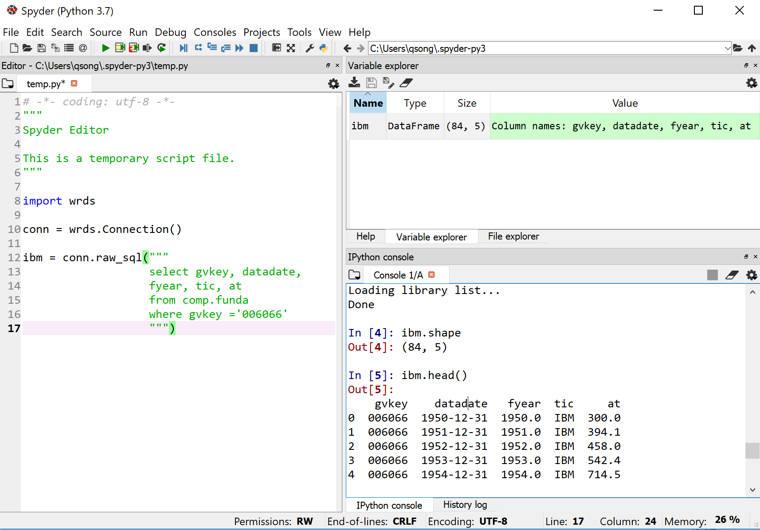
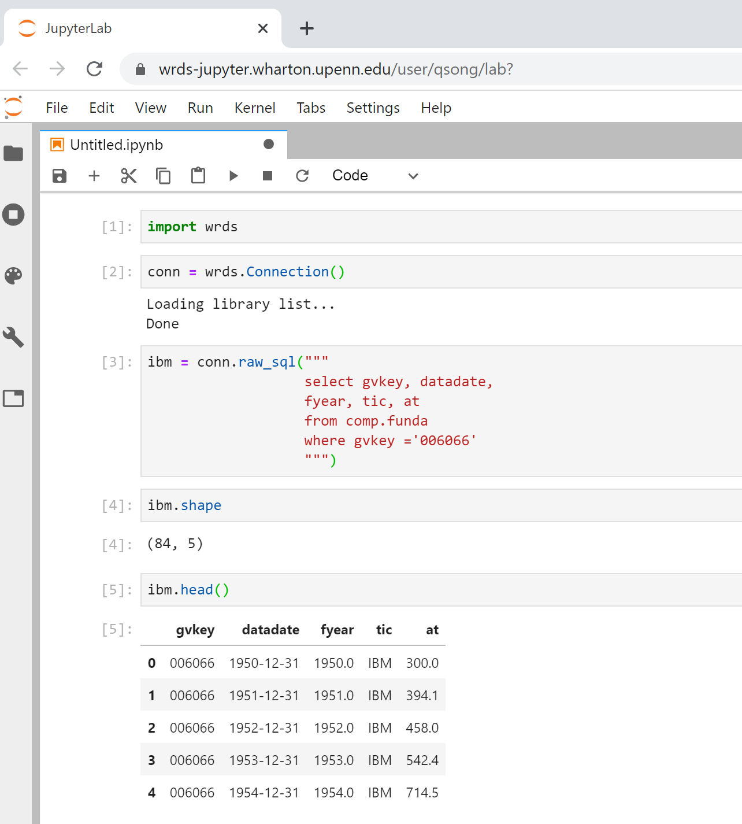
Accessing Through Python
For more advanced researchers
Accommodates:
Spyder/Jupyter
JupyterLab on WRDS Cloud (coming soon)
Requirement:
WRDS Python API

Slide 8
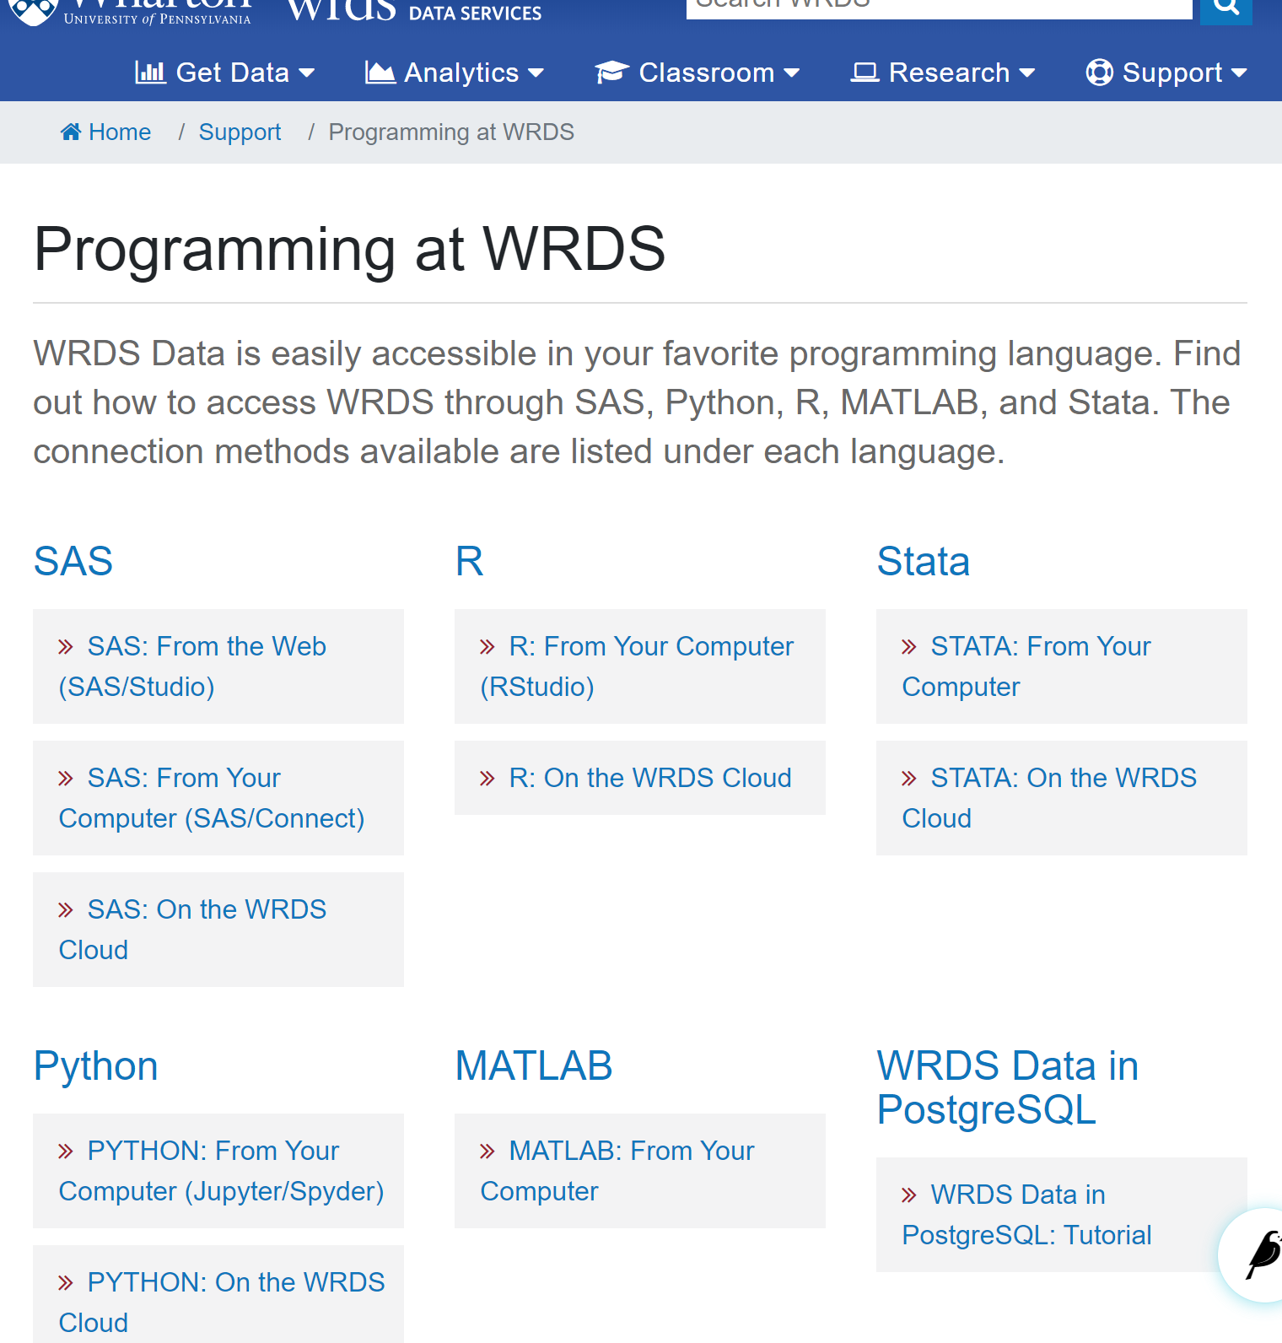
Other Accessing Methods:
WRDS also provides additional access methods:
R
Stata
Matlab
PostgreSQL
Support -> Programming at WRDS

Slide 9
Compustat – North America
1
Compustat Data Structure on WRDS
2
How to Access the Data
3
How to Link with Other Databases

Slide 10
Compustat Identifiers
Primary identifier: GVKEY
- Permanent identifier for a given company
- At issue level, use GVKEY+IID
Other identifiers: CUSIP, CIK, TICKER
- “Header” information, changes over time
- Use with caution as a linking key.

Slide 11
Linking to CRSP
CRSP-CCM:
Linking table to combine CRSP’s PERMCO/PERMNO with COMP’s GVKEY IID
GVKEY | LINKPRIM | LIID | LINKTYPE | LPERMNO | LPERMCO | LINKDT | LINKENDDT
 | Primary Link Marker | Security-Level Identifier | Link Type Code | Linked CRSP PERMNO | Linked CRSP PERMCO | First Eff Date of Link | Last Eff Date of Link
010411 | P | 01 | LC | 63773 | 5230 | 19811215 | .E
010411 | P | 01 | NR |  |  | 19741129 | 19811214
010411 | J | 07 | LC | 90655 | 5230 | 20050516 | 20120131
010411 | J | 06 | NR |  |  | 20050429 | 20060131
010411 | J | 02 | NR |  |  | 19940331 | .E
010411 | J | 04 | NR |  |  | 20020131
https://wrds-www.wharton.upenn.edu/pages/support/manuals-and-overviews/crsp/crspcompustat-merged-ccm/wrds-overview-crspcompustat-merged-ccm/

Slide 12
Linking to IBES
IBES – estimates and earnings database by TR
Comp.Security dataset contains IBES native identifier: IBTIC

Slide 13
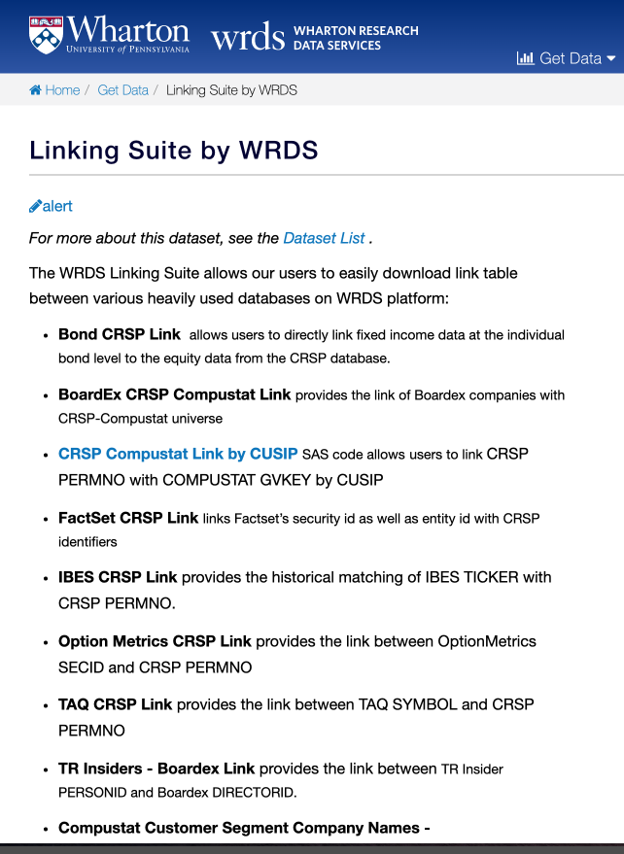
Linking to Other DB
The basic linking key is CUSIP
Be aware of the “header” nature of CUSIP
Use other measures as additional quality check
Fuzzy Company Name Matching
Price comparison

