Slide 1
Introduction to Compustat
North America - 1
April 2020
Qingyi (Freda) Song Drechsler, Ph.D.

Slide 2
Compustat – North America
1
What is Compustat?
2
Compustat Coverage
3
Important Compustat Component

Slide 3
Compustat - NA
Fundamental database – BS, IS and CF
Draws data from companies’ SEC filings (10-K, 10-Q)
Reports data items on Annual and Quarterly basis
Covers both Industry and Financial companies:
Standardized to allow for better comparison across industries
Carries companies that are both active and delisted
Survivor bias free

Slide 4
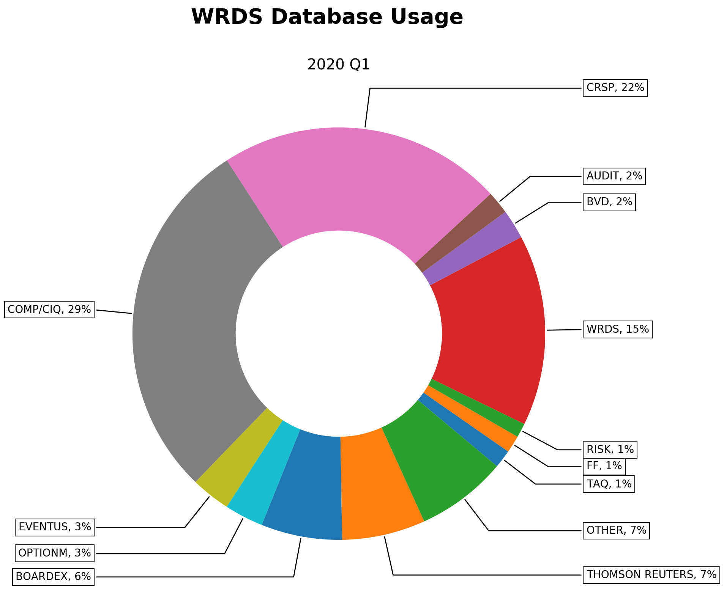
Pillar of Empirical Research

Slide 5
Compustat – North America
1
What is Compustat?
2
Compustat Coverage
3
Important Compustat Component

Slide 6
Coverage
Region: U.S. and Canada
35,000+ active and inactive public companies, covering major indices such as S&P and Russell.
Frequency:
Fundamental Annual (10-K)
Fundamental Quarterly (10-Q)

Slide 7
Coverage
 |  | Compustat North-America
Fundamental Date Range | Annual | 1950 - present
 | Quarterly | 1962 - present
Security Date Range | Monthly | 1962 - present
 | Daily | 1983 - present

Slide 8
Compustat – North America
1
What is Compustat?
2
Compustat Coverage
3
Important Compustat Component

Slide 9
Compustat Data Family
COMP
Annual/Quarterly Fundamental
Global
Accounting and Financial Items
North America
Market Data
Daily / Monthly Security Data
Additional Info
Segment
S&P Credit Ratings Xpress
Snapshot
Executive Compensation
Index – Cst / Price / Fundamental

Slide 10
Important Components
Fundamental Annual/Quarterly Data:
Extracted from companies’ Balance Sheet, Income Statement and Cash Flow Statement
E.g.: Total Assets (AT / ATQ)

Slide 11
Important Components
Security Daily/Monthly
Pricing data as an alterative to CRSP
E.g. Closing Price (PRCCD/PRCCM), Adjustment Factor, Shares traded, etc.

Slide 12
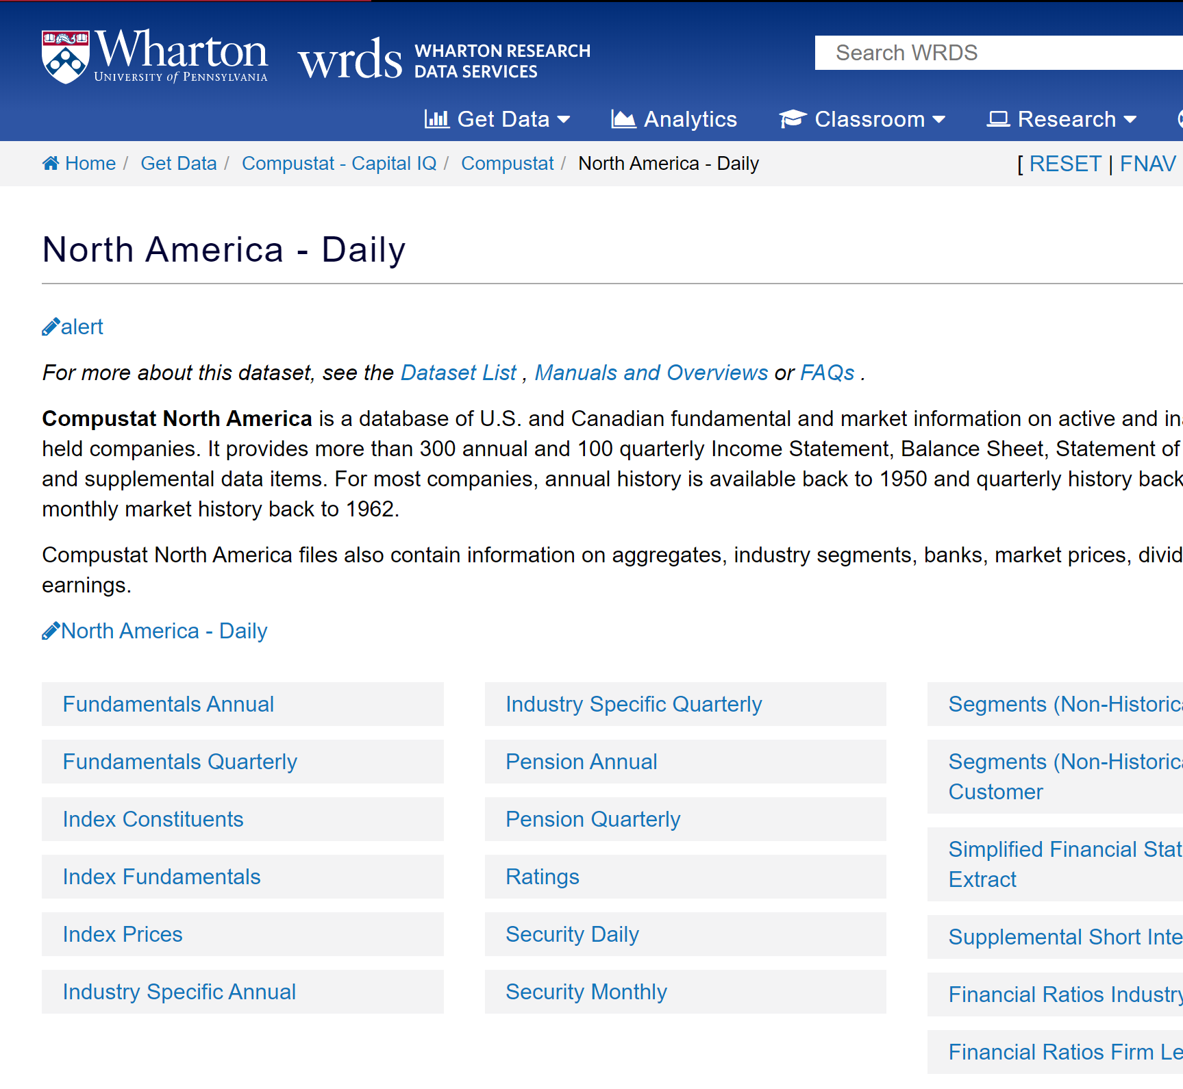
Important Components
Index Constituents:
Provides historical major index constituents (comp.idxcst_hst)
E.g.: Companies that made up S&P500 Index during the subprime crisis

