Slide 1
Introduction to Event Study by WRDS
WHARTON RESEARCH DATA SERVICES
Xuan Liu May, 2020

Slide 2
1
Event Study Basics
2
Overview of Event Study by WRDS
3
Demo – Run a Event Study Using WRDS Event Study Web Query Form

Slide 3
Introduction to Event Study
An event study is an analysis of whether a given type of event will affect a firm’s market value.
Examples of events
Mergers and acquisitions
Stock split
Earnings announcement
Trade deficit
…
Time interval
Short term
High frequency (intraday)
Long term

Slide 4
Event Study Recipe
permno evtdate
12188 22MAR2011
12266 26SEP2012
12486 31DEC2012
54439 19FEB2010
78910 08NOV2012
…
Estimation window
Event window
Gap
t = 0
Event date
Market model:
$$E\left(R_{i,t} | X_{t}\right)= α_{i}+β_{i}{Rm}_{t}+ε_{i,t}$$
Return
0%
Abnormal return:
$${AR}_{i,t}=R_{i,t}−α_{i}−β_{i}{Rm}_{t}$$
t = 0
Actual return
Day relative to event

Slide 5
1
Event Study Basics
2
Overview of Event Study by WRDS
3
Demo – Run a Event Study Using WRDS Event Study Web Query Form

Slide 6
Event Study by WRDS
U.S. Daily
Event Study
Intraday Second-by-Second
Event Study
Long run
Event Study
International
Event Study
- Upload your own events
- Events from Capital IQ
- Upload your own events
- Events from RavenPack
- Upload your own events
- Events from Capital IQ
- Upload your own events
Compustat Global
IHS Global Insight
- Events from Capital IQ
Compustat Global
IHS Global Insight

Slide 7
U.S. Daily Event Study
Stock price used
CRSP daily stock (date range for annual update - 12/31/1925 - 12/31/2019 )
Event file source
Upload your own events
Events from Capital IQ Key Developments
Company identifiers
PERMNO
CUSIP （CUSIP8）
TICKER
Date format
DD-MMM-YYYY (i.e., 24-JUN-2015)
MM/DD/YYYY (i.e., 06/24/2015)
YYYY-MM-DD (i.e., 2015-06-24)
YYYYMMDD (i.e., 20150624)
Risk model*
Market-adjusted model
Market model
Fama-French three factor model
Fama-French plus momentum
* The Market returns and Fama-French factors are taken from Fama-French factors - daily frequency table, a free table from Kenneth French's web site, this table is also available on WRDS under the Fama-French portfolios and factors database.

Slide 8
U.S. Daily Event Study Significance Tests
Parametric Tests | Nonparametric Tests
Cross-sectional t tests | Wilcoxon signed rank test
Patell’s z tests | Sign test
 | Gen(generalized) sign test
 | Corrado rank test

Slide 9
International Event Study
Stock price used
Compustat Global security daily
(date range is limited by the availability of the market return for that country)
Event file source
Upload your own events
Events from Capital IQ Key Developments
Company identifiers
GVKEY
ISIN
SEDOL
Date format
DD-MMM-YYYY (i.e., 24-JUN-2015)
MM/DD/YYYY (i.e., 06/24/2015)
YYYY-MM-DD (i.e., 2015-06-24)
YYYYMMDD (i.e., 20150624)
Risk model
Market-adjusted model Abret (abnormal return) = Ret - Rm
Compustat Global - Daily WRDS World Indices (Beta)
Global Insight – MSCI from IHS Global Insight

Slide 10
Intraday Second-by-Second Event Study
Stock price used
The NBBO files derived from the TAQ data by WRDS
Event file source
Upload your own events
Events from RavenPack
Company identifiers
SYMBOL
Date format
DD-MMM-YYYY (i.e., 24-JUN-2015 00:00:00)
MM/DD/YYYY (i.e., 06/24/2015 09:30:00)
YYYY-MM-DD (i.e., 2015-06-24 12:00:00)
YYYYMMDD (i.e., 20150624 14:00:00)
Key outputs
RET – Second-by-Second return
CUM - Cumulative return
CUM_BH - Buy-and-Hold cumulative return

Slide 11
Long Run Event Study
Stock price used
CRSP daily stock (date range for annual update - 12/31/1925 - 12/31/2019 )
Event file source
Upload your own events
Events from Capital IQ Key Developments
Company identifiers
PERMNO
CUSIP
TICKER
Date format
DD-MMM-YYYY (i.e., 24-JUN-2015)
MM/DD/YYYY (i.e., 06/24/2015)
YYYY-MM-DD (i.e., 2015-06-24)
YYYYMMDD (i.e., 20150624)
Key outputs
Buy-and-Hold Abnormal Returns (BHAR) are calculated by using equally/value-weighted benchmark portfolio returns with/without annual rebalance

Slide 12
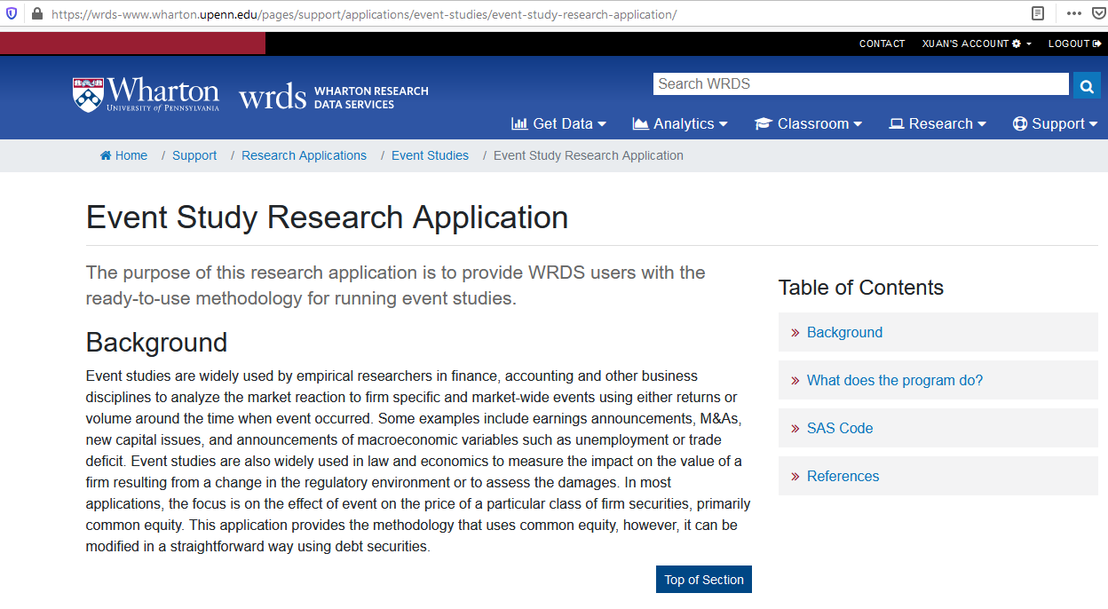
Learning Resources - Event Study Research Application

Slide 13
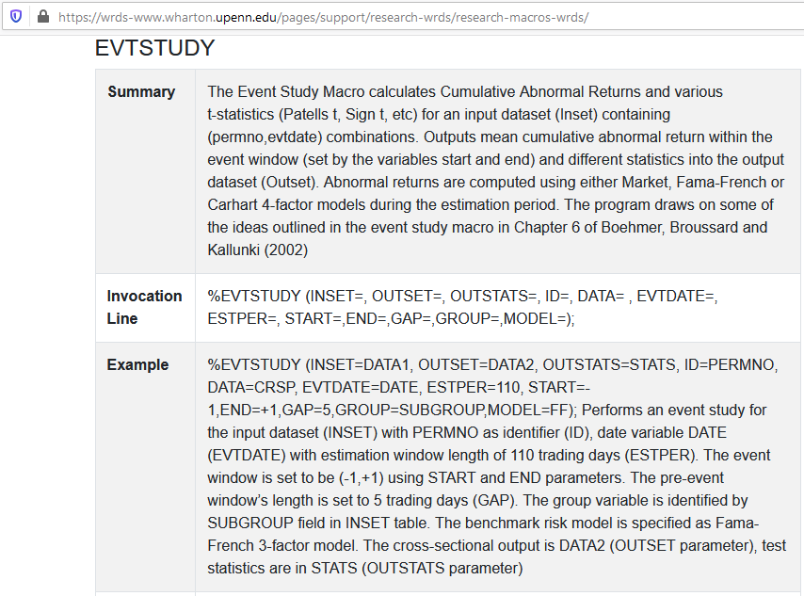
Learning Resources - WRDS Macros: EVTSTUDY

Slide 14
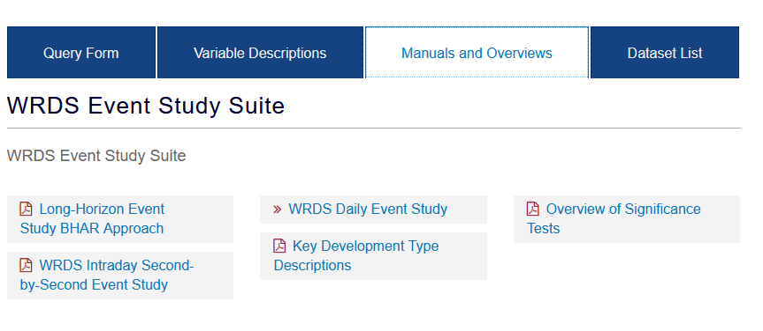
Learning Resources - Manuals and Overviews

Slide 15
1
Event Study Basics
2
Overview of Event Study by WRDS
3
Demo – Run a Event Study Using WRDS Event Study Web Query Form

Slide 16
Event Study Estimation Parameters
Estimation window
Event window
Gap
t = 0
Event date

Slide 17
Thank You!

