Slide 1
Introduction to BoardEx
July 26^{th,} 2023
Presenter: Jun Wu, Ph.D.

Slide 2
What is a Board of Directors?
The board of directors is the governing body of a corporate entity.
All public companies have a board of directors.
In the context of a public company, the board of directors is the group of people elected by—and responsible to—the company’s shareholders.

Slide 3
Role of the Board of Directors
The board meets regularly, providing oversight and setting policies and strategy for the corporate management of the organization.
The board is responsible for appointing the chief executive officer (CEO).
The head of the board of directors is the “chairperson.” In some cases, the CEO is also the chair of the board. This is known as “CEO duality.”

Slide 4
Board of Directors: International Differences
In some European countries a portion of the board is elected by the company’s workers rather than the shareholders.
Several countries outside of the U.S. utilize “dual boards,” meaning their corporations have a two-tiered board structure: (1) one board of directors for management, and (2) a separate board of directors in a supervisory role.

Slide 5
What Data is in BoardEx?
BoardEx contains extensive information about board members of publicly traded and large private companies. Some not-for-profits are also included.
BoardEx also contains information about a company’s top or senior managers, known as “disclosed earners.”
The data includes:
Biographical information
Detailed compensation data
Board and committee membership
Connecting networks between individuals and companies/associations

Slide 6
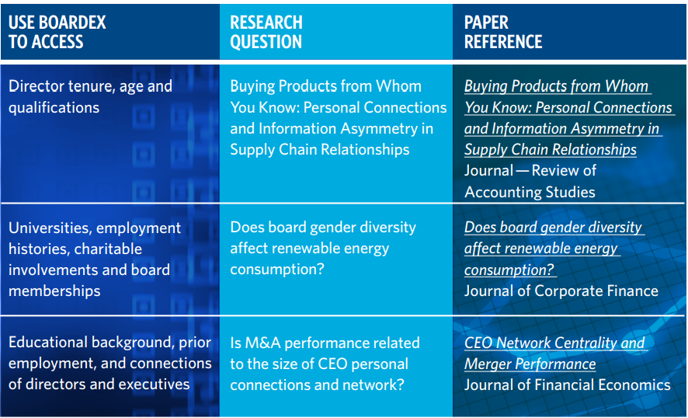

Slide 7
BoardEx Coverage
BoardEx contains information on over 25,000 firms in the United States, United Kingdom, Europe, and other parts of the world.
BoardEx includes data on over a million senior managers and board members.
Data coverage began in 1999. However, individual company records may contain a deeper history.

Slide 8
BoardEx vs Other Similar Datasets

Slide 9
Where Does the Data Come From?
BoardEx collects its data from a wide variety of public domain sources.
For example, in the United States, the major sources for BoardEx include:
The Securities and Exchange Commission (SEC)
Press releases
Corporate websites
U.S. stock exchanges

Slide 10
BoardEx Identifiers
The three primary BoardEx-specific identifiers are BoardID, CompanyID, and DirectorID.
BoardID and CompanyID pertain to company-level data, while DirectorID pertains to individual-level data.
Note: BoardID is the same as CompanyID.
In other words, BoardID and CompanyID can be used interchangeably. BoardEx provides the data in some tables using BoardID and others using CompanyID, but the values are equivalent.

Slide 11
Data Organization: By Region
BoardEx data is first divided into four regions:
North America
Europe
United Kingdom
Rest of World
Company regions are based on the country of the company’s headquarters, or the company’s inclusion in certain indices. Details can be found here.
Note that both companies and individuals can exist in more than one region.

Slide 12
Data Organization: By Region (cont.)
Director profiles are divided into regions based on the director's employment records. If a director is currently employed, they are included in the same region(s) as the company(ies) where they are employed.
If the director is not currently employed, the most recent employment records are used.

Slide 13
Data Organization: By Section
Each region’s data is categorized into seven sections.

Slide 14
Individual Profile
Individual Profile includes biographical details, such as age, gender, and nationality; this section also contains information about the individual’s employment, education, achievements, and other “non-business” activities.

Slide 15
Organization Summary
Organization Summary provides information about the board of directors. It includes the organization’s name, and its constituents’ names and roles.
This section also contains board-level summary statistics, such as the number of board members, its nationality mix, gender ratio, and attrition rate.

Slide 16
Networks/Associations
Networks/Associations contains: (1) “organizational network data,” which show linked organizations and the name and role of the individual that connects them; and (2) “individual networks,” with names of linked individuals, as well as the organization linking them.
According to the vendor in May 2022: An individual's network is the number of overlaps this person has with other individuals within Boardex through education, career, board roles, etc.

Slide 17
Compensation Analysis
Compensation Analysis includes a detailed breakdown of the individual’s annual remuneration. Total annual remuneration is the total financial compensation paid to an employee for that period. For executive employees, remuneration typically includes salary, options, bonuses, deferred compensation, and any other financial compensation. The data also includes the appropriate currency.
As of 1/2021 Boardex stated that compensation data is available for the top 5 individuals in the following indices:
FTSE, Stoxx Europe 5, S&P 500, NASDAQ 100, DAX and CAC quoted companies.

Slide 18
Committee Details, Company Profile & Announcements
Committee Details names the committee(s) upon which the individual sits.
Company Profile includes contact information for the organization, as well as standardized company IDs, such as ISIN code.
Announcements are changes to individuals’ positions as described by the organization.

Slide 19
Example: TSLA
Access BoardEx’s organizational summary for Tesla, Inc. Use the ticker TSLA.
Download the board members, as well as the board’s gender ratio (male to female), for the fiscal year ending 12/2019.
Include each individual’s name and role on Tesla’s board.

Slide 20
Example: TSLA (cont.)
1. From the BoardEx screen, locate North America and click on Organization Summary.

Slide 21
Example: TSLA (cont.)
Click on Organization Summary – Analytics.

Slide 22
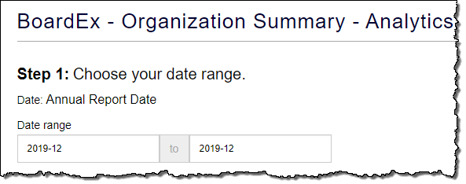
Example: TSLA (cont.)
Enter 2019-12 to 2019-12 as the date of the annual report.

Slide 23
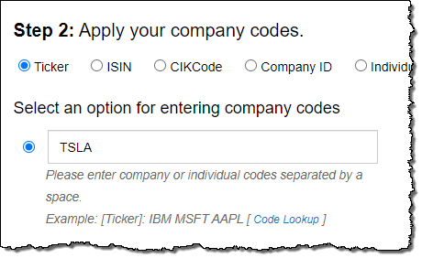
Example: TSLA (cont.)
Select the Ticker option for entering the company code.
Enter Tesla, Inc.’s ticker, TSLA.

Slide 24
Example: TSLA (cont.)
For this query, we are only interested in the board members—not the other “Disclosed Earners” the company reports. Narrow the search by selecting Board Members in the query window. Deselect Disclosed Earners.

Slide 25
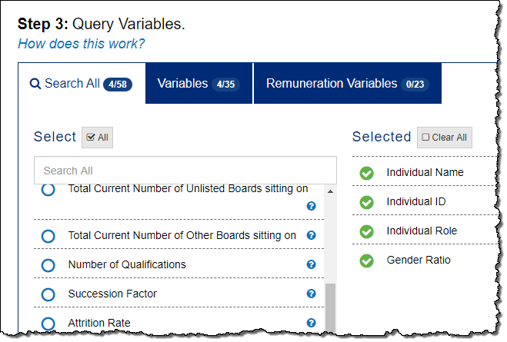
Example: TSLA (cont.)
7. Select the following query variables:
Individual Name, Individual ID, Individual Role, and Gender Ratio*
*BoardEx calculates the gender ratio as male/total.

Slide 26
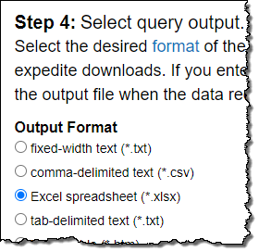
Example: TSLA (cont.)
8. Select Excel spreadsheet (*.xlsx) as the query output.
Click the Submit Query button.

Slide 27
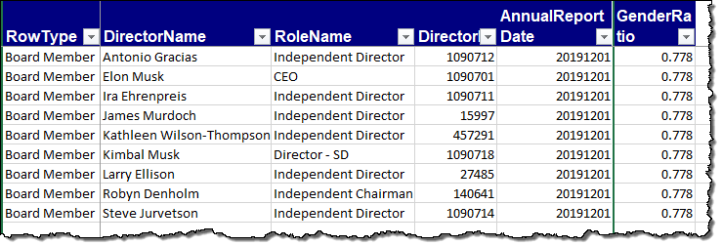
Example: TSLA (cont.)
10. Review your results.

Slide 28
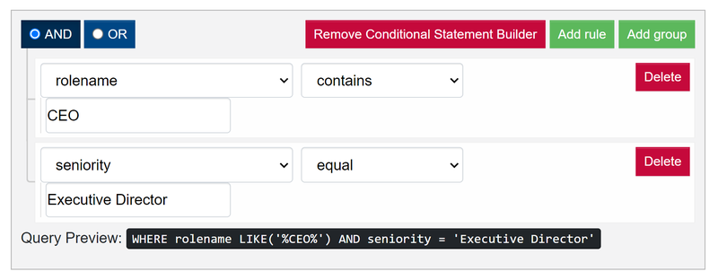
FAQ #1: Finding CEO in BoardEx

Slide 29
FAQ #1: Finding CEO in BoardEx (cont.)

Slide 30
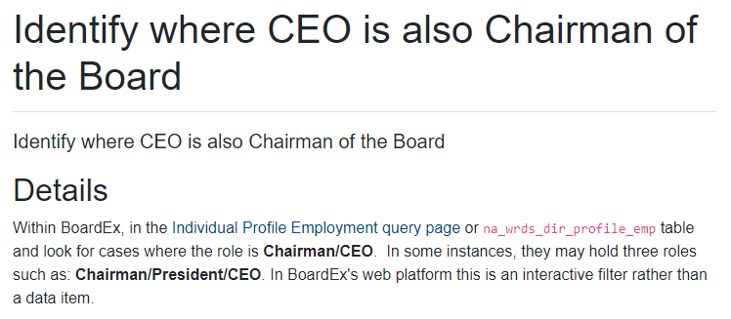
FAQ #2: Finding CEO/Chairman Dual Titles

Slide 31
FAQ #3: Independent Directors

Slide 32
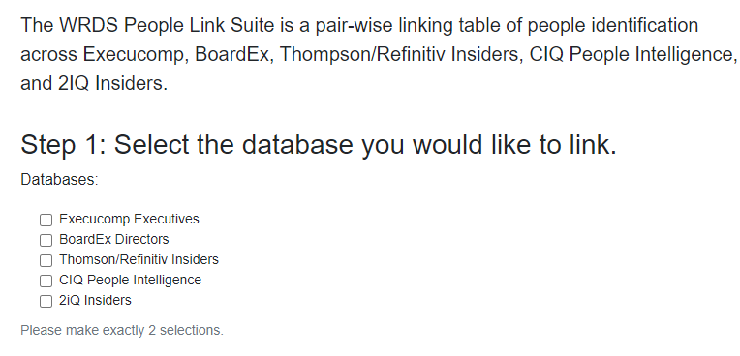
WRDS Value-add for Research
People linking:
https://wrds-www.wharton.upenn.edu/pages/get-data/linking-suite-wrds/wrds-people-link/

Slide 33
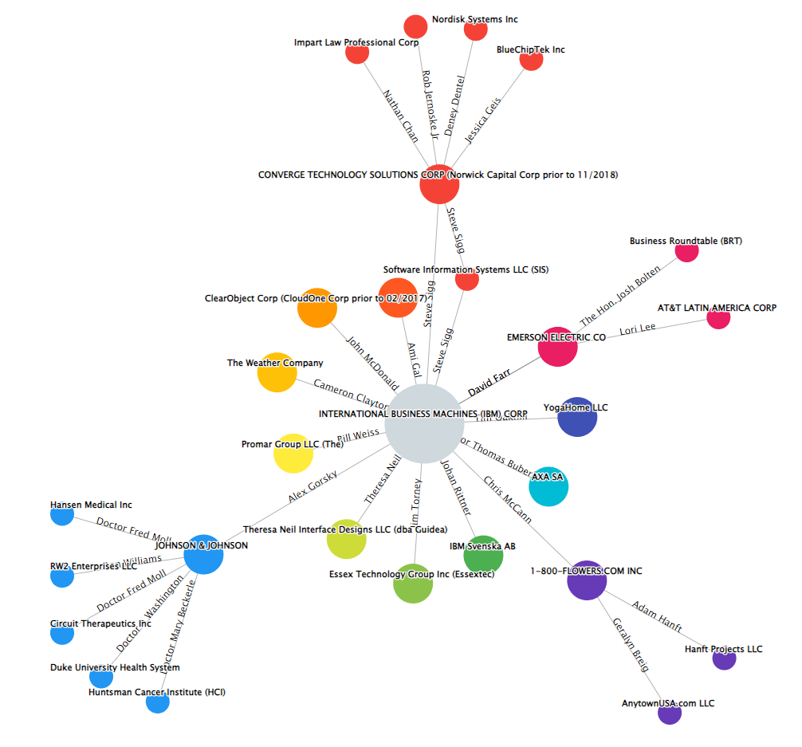
WRDS Value-add for Teaching
Network Visualization: https://wrds-www.wharton.upenn.edu/classroom/boardex-network-example/

Slide 34
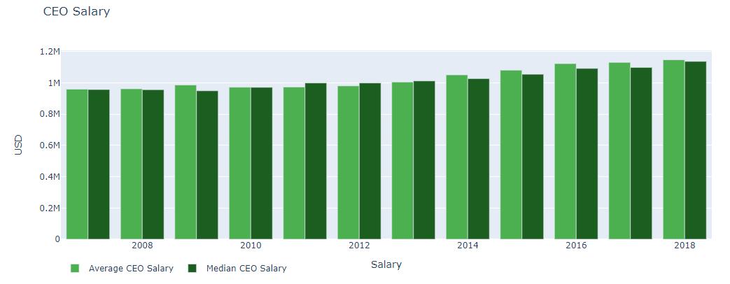
WRDS Value-add for Teaching
CEO Salary Trend:
https://wrds-www.wharton.upenn.edu/classroom/boardex-nba-comparison/

Slide 35
In Sum
BoardEx contains extensive information about board members and senior managers of publicly traded and large private companies.
This information includes biographical details, compensation data, board and committee membership, and connecting networks between individuals and companies and organizations.
Coverage includes over 25,000 firms in the United States, United Kingdom, Europe, and other parts of the world. Data coverage began in 1999.

Slide 36
Questions?
Jun (Research Support): jun5@wharton.upenn.edu
Ron (User EX): ronaldr@wharton.upenn.edu

Slide 37
Thank You!

