Slide 1
Financial Data on WRDS Intro to COMPUSTAT, CRSP and WRDS Analytics
January 31st, 2024
Presenter: Eunji Oh, Ph.D., Research Support Director, WRDS

Slide 2
Agenda
1
What is WRDS?
2
Accessing the Data
3
Financial Data on WRDS
4
COMPUSTAT / CRSP overview
5
Advanced Access Features
6
WRDS Research Products & Support

Slide 3
Overview of WRDS

Slide 4
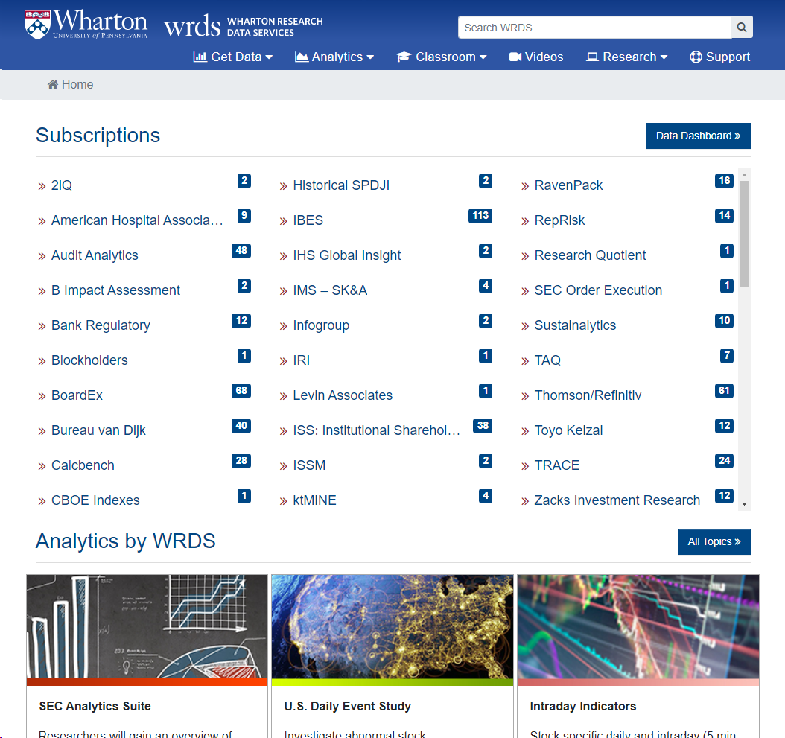
What is WRDS?
Financial Database / Analytics platform
Data vendor products
WRDS own products
Research hub
WRDS Cloud, PC-SAS, SAS Studio, Jupyter lab
Sample programs
Knowledge base
Supporting over 75,000 researchers at 500+ institutions in 35+ countries

Slide 5
Evolution of WRDS
Data Aggregator (1993 - present)
Access to Cloud Servers with Research Data and Macros
Economy of Scale in Data distribution
Full-time Technical support
Online help, email support, and 24/7 network monitoring
Research Platform (2001– present)
Knowledge Base: Data Overviews, Research Applications, and SAS macros
Full-time Research support
Research Team: 8 Ph.D.s in Economics and Finance
Research Analytics (since 2013)

Slide 6
WRDS Data Vendors

Slide 7
WRDS advantages over financial portal
Batch download of data:
Ex: One can download CRSP’s historical stock data from 1926 – current
Optimal structure for research
WRDS review original data from vendor and restructure it so that it can be ready for research
Academic research analytics (ex – linking suite, financial ratio, SEC analytics, etc.)
WRDS provides research analytics and research program that can help academic research
One stop shop for academic research
User can access WRDS data and run programs on WRDS cloud
User can link their Dropbox to WRDS and easily use outside data on WRDS cloud or share research output with co-authors

Slide 8
Agenda
1
What is WRDS?
2
Accessing the Data
3
Financial Data on WRDS
4
COMPUSTAT / CRSP overview
5
Advanced Access Features
6
WRDS Research Products & Support

Slide 9
Accessing Methods on WRDS

Slide 10
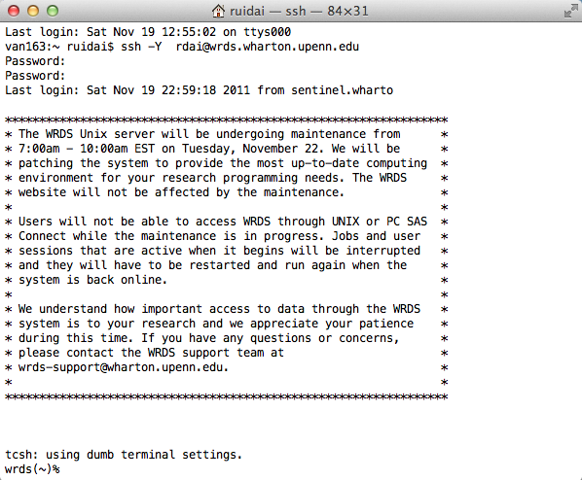
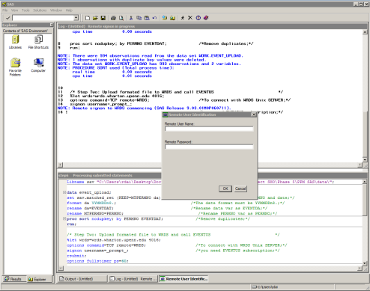
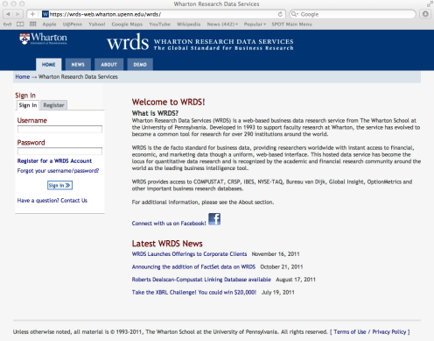
Multiple Access Options
WRDS
Internet
Web Queries: For Downloading
Unix WRDS Cloud:
For efficient querying and storage access
PC SAS, R, Python, STATA, etc.:
For programming language users
Web-based Applications:
SAS Studio / Jupyter Hub

Slide 11
Agenda
1
What is WRDS?
2
Accessing the Data
3
Financial Data on WRDS
4
COMPUSTAT / CRSP overview
5
Advanced Access Features
6
WRDS Research Products & Support

Slide 12
Financial Data on WRDS

Slide 13
Sources of Financial Data (see full data list in the appendix)
Fundamentals/Filings
Yearly/Quarterly Snapshots of a Firm (Unit: Firm)
Assets/Trading
Daily/Monthly Trading Price/Volume of a Security(Equity, Bond, Derivatives) (Unit: Issue)
Industry Specific
(Ex) Bank specific database (Unit: Firm/Industry)
Events/Transactions
M&A, Security Issuance(IPO, SEO), News Datasets (Unit: Firm)
Institutional Investors (Hedge Funds and Mutual Funds)
Characteristics, Ownership, Return of Funds(Mutual/Hedge) (Unit: Fund)
Firm Behavior/Individuals
Corporate Governance, Social Responsibility (Unit: Firm)
Analysts, Human Networks (Unit: Individual)

Slide 14
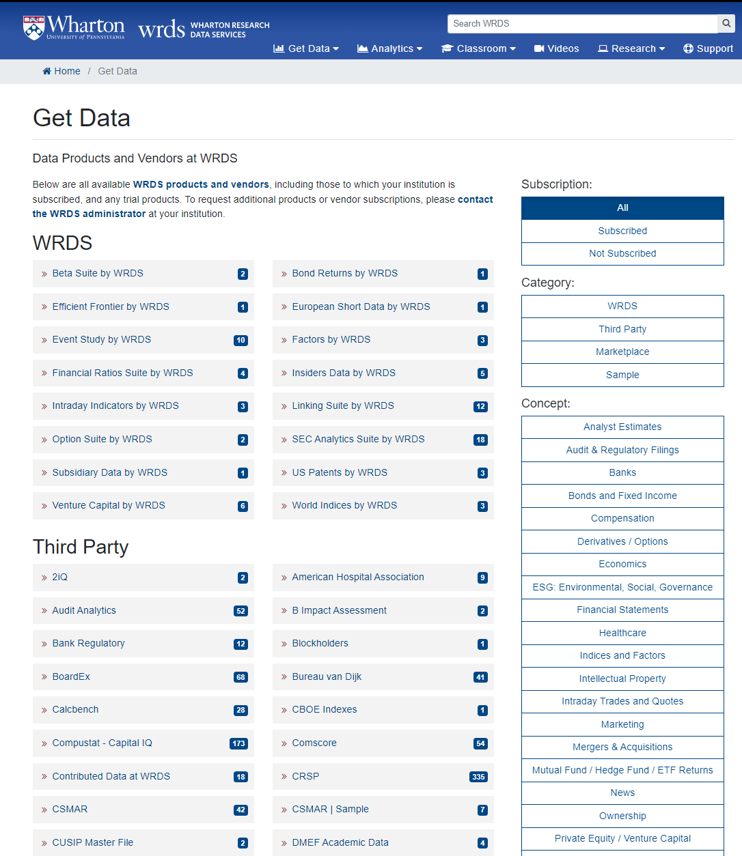
Browse Data by Concept
https://wrds-www.wharton.upenn.edu/pages/get-data/

Slide 15
Global Data on WRDS
Financial Fundamentals:
Public companies: Compustat Global, Worldscope, Factset Fundamental
Private companies: Bvd Orbis, Bvd Amadeus
Stock prices: Compustat Global, Datastream, and more
Ownership: Thomson Global Ownership
M&A: Thomson SDC
Others: Wind, Toyo Keizai, ESG databases, and more

Slide 16
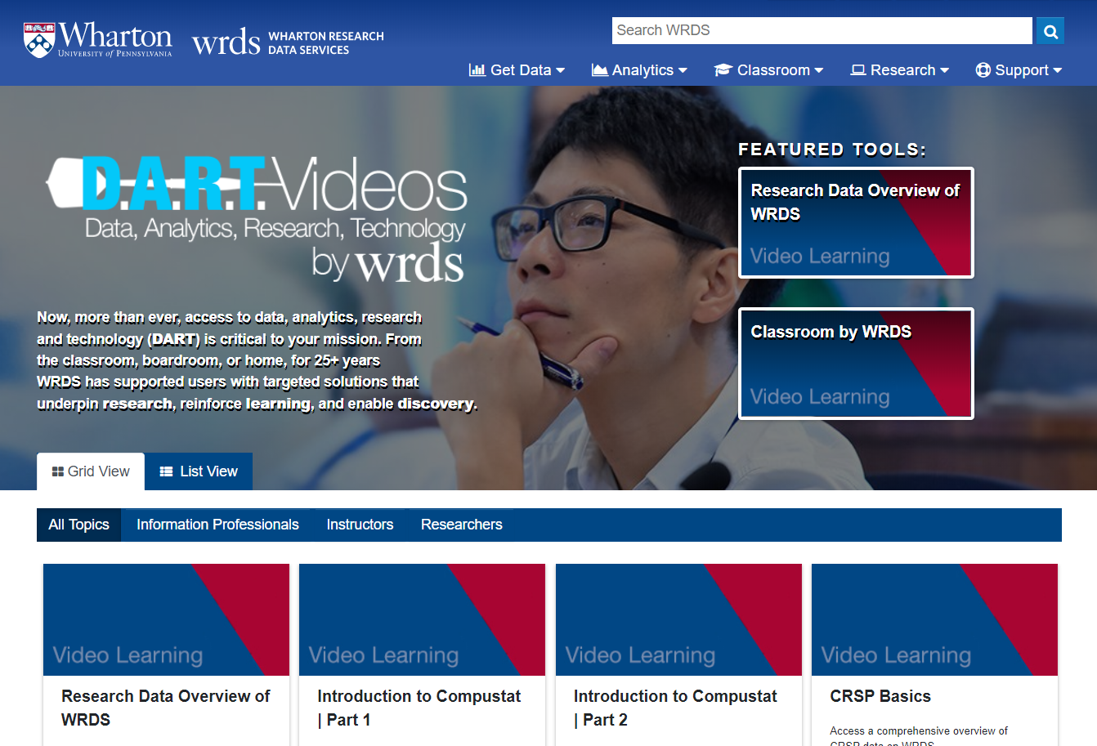
WRDS Video Resources
Remote Learning
Data
Analytics
Research
Technology
https://wrds-www.wharton.upenn.edu/pages/video-support/

Slide 17
Agenda
1
What is WRDS?
2
Accessing the Data
3
Financial Data on WRDS
4
COMPUSTAT / CRSP overview
5
Advanced Access Features
6
WRDS Research Products & Support

Slide 18
COMPUSTAT / CRSP

Slide 19
Accounting and Financial Data in COMPUSTAT
COMPUSTAT North-America: U.S. and Canadian fundamental and market information on 35,000+ active and inactive public companies, from 1950-present
COMPUSTAT Global: Fundamental data of 39,000+ active and inactive companies in 80+ countries, the earliest data is from 1986
Fundamental data available on an annual and quarterly frequencies with thousands of Income Statement, Balance Sheet, Statement of Cash Flows, and supplemental & industry-specific data items
Market data available on a monthly and daily frequencies with Prices, Dividends, Returns, Trading Volume, Shares Outstanding and Short-Interest Information (Very Similar to CRSP in many dimensions)
Both Fundamental Data and Market Data are now in the same data feed and are updated daily

Slide 20
COMPUSTAT Coverage
 |  | COMPUSTAT North-America | COMPUSTAT Global
Region |  | U.S. and Canada | About 80 countries excluding North America
Coverage |  | 35,000+ active and inactive public companies | 39,000+ active and inactive public companies
Frequency |  | Annual and Quarterly for Fundamental, Daily for Securities | Annual, Quarterly for Fundamental, Daily for Securities
Fundamental Date Range | Annual | 1950 - present | 1987 - present
 | Quarterly | 1962 - present | 1987 - present
Security Date Range | Monthly | 1962 - present
 | Daily | 1983 - present | 1985 - present
Currency |  | Values in original currency | Values in original currency

Slide 21
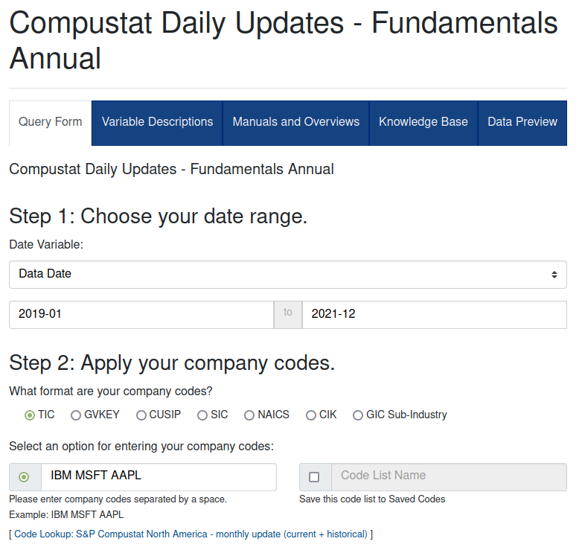
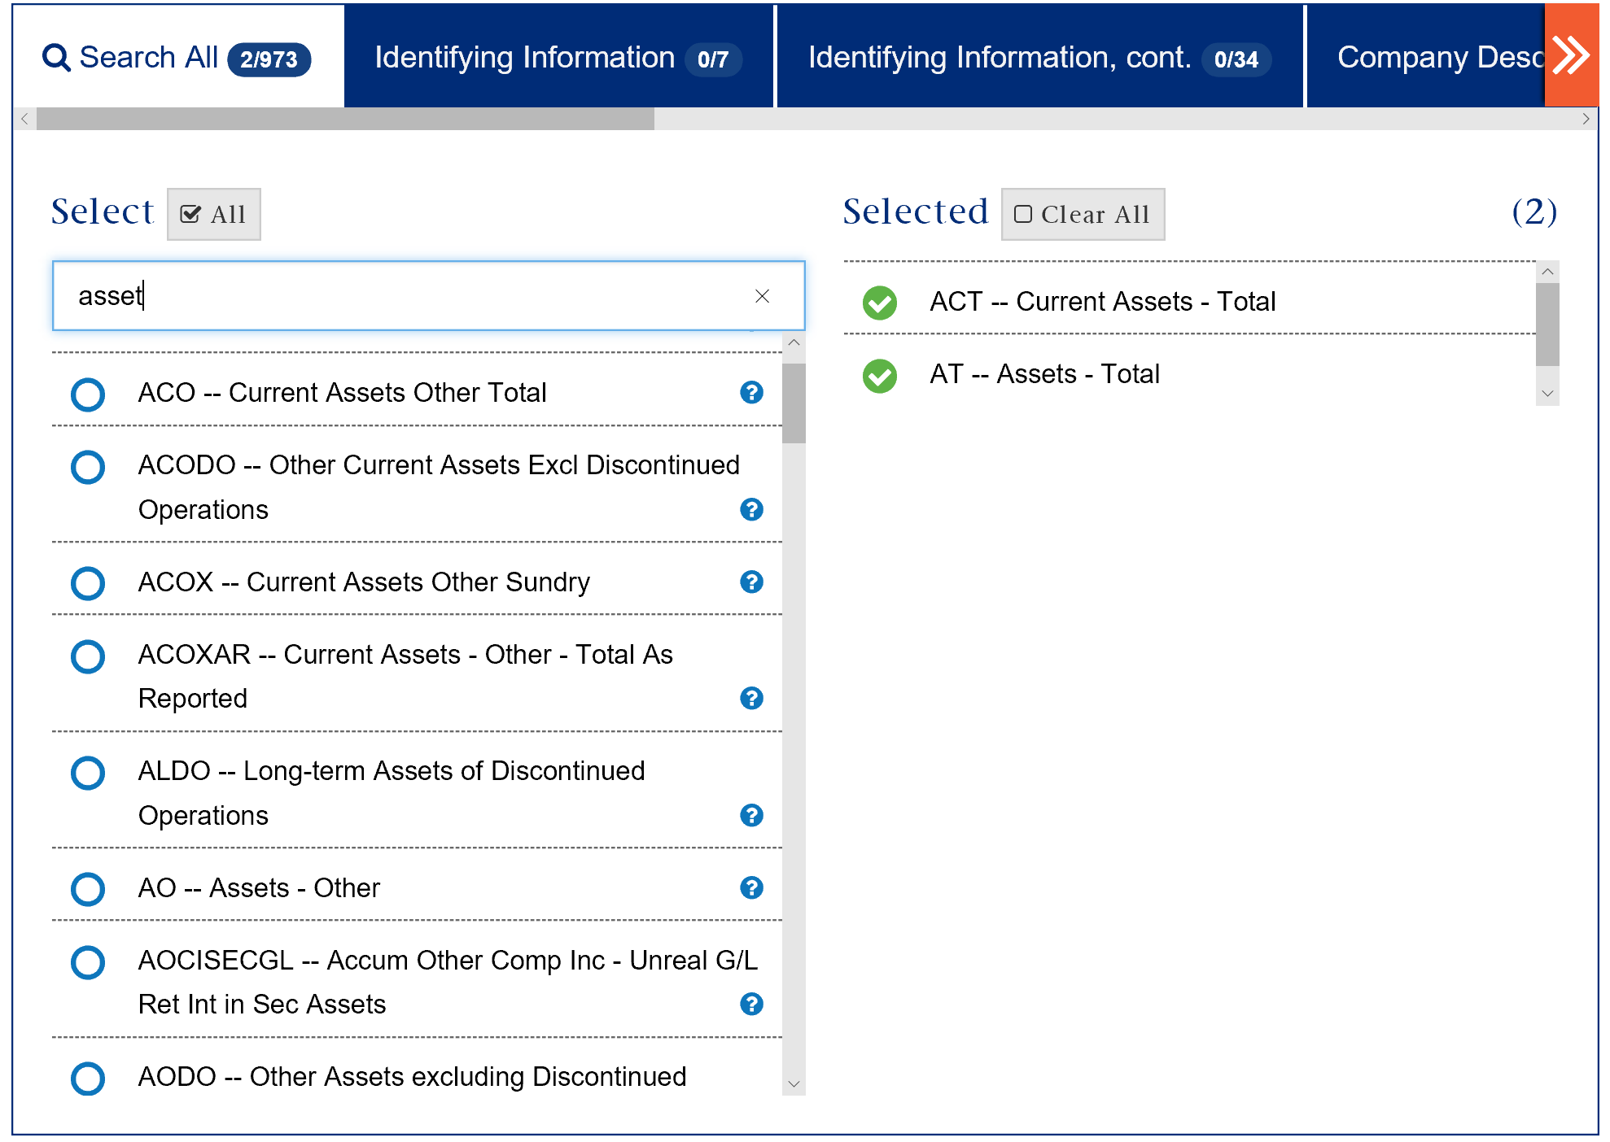
COMPUSTAT Example
Get Current Assets, Assets for IBM, Microsoft, and Apple between Jan 2019 and Dec 2021

Slide 22
COMPUSTAT Examples
Finding Financial Statement Variables for IBM
Finding Financial Statement Variables for unknown ID
Finding ~ for more than one company with known IDs
Add web query output filters
Choose the output format you need

Slide 23
WRDS Support for COMPUSTAT
Compustat manual
WRDS Documents
Sample Programs (extracts, point-in-time, etc.)
Research → Sample Programs → Compustat
Research Applications (book-to-market, P/E Ratio )
Research → Applications
Remote learning clip part a and part b

Slide 24
Primary Identifiers
The Primary Identifiers
GVKEY at firm-level
GVKEY + IID at security-level
GVKEY is a unique six-digit identifier and primary key for each company and assigned by COMPUSTAT: Permanent, and Unique (Not Recyclable).
IID is assigned for each securities
Alphabet’s class A stocks: IID = 01
Alphabet’s class C stocks: IID = 03

Slide 25
Common Secondary Identifiers
Stock Tickers: Exchange Specific, with Suffixes, NOT Permanent, and Recyclable
CUSIP also is NOT Permanent but Unique and NOT Exchange Specific.
8- or 9-digit CUSIP is assigned for issues (e.g. equities and bonds).
6-digit CUSIP is assigned for issuers (e.g. firms)
CIK: US filing number at the SEC, and Changeable
Company Names are often abbreviated/manipulated by data vendors
Very difficult to have a reliable merging code by using company names

Slide 26
Identifiers example
Alphabet & Meta (source table: Compustat’s comp.SECURITY)
Alphabet & Meta (source table: Compustat’s comp.NAMES)
Compustat’s TICKERs, CUSIPs, CIKs are updated to the most current information (header)
Source: CRSP Historical Names file

Slide 27
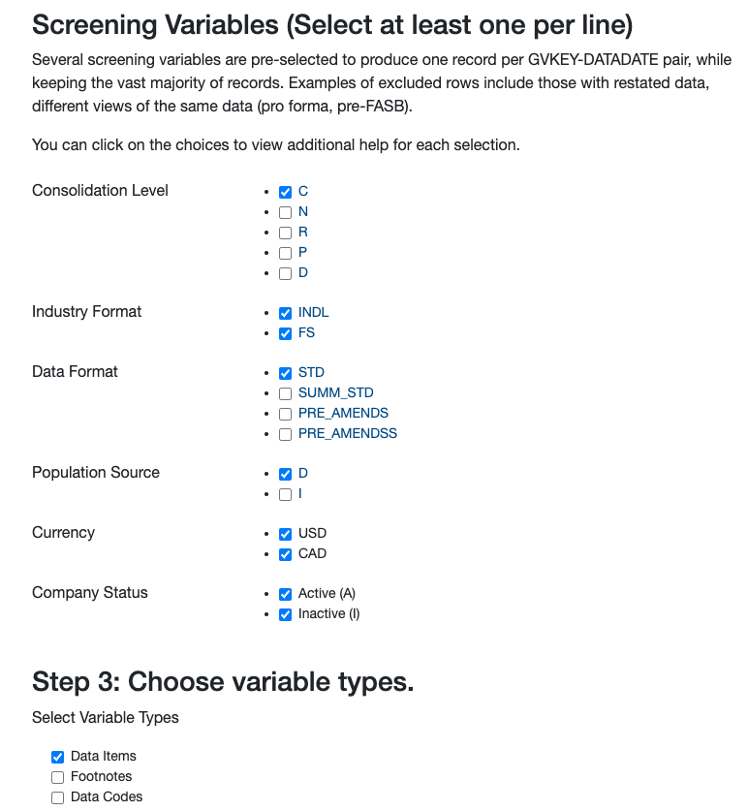
Compustat Data – Basic screening
Screening with filing type, data source, and data type
Consolidation Level:
Consolidated (C) / Non-Consolidated (N) / etc.
Industry Format:
Industrial (INDL) / Financial (FS)
Data Format:
Standard (STD) / Summary (SUMM_STD) / etc.
Population Source:
Domestic (D) / International (I)
Company Status:
Active (A) / Inactive (I)
Data Items / Footnotes / Data Codes

Slide 28
Compustat Fundamental Data Sample

Slide 29
Stock Market Data in CRSP
Center for Research in Security Prices (CRSP) is a research center at the Booth School of Business of the University of Chicago
Comprehensive collection of daily and monthly security records for the NYSE/AMEX/NASDAQ/ARCA trading activities
Daily and Monthly data for roughly 28K + securities of Domestic companies and ADRs traded on major exchanges from 1925–present
Complete historical information :
Accurate records of special distributions and stock splits in return calculation
Keep delisting companies (pre-M&A or bankruptcies), and delisting returns

Slide 30
Primary Identifiers
Primary Identifiers
PERMNO at security level
PERMCO at firm level
PERMNO is a unique permanent identifier and primary key assigned by CRSP to each security: Permanent, and Unique (Not Recyclable).
PERMCO is a unique identifier for each company assigned by CRSP : Permanent, and Unique (Not Recyclable).
Date Identifiers
Calendar date: date
In monthly stock file, date is set to be the end of the month

Slide 31
Common Secondary Identifiers
Stock Tickers: Exchange Specific, with Suffixes, NOT Permanent, and Recyclable
CRSP keeps historical changes in Ticker symbols
CUSIP also is NOT Permanent but Unique and NOT Exchange Specific.
8- or 9-digit CUSIP is assigned for issues (e.g. equities and bonds).
6-digit CUSIP is assigned for issuers (e.g. firms)
CRSP keeps both most current CUSIP and historical CUSIP (NCUSIP)
Company Names are often abbreviated/manipulated by data vendors
CRSP keeps historical changes in company names
Very difficult to have a reliable merging code by using company names

Slide 32
Identifiers Example
CRSP PERMANENT | CRSP PERMANENT | START DATE OF | END DATE OF EFFECTIVE | CUSIP IDENTIFIER | EXCHANGE | COMPANY NAME - HISTORICAL
NUMBER | COMPANY | EFFECTIVE NAME | NAME | - HISTORICAL | TICKER SYMBOL
 | NUMBER |  |  |  | - HISTORICAL
86079 | 665 | 19801204 | 19890131 | 11003510 | BRST | BRISTOL GAMING CORP
86079 | 665 | 19890201 | 19920419 | 11003520 | BRST | BRISTOL HOLDINGS INC
86079 | 665 | 19920420 | 19950822 | 84892010 | SPTK | SPORTS TECH INC
86079 | 665 | 19950823 | 19970630 | 01662710 | ALCM | ALL COMM MEDIA CORP
86079 | 665 | 19970701 | 20010729 | 57090710 | MSGI | MARKETING SERVICES GROUP INC
86079 | 665 | 20010730 | 20011014 | 57090710 | MKTG | MARKETING SERVICES GROUP INC
86079 | 665 | 20011015 | 20020331 | 57090720 | MKTG | MARKETING SERVICES GROUP INC
86079 | 665 | 20020401 | 20030126 | 55308X10 | MKTG | M K T G SERVICES INC
86079 | 665 | 20030127 | 20031127 | 55308X30 | MKTG | M K T G SERVICES INC
86079 | 665 | 20031128 | 20040111 | 55308X30 | MSGI | M K T G SERVICES INC
86079 | 665 | 20040112 | 20050208 | 58445910 | MSGI | MEDIA SERVICES GROUP INC
86079 | 665 | 20050209 | 20061019 | 55357010 | MSGI | M S G I SECURITY SOLUTIONS INC
1 PERMNO per stock
1 PERMCO per company
10 Different CUSIPs
5 Different Tickers
8 Different Names

Slide 33
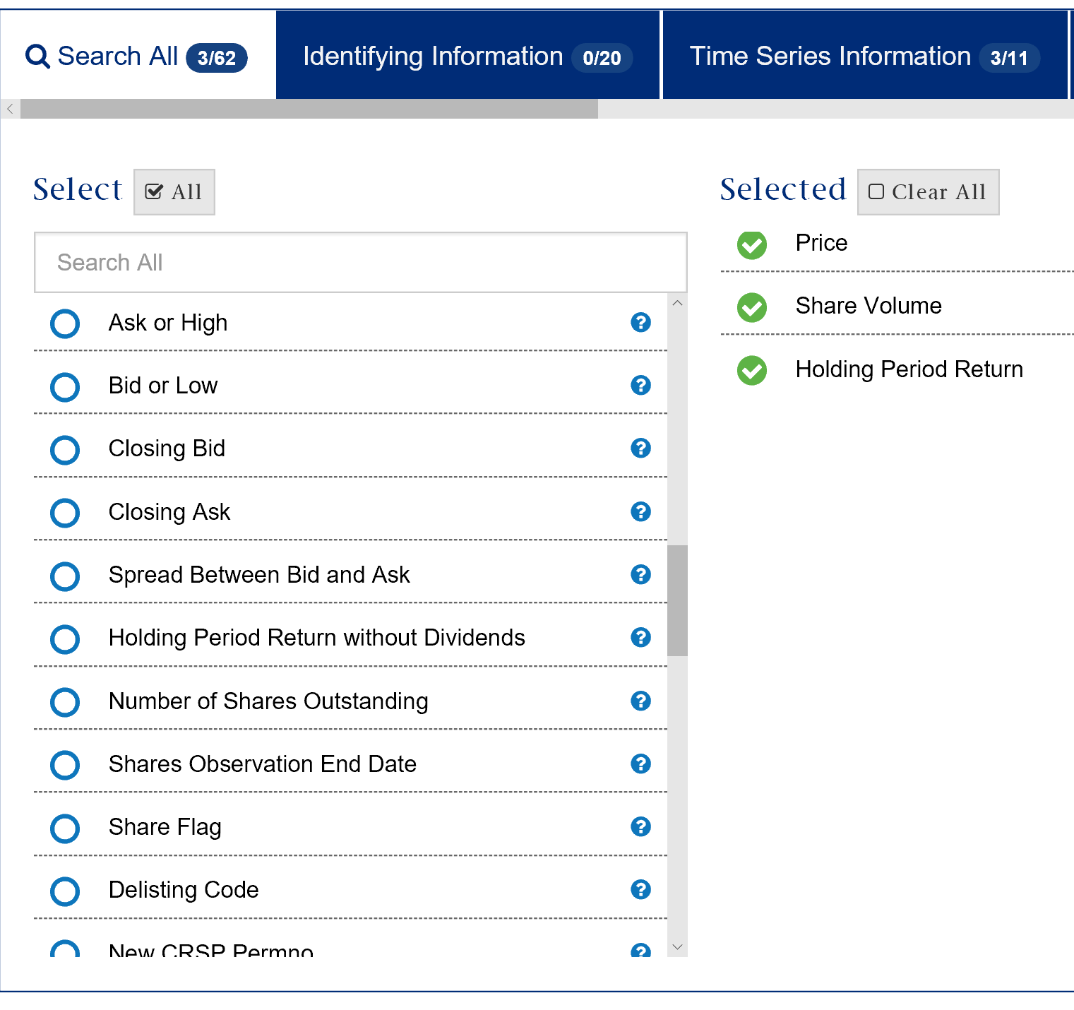
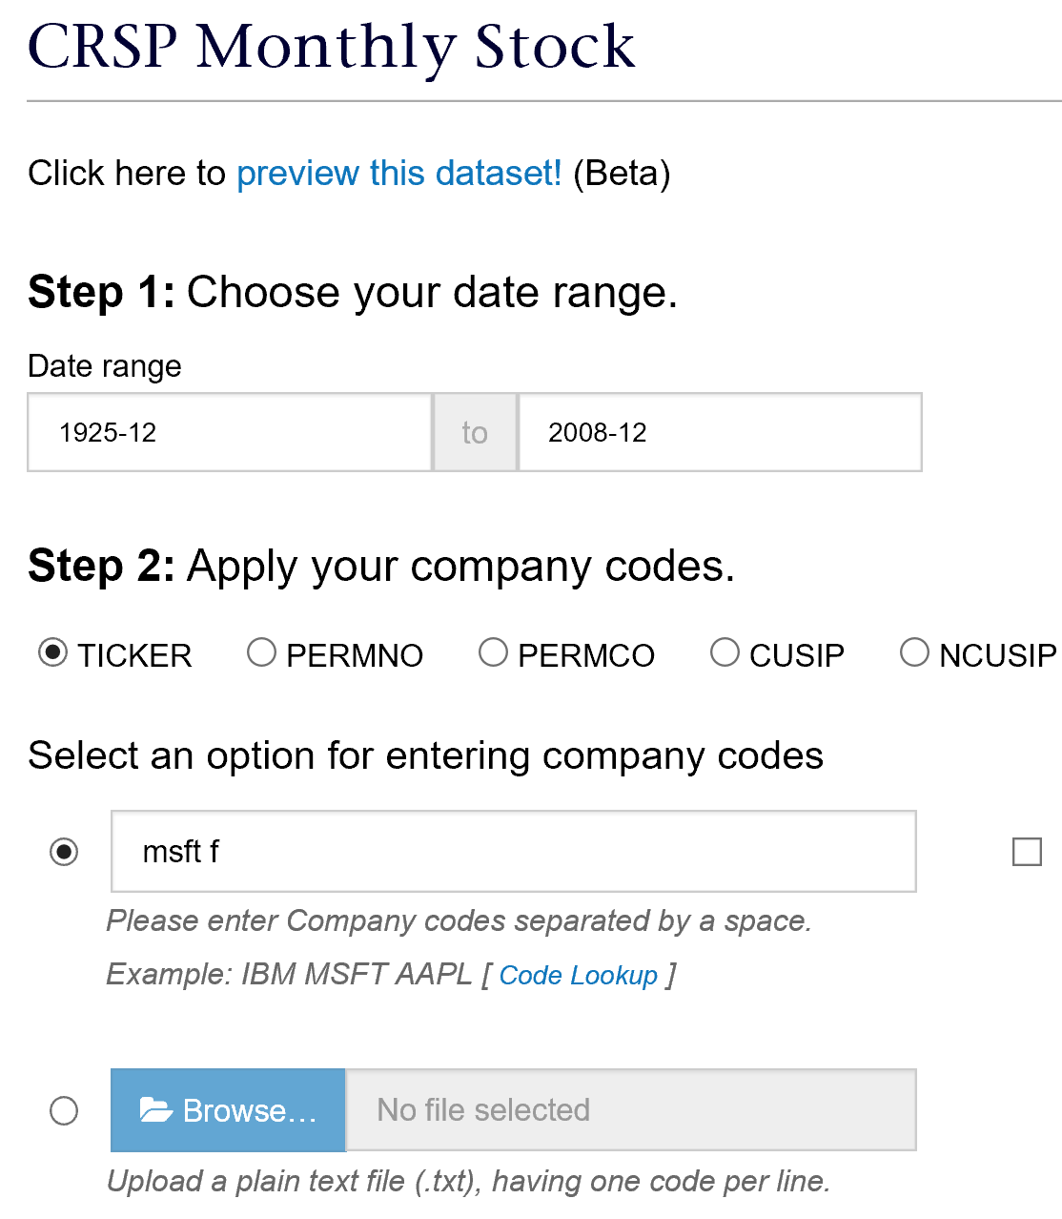
CRSP Example
Get monthly prices, return and volume information for Microsoft and Ford from 1925 to 2008

Slide 34
CRSP Examples
Stock returns
Stock headers
Dividends/share repurchases
Distribution
Adjustment factors
https://wrds-www.wharton.upenn.edu/pages/grid-items/crsp-basics/

Slide 35
WRDS Support for CRSP
Sample Programs
Data Extracts, CCM and merging by CUSIP
Calculate CAPM beta and excess returns
Research → Sample Programs → CRSP Sample Programs
Research Applications
Compound returns, Momentum and Governance Portfolios
Fama-French factors and B/M portfolios, Beta Estimation Research → Applications
Remote learning
Useful Variables, Basics, Coverage, Database Structure

Slide 36
How to Link CRSP and COMPUSTAT
Major Difficulties to link CRSP and COMPUSTAT
Different Frequencies:
COMPUSTAT – Accounting items are on annual-basis or quarterly-basis
CRSP– Security trading data is Monthly or Daily
Different Universe of Companies
CRSP: Equities listed in NYSE, AMEX, NASDAQ, ARCA, and BATS
COMPUSTAT: 10K and 10Q Filers to the SEC
Solution: Use the CCM(CRSP-COMPUSTAT Merged) Dataset or the linking macro

Slide 37
Agenda
1
What is WRDS?
2
Accessing the Data
3
Financial Data on WRDS
4
COMPUSTAT / CRSP overview
5
Advanced Access Features
6
WRDS Research Products & Support

Slide 38
Advanced Data Access on WRDS

Slide 39
Advanced Features – Access Data Remotely on WRDS Server
What if a web query does not do all that you need it to do?
Filtering data on multiple conditions
Some data tables are only accessible on WRDS cloud
More ways to access finance data at WRDS
WRDS Cloud gives you 10GB secure, personal home directory storage and access to 500GB shared directory storage within your institution. Helpful for storing code and results!
Customize your software (R, Python, SAS, etc) and connect to WRDS cloud server
 | Advantage
UNIX (SSH) | Batch Running Fast remote data access
Remote connection via local computer | Interactive Programming Programming language needs to be installed PC-SAS has slow remote data access
Web-based applications (WRDS SAS Studio, WRDS Jupyter Hub, RStudio) | Easy access and work from anywhere online No installation required

Slide 40
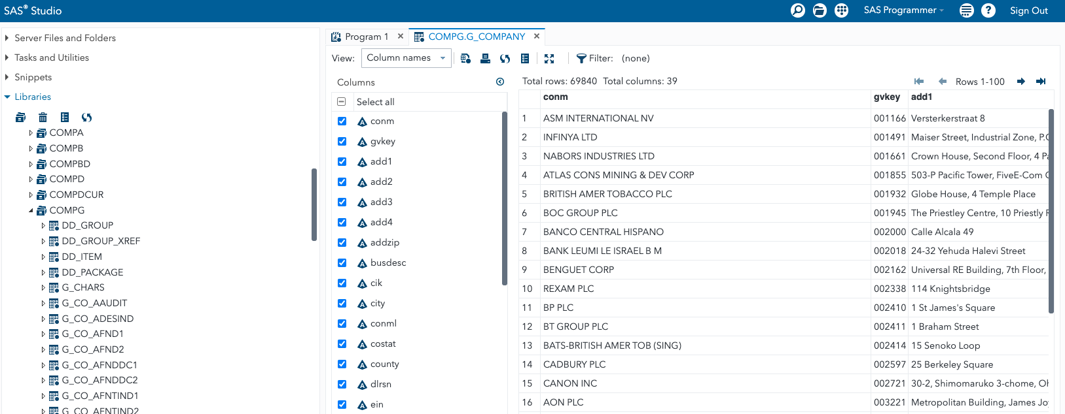
WRDS SAS Studio
https://wrds-cloud.wharton.upenn.edu/SASStudio/
A web-based SAS application running on WRDS cloud
WRDS SAS Studio support: https://wrds-www.wharton.upenn.edu/pages/support/programming-wrds/programming-sas/sas-web-sasstudio/

Slide 41
WRDS Jupyter Hub
https://wrds-jupyter.wharton.upenn.edu/hub/
Jupyter Hub is a web-based notebook style Interactive Development Environment
Python3 and R are supported

Slide 42
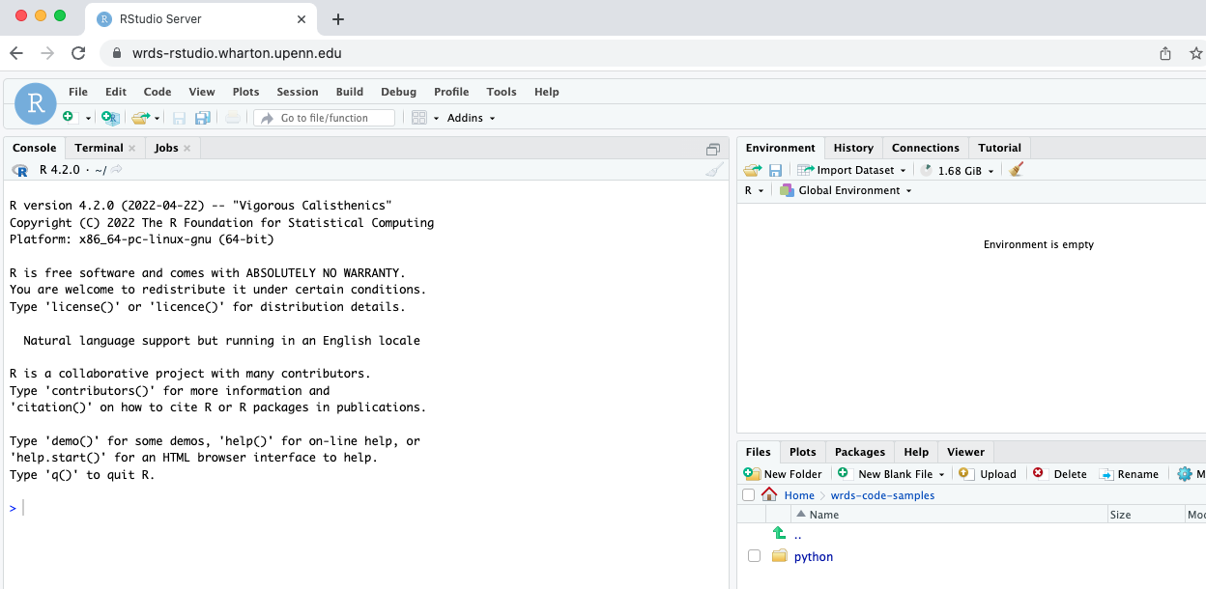
WRDS RStudio
https://wrds-rstudio.wharton.upenn.edu/
A web-based R application running on WRDS cloud
WRDS RStudio support: https://wrds-www.wharton.upenn.edu/pages/support/programming-wrds/programming-r/r-from-the-web/

Slide 43
PC-SAS / Connect – Concept
SAS software installed on your Windows PC
Some local SAS dataset in your PC
Remote access WRDS data by connecting to WRDS server
Use WRDS powerful Unix server processing resources
Access Unix permanent (10GB) & temp (4.5TB) disk spaces
Steps:
Connect to WRDS server
%let wrds = wrds-cloud.wharton.upenn.edu 4016;
options comamid = TCP remote = WRDS;
signon username = _prompt_;
Remote Submit rsubmit; {Program} endrsubmit;
Sign off
signoff;
Support → Getting Started -> Accessing WRDS -> PC-SAS Connect

Slide 44
PC-SAS / Connect – An Example
Example: Find all companies in 1997^{①} with sales >= 1 billion^{②}, total assets >= 5 billions^{③}, and with >= 30 years of publicly reported financial statements^{④}.
/* PC-SAS/Connect Communication Block */
%let wrds = wrds-cloud.wharton.upenn.edu 4016;
options comamid=TCP remote=WRDS;
signon username=_prompt_;
/* Submit SAS code to WRDS Unix Server */
rsubmit ;
/* SAS CODE submitted to WRDS Sever */
proc sql;
create table demo(
where= (fyear=1997 and sale>=1000 and at>=5000 and firm_age>=30)) as
select fyear, conm, tic, gvkey, sale, at, (fyear - min(fyear)) as Firm_Age
from comp.funda where not missing(at) and consol="C" and indfmt="INDL" and datafmt="STD" and popsrc="D"
group by gvkey;
quit;
/* Remote SAS CODE submission Ends */
endrsubmit;
/* Sign off from PC-SAS/Connect */
Signoff;

Slide 45
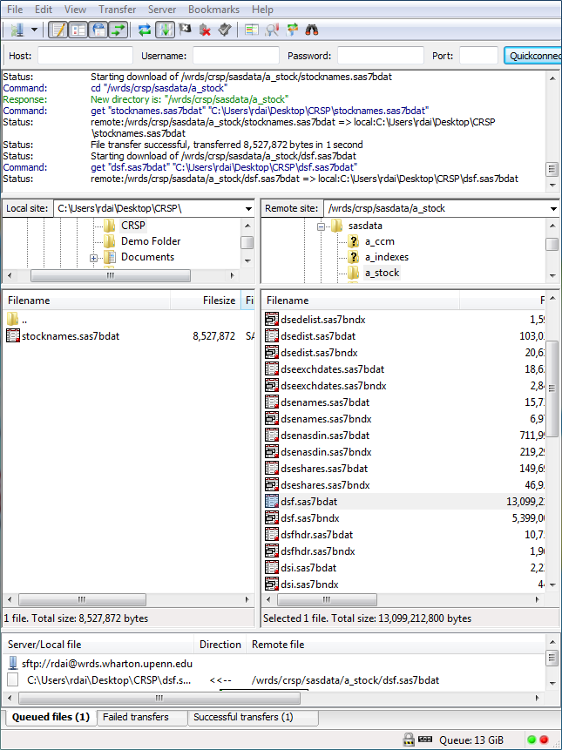
How to Access SAS Data in UNIX
Install SFTP Client software in your PC (freeware such as WIN SCP)
Set SFTP Client to be connected to the server: wrds-cloud.wharton.upenn.edu with your wrds (wharton) username and password
Retrieve and Upload files in SAS and other formats among your local machine and remote UNIX server.
Support → Getting Started -> Accessing WRDS -> SSH & UNIX

Slide 46
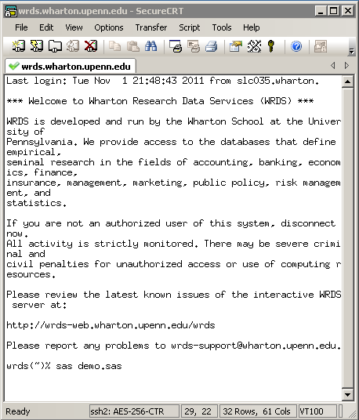
How to run SAS in UNIX
Install SSH Secure Shell (free) software in your PC
Set SSH to be connected to the server: wrds-cloud.wharton.upenn.edu with your wrds (wharton) username and password
Create, Edit and Run your SAS program using Unix commands.

Slide 47
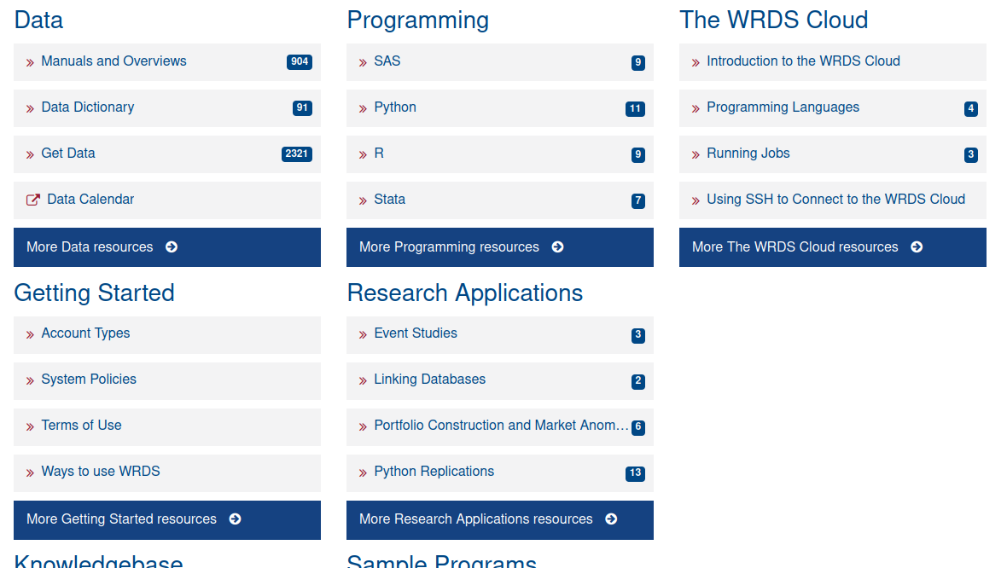
Step-by-step Remote Access Setup
SAS Python R STATA UNIX(SFTP)

Slide 48
Agenda
1
What is WRDS?
2
Accessing the Data
3
Financial Data on WRDS
4
COMPUSTAT /CRSP overview
5
Advanced Access Features
6
WRDS Research Products & Support

Slide 49
WRDS Research Products

Slide 50
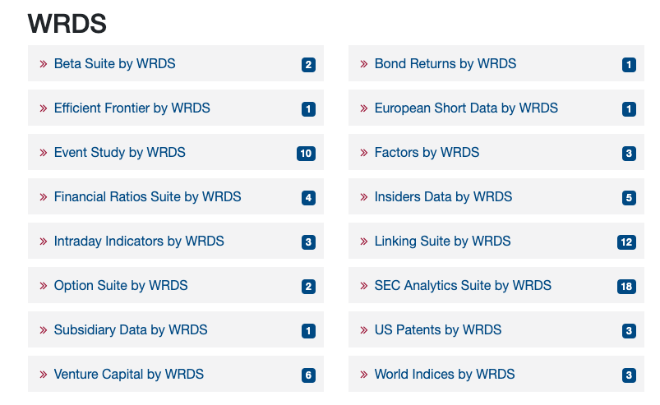
WRDS Research Products
WRDS Research: https://wrds-www.wharton.upenn.edu/pages/support/wrds-research/
Data
Research Analytics
Research Programs & Guides

Slide 51
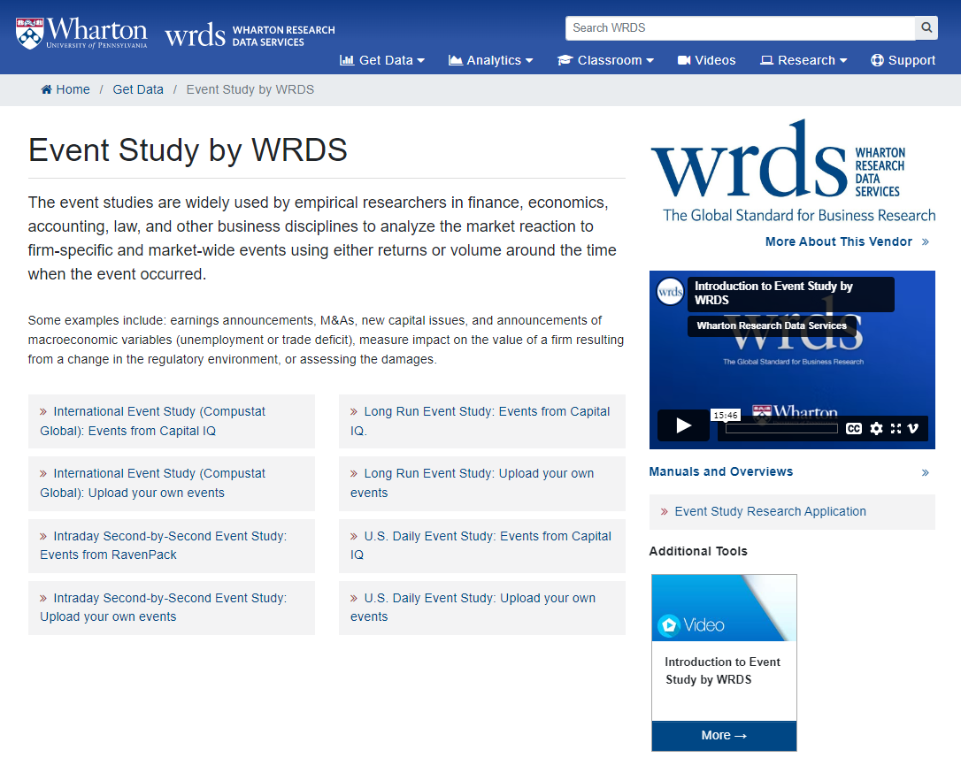
Analytics Example: Event Study
A complimentary research analytics with subscriptions to CRSP, Compustat Global, and etc.
User-friendly web interface
Example: Event study for Announcement of M&A (target companies) Link: WRDS US Daily Event Study

Slide 52
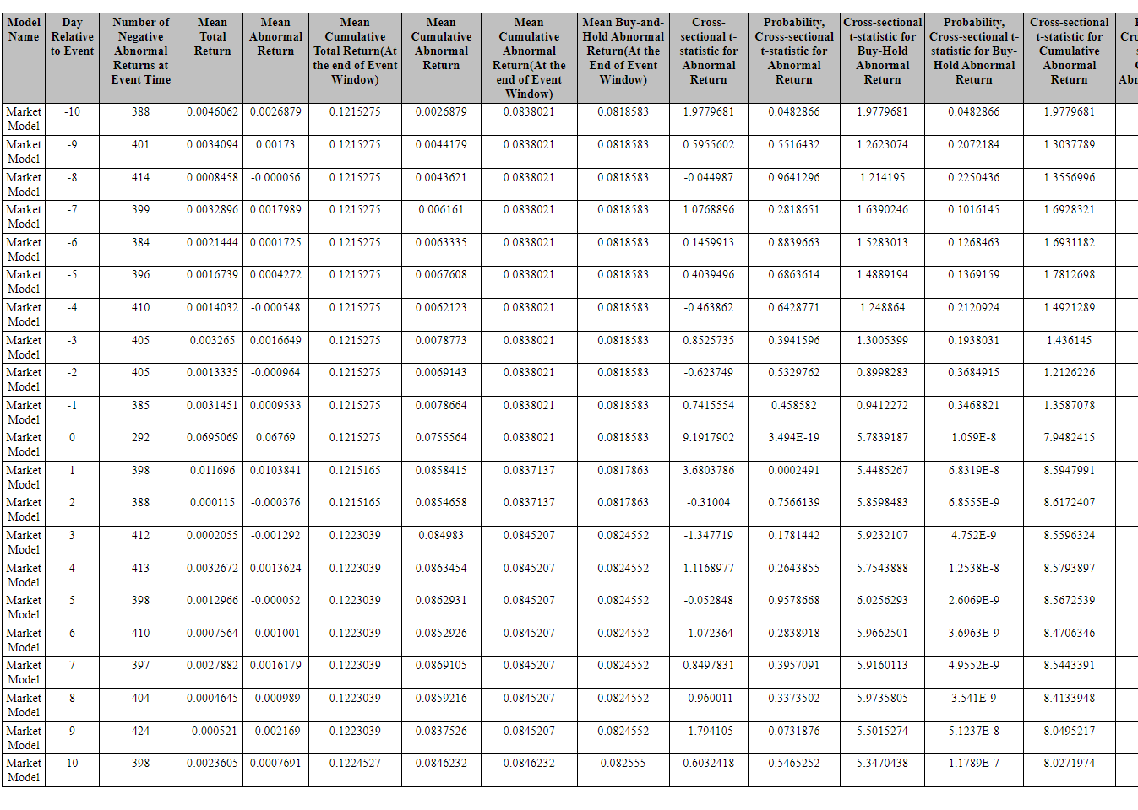
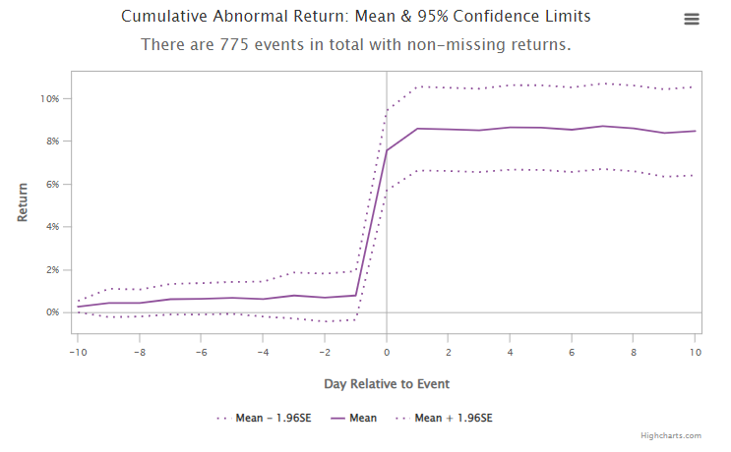
Event Study - Example
Stock market reaction for M&A target companies around the M&A announcements made in 2021
M&A data: SDC (via WRDS)
Stock data: CRSP

Slide 53
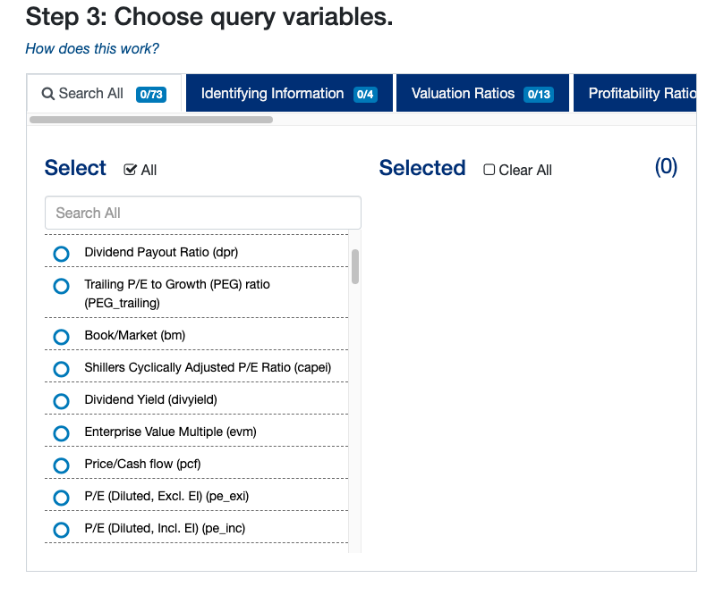
WRDS Financial Ratio Suite
Pre-calculated 65 + Financial Ratio including P/E, B/M, ROA, etc.
Web query: https://wrds-www.wharton.upenn.edu/pages/get-data/financial-ratios-suite-wrds/financial-ratios/financial-ratios-firm-level-by-wrds-beta/
Source code (SAS): https://wrds-www.wharton.upenn.edu/pages/support/manuals-and-overviews/wrds-financial-ratios/financial-ratios-sas-code/

Slide 54
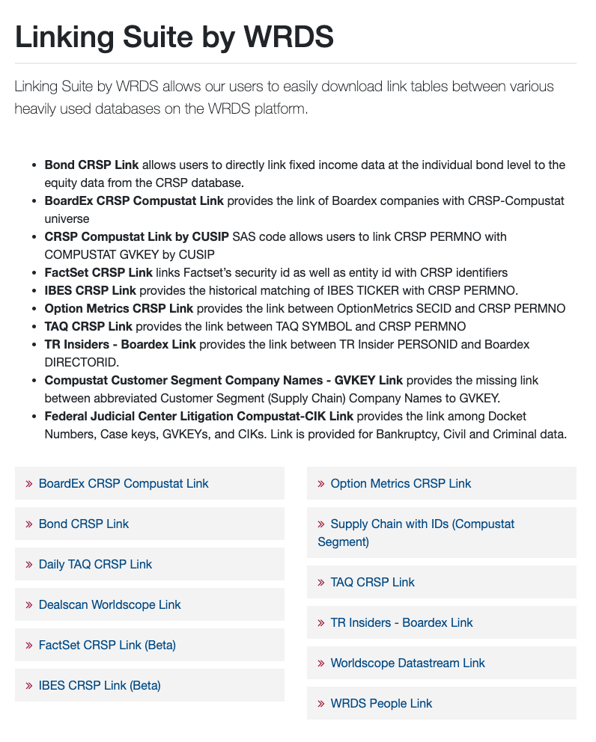
WRDS Linking Suite
WRDS-created linking tables across different databases (link)
Complimentary with the database subscriptions
Ex – BoardEX-CRSP-Compustat Link is only available for who has subscriptions to all three products
Worldscope Datastream Link
WRDS created a linking table between Worldscope and Datastream so that users do international research more conveniently
The latest addition: WRDS People Link
Link people across various databases on WRDS including Execucomp, BoardEx, Thompson/Refinitiv Insiders, CIQ People Intelligence, and 2IQ Insiders.

Slide 55
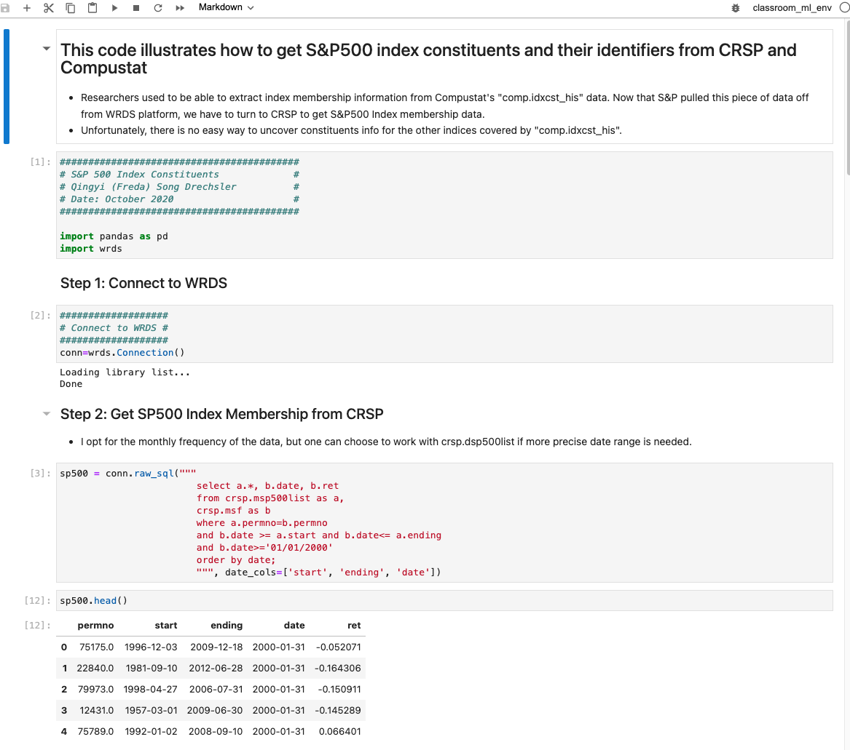
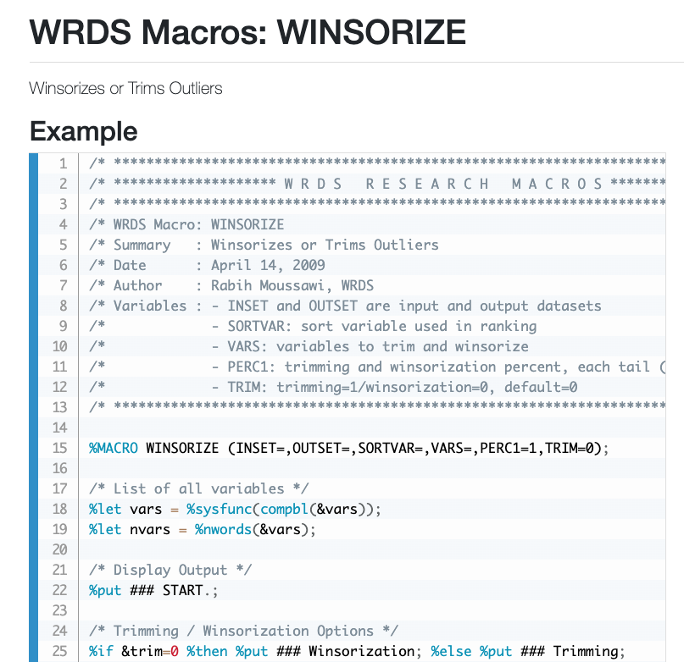
Sample Research Program
WRDS Research produces sample research programs, research macros in SAS and Python.

Slide 56
WRDS Support

Slide 57
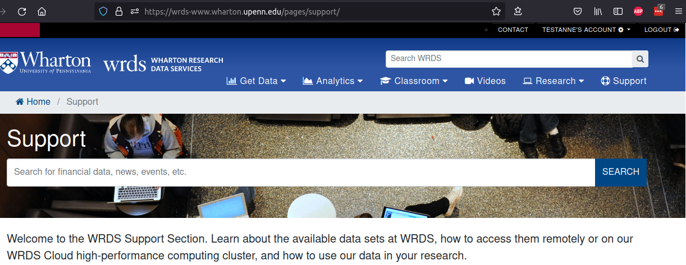
WRDS Support
Submit a Zendesk ticket by clicking “contact”
Provide details in your question (descriptions, research paper references, screenshots, error messages, etc.)

Slide 58
Research and Technical Support
Online Help
Database Manuals plus additional support documentation
Data Overviews
Research Applications
Sample Programs
Variable Search
Company Search
WRDS Knowledge Base: FAQ archive of answers to common user questions
Email support at wrds-support@wharton.upenn.edu (Monday-Friday, 9a-5p EST) Researchers and Technical Experts ready to assist with:
Data access, merging, and management
Technical problems

Slide 59
Thank You!

