Slide 1
Foreign Exchange Rates

Slide 2
Learning Objectives
After completing this assignment, students will:
Understand factors that can affect the value of a currency’s exchange rate

Slide 3
Foreign Exchange Rate
Currencies are continuously traded on foreign exchange markets; dealers adjust to changes in supply and demand, and the prices change accordingly.
Foreign exchange rate: the price at which one currency can be converted into another currency.

Slide 4
Foreign Exchange Rate (cont.)
For examples in this slide deck, we define the exchange rate as how many units of foreign currency you can get for 1 unit of the home currency (in this case, the US dollar).
For example, on 12/4/2017 the US dollar to Indian rupee exchange rate was 64.42 rupees per dollar. A person could go to a bank and exchange 1 US dollar for 64.42 Indian rupees.

Slide 5
Supply and Demand
Using the supply and demand diagram, the demand curve (D) for US dollars intersects with the supply curve (S) of US dollars at the equilibrium point. The graph shows this equilibrium price at an exchange rate of 64.42 Indian rupees per dollar.
Exchange rate ₹/$
Market for USD in India
S
64.42 ₹/$
D
Quantity

Slide 6
Supply and Demand (cont.)
If the demand for US dollars increases from D₁ to D_{2,} the demand curve shifts outward. The new equilibrium point indicates the exchange rate has risen to 65 Indian rupees per dollar.
Exchange rate ₹/$
Market for USD in India
S
65.00 ₹/$
64.42 ₹/$
D₂
D₁
Quantity

Slide 7
Factors Affecting Currency Supply
Imports: domestic currency must be supplied and exchanged into the foreign currency to purchase the imported goods.
Investment in foreign assets (e.g., purchasing bonds or real estate in a foreign country)
Speculation by investors in the foreign exchange market
Government intervention
Travel for business/tourism to the foreign country

Slide 8
Factors Affecting Currency Demand
Exports: foreigners demand the domestic currency to make their purchases.
Foreign investment in domestic assets
Speculation by investors in the foreign exchange market
Government intervention
Foreigners visiting for business/tourism

Slide 9
Factors Affecting Currency Exchange Rates
Supply | Demand
Imports | Exports
Investing in foreign assets | Foreign investment in domestic assets
Speculation | Speculation
Government intervention | Government intervention
Travel abroad | Travel from abroad
Interest
rates
Inflation
rates
Commodity prices
Political stability
Economic growth or recession
Balance of trade & Terms of trade
Government debt

Slide 10
Changing Demand: Example
To return to the example of a shifting demand curve, one scenario resulting in increased demand for USD could be US interest rates rising. Indian investors may then demand more USD in order to purchase US bonds as investments. The ₹/$ exchange rate would rise.
Exchange rate ₹/$
Market for USD in India
S
65.00 ₹/$
64.42 ₹/$
D₂
D₁
Quantity

Slide 11
Appreciation
Appreciation is an increase in the value of a country’s currency with respect to another currency.
For example, if the exchange rate starts at 100 Kenyan Shilling/USD and it rises to 105 Kenyan Shilling/USD, the dollar has experienced a 5% appreciation relative to the Kenyan Shilling.

Slide 12
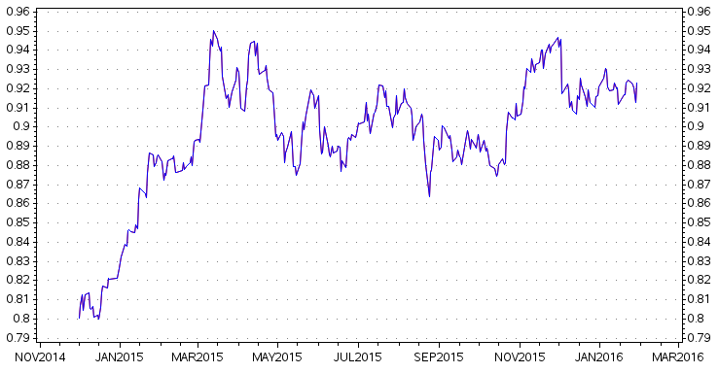
Appreciation: Chart Example
In 2015, the US dollar appreciated 11.4% against the Euro. In this period, the US economy was strengthening, while Europe’s economy was struggling. Europe began to lower interest rates as part of an economic stimulus program.

Slide 13
Depreciation
Depreciation is a decrease in the value of a country’s currency with respect to another currency.
For example, if the exchange rate starts at 100 Kenyan Shilling/USD and it falls to 95 Kenyan Shilling/USD, the dollar has experienced a 5% depreciation relative to the Kenyan Shilling.

Slide 14
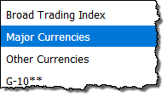
Using Indexes
Economists track overall appreciation or depreciation of the dollar using exchange rate indices comprised of a basket of several international currencies.
For example the Federal Reserve’s “Major Currencies” index is a weighted average of the foreign exchange values of the US dollar against a subset of currencies chosen because they circulate widely outside the country of issue.

Slide 15
Devaluation and Revaluation
Devaluation occurs when the government or central bank of a country controls the exchange rate and reduces the value of the domestic currency. (Whereas depreciation refers to a loss of value in the market when the exchange rate is floating).
Conversely, revaluation is when the government or central bank of a country controls the exchange rate and increases the value of the domestic currency. (Whereas appreciation refers to a gain of value in the market when the exchange rate is floating).

Slide 16
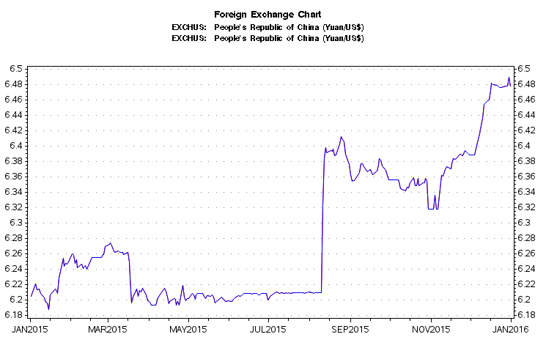
Devaluation: Chart Example
August 11th, 2015, the People’s Bank of China devalued the yuan (renminbi). As this exchange rate chart illustrates, on that day the US dollar appreciated in value close to 2% against the yuan.

Slide 17
Conclusion
Changes to supply/demand of a currency are affected by:
Imports/exports
Investment in foreign assets/foreign investors
Speculation by investors in the foreign exchange market
Government intervention
Travel abroad/travel from abroad

Slide 18
Conclusion (cont.)
Appreciation is when the value of a currency rises in relation to another currency (or index of currencies); depreciation is when the value of a currency falls in relation to another currency/index.
Devaluation and revaluation are similar to depreciation and appreciation, but occur when a government or central bank actively adjusts the value of the currency.

Slide 19
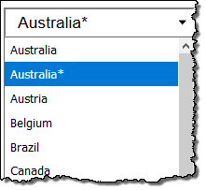
Notes
When using the Foreign Exchange Rates Charts query, most charts illustrate how many units of foreign currency you can get for 1 US dollar.
In the WRDS query form, if a country or index has an asterisk (*) this indicates the inverted format is also available. These charts illustrate how many units of the domestic currency (the US dollar) you can get for 1 unit of the foreign currency.

