Slide 1
CRSP Stock Database Structure in WRDS
WHARTON RESEARCH DATA SERVICES
April 15, 2020

Slide 2
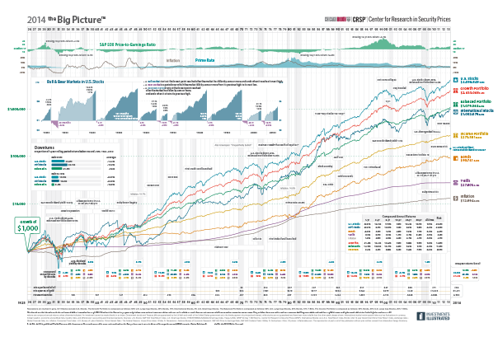
Data Structure in WRDS
Types of Updates
Time Series vs Event Files
How to merge those files.

Slide 3
1. Types of Updates

Slide 4
Updates (subscriptions)
Annually: /wrds/crsp/sasdata/a_stock Quarterly: /wrds/crsp/sasdata/q_stock
Monthly: /wrds/crsp/sasdata/m_stock

Slide 5
2. Time-series and Event files

Slide 6
2 Types of CRSP Files
* = D or M
1
Time-Series:
*SF, *SI
2
Event files:
*SENAMES,*SESHARES, *SEDELIST, *SEDIST

Slide 7
Example : DSF (Time-series) DSENAMES (Event file)
PERMNO | date | PRC | VOL | RET
11081 | 20020501 | 26.48 | 24852686 | 0.005315
11081 | 20020502 | 25.42 | 28163281 | -0.04003
11081 | 20020503 | 24.32 | 32577239 | -0.04327
11081 | 20020506 | 23.75 | 20276240 | -0.02344
11081 | 20020507 | 22.33 | 35223880 | -0.05979
11081 | 20020508 | 25.65 | 34750543 | 0.148679
11081 | 20020509 | 25.24 | 19617279 | -0.01598
11081 | 20020510 | 23.88 | 22611509 | -0.05388
DATE | NAMEENDT | COMNAM | NCUSIP | TICKER | PERMNO | SHRCD | EXCHCD | SICCD | NAICS
19880622 | 20030721 | DELL COMPUTER CORP | 24702510 | DELL | 11081 | 11 | 3 | 3570
20030722 | 20040609 | DELL INC | 24702R10 | DELL | 11081 | 11 | 3 | 3570
20040610 | 20060629 | DELL INC | 24702R10 | DELL | 11081 | 11 | 3 | 3570 | 334111
20060630 | 20120522 | DELL INC | 24702R10 | DELL | 11081 | 11 | 3 | 3570 | 334113
20120523 | 20131029 | DELL INC | 24702R10 | DELL | 11081 | 11 | 3 | 3570 | 334118

Slide 8
Examples : DSESHARES (Event File) DSEDELIST (Event file)
PERMNO | SHRSDT | SHRENDDT | SHROUT
11081 | 20030131 | 20030420 | 2,579,000
11081 | 20030421 | 20030429 | 2,568,286
11081 | 20030430 | 20030501 | 2,568,117
11081 | 20030502 | 20030522 | 2,568,000
11081 | 20030523 | 20030529 | 2,568,252
11081 | 20030530 | 20030721 | 2,568,631
PERMNO | DLSTDT | DLSTCD | DLAMT | DLRETX | DLPDT | DLRET
11081 | 20131029 | 233 | 13.88 | 0.001443 | 20131030 | 0.001443

Slide 9
3. How to merge both Time-Series and Event files.

Slide 10
Adding Shares Outstanding to Time-Series…
libname crsp '/wrds/crsp/sasdata/a_stock';
proc sql; create table Adding_Shrout as select a.permno, a.date, a.prc, b.shrout from crsp.dsf as a, crsp.dseshares as b where a.permno = b.permno and a.date between b.shrsdt and b.shrenddt a.permno=11081 and /* example for DELL */ and year(date)=2013 and month(date)=10 order by date; quit;

Slide 11
Output
PERMNO | date | prc | shrout
11081 | 20131001 | 13.84 | 1758369
11081 | 20131002 | 13.83 | 1758369
11081 | 20131003 | 13.83 | 1758369
11081 | 20131004 | 13.84 | 1758369
11081 | 20131007 | 13.84 | 1758369
11081 | 20131008 | 13.83 | 1758369
11081 | 20131009 | 13.83 | 1758369
11081 | 20131010 | 13.84 | 1758369
11081 | 20131011 | 13.85 | 1758369
11081 | 20131014 | 13.85 | 1758369
11081 | 20131015 | 13.83 | 1758369
11081 | 20131016 | 13.85 | 1758369
11081 | 20131017 | 13.85 | 1758369
11081 | 20131018 | 13.83 | 1758369
11081 | 20131021 | 13.85 | 1758369
11081 | 20131022 | 13.85 | 1758369
11081 | 20131023 | 13.84 | 1758369
11081 | 20131024 | 13.85 | 1758369
11081 | 20131025 | 13.84 | 1758369
11081 | 20131028 | 13.83 | 1758369
11081 | 20131029 | 13.86 | 1758369

Slide 12
CRSP on WRDS web page
Time-Series and Event files are merged on the fly. No need to program…

Slide 13
Summary
Types of CRSP Updates
Time Series vs Event Files
How to merge both Time-Series and Event files.

