Slide 1
CRSP in WRDS: The Basics
WHARTON RESEARCH DATA SERVICES
April 15, 2020

Slide 2
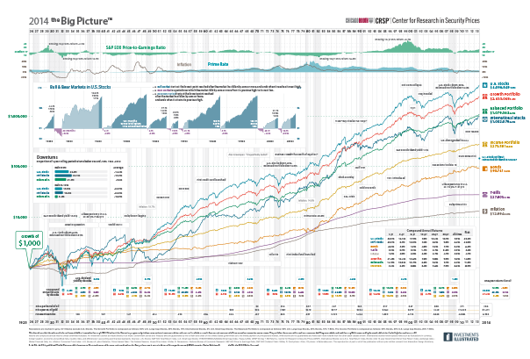
CRSP in WRDS: The Basics
How popular is CRSP?
Highlights
Types of CRSP data
How the Data looks

Slide 3
1. How Popular is CRSP data?

Slide 4
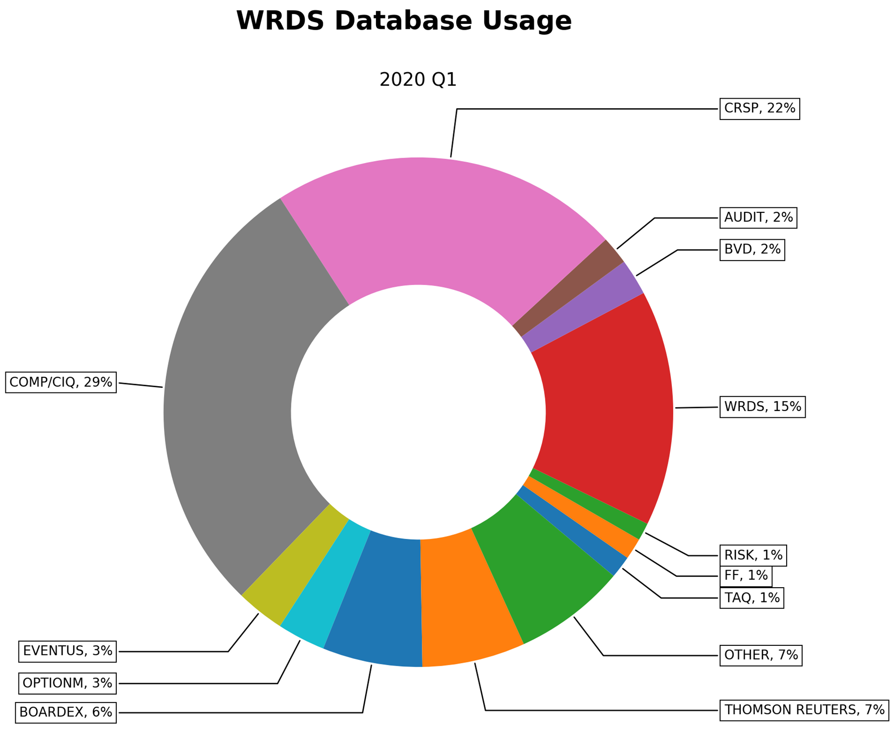

Slide 5
2. Highlights

Slide 6
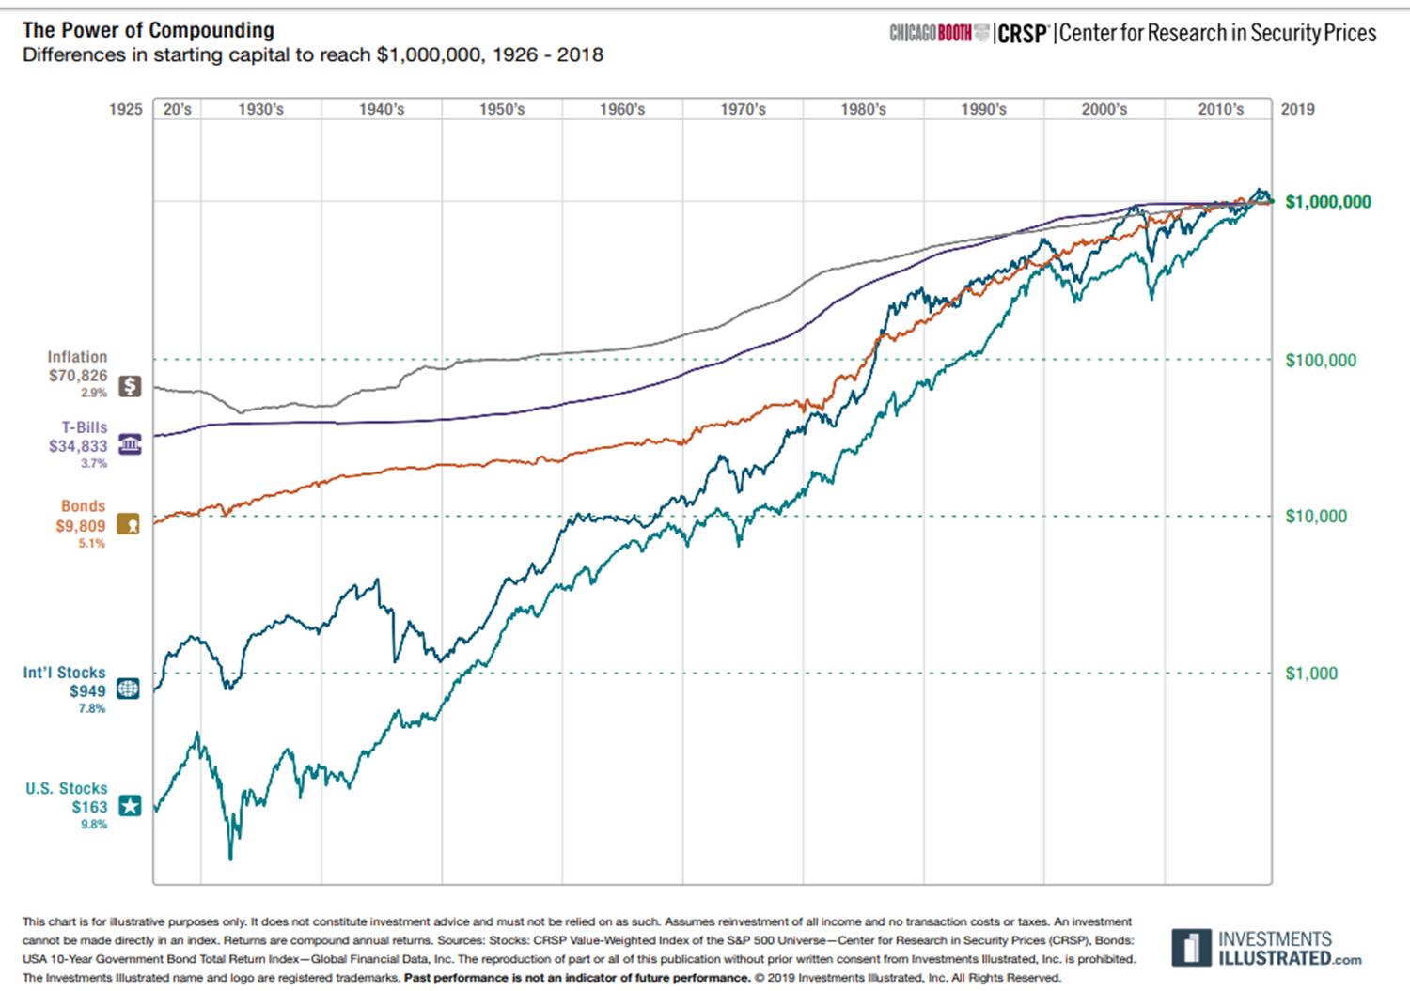
Stock Market data for US Equities
Daily and Monthly Frequency.
Since 1926.
Covers 16 business cycles.
Clean data
Well defined Universe
No Survivor-biased
Keep Historical Identifiers.
Provide Permanent Identifiers.
Prices, Returns with Dividends, Shares Outstanding, Adjustment Factors, Industrial Codes, Delisting returns…

Slide 7
3. Types of CRSP Data

Slide 8
Types of CRSP data
1
Stock Markets Data (daily and monthly)
2
CRSP/COMPUSTAT Merged database
3
Mutual Funds
4
Other Databases
Notes:
Other databases: CRSP Portfolios and Stock Indices database CRSP Treasuries Ziman REIT database

Slide 9
4. How the Data looks…

Slide 10
Monthly CRSP data for IBM
PERMNO | date | TICKER | PRC | RET | SHROUT
12490 | 20190131 | IBM | 134.42 | 0.182546 | 908,794
12490 | 20190228 | IBM | 138.13 | 0.03928 | 889,866
12490 | 20190329 | IBM | 141.1 | 0.021501 | 889,866
12490 | 20190430 | IBM | 140.27 | -0.00588 | 886,643
12490 | 20190531 | IBM | 126.99 | -0.08313 | 886,643
12490 | 20190628 | IBM | 137.9 | 0.085912 | 886,643
12490 | 20190731 | IBM | 148.24 | 0.074982 | 885,875
12490 | 20190830 | IBM | 135.53 | -0.07481 | 885,875
12490 | 20190930 | IBM | 145.42 | 0.072973 | 885,875
12490 | 20191031 | IBM | 133.73 | -0.08039 | 885,637
12490 | 20191129 | IBM | 134.45 | 0.017498 | 885,637
12490 | 20191231 | IBM | 134.04 | -0.00305 | 885,637

Slide 11
Example when Ticker change on CRSP daily data
PERMNO | date | TICKER | COMNAM | PERMCO | PRC
16940 | 20190201 | BSTI | BEST INC | 56072 | 4.53
16940 | 20190204 | BSTI | BEST INC | 56072 | 4.73
16940 | 20190205 | BSTI | BEST INC | 56072 | 5.09
16940 | 20190206 | BSTI | BEST INC | 56072 | 5.13
16940 | 20190207 | BSTI | BEST INC | 56072 | 5.00
16940 | 20190208 | BSTI | BEST INC | 56072 | 4.74
16940 | 20190211 | BSTI | BEST INC | 56072 | 5.08
16940 | 20190212 | BSTI | BEST INC | 56072 | 5.44
16940 | 20190213 | BSTI | BEST INC | 56072 | 6.23
16940 | 20190214 | BSTI | BEST INC | 56072 | 5.97
16940 | 20190215 | BSTI | BEST INC | 56072 | 5.89
16940 | 20190219 | BEST | BEST INC | 56072 | 5.90
16940 | 20190220 | BEST | BEST INC | 56072 | 5.79
16940 | 20190221 | BEST | BEST INC | 56072 | 5.81
16940 | 20190222 | BEST | BEST INC | 56072 | 6.00
16940 | 20190225 | BEST | BEST INC | 56072 | 6.19
16940 | 20190226 | BEST | BEST INC | 56072 | 6.14
16940 | 20190227 | BEST | BEST INC | 56072 | 6.14
16940 | 20190228 | BEST | BEST INC | 56072 | 6.10

Slide 12
Dealing with Stock Splits: Example Apple 7-for-1 split June 2014
PERMNO | date | TICKER | PRC | RET | SHROUT | CFACPR
14593 | 20140603 | AAPL | 637.54 | 0.01414 | 861,381 | 7
14593 | 20140604 | AAPL | 644.82 | 0.01142 | 861,381 | 7
14593 | 20140605 | AAPL | 647.35 | 0.00392 | 861,381 | 7
14593 | 20140606 | AAPL | 645.57 | -0.00275 | 861,381 | 7
14593 | 20140609 | AAPL | 93.70 | 0.01600 | 6,029,667 | 1
14593 | 20140610 | AAPL | 94.25 | 0.00587 | 6,029,667 | 1
14593 | 20140611 | AAPL | 93.86 | -0.00414 | 6,029,667 | 1
14593 | 20140612 | AAPL | 92.29 | -0.01673 | 6,029,667 | 1

Slide 13
Dealing with M&A: Example Energy Transfer Partners LP and Sunoco Logistic Partners.
PERMNO | date | NCUSIP | TICKER | COMNAM | ACPERM | PRC
84400 | 26/4/2017 | 29273R10 | ETP | ENERGY TRANSFER PARTNERS L P |  | 36.39
84400 | 27/4/2017 | 29273R10 | ETP | ENERGY TRANSFER PARTNERS L P |  | 35.93
84400 | 28/4/2017 | 29273R10 | ETP | ENERGY TRANSFER PARTNERS L P | 89304
PERMNO | date | NCUSIP | TICKER | COMNAM | ACPERM | PRC
89304 | 26/4/2017 | 86764L10 | SXL | SUNOCO LOGISTICS PARTNERS |  | 24.27
89304 | 27/4/2017 | 86764L10 | SXL | SUNOCO LOGISTICS PARTNERS |  | 24.03
89304 | 28/4/2017 | 86764L10 | SXL | SUNOCO LOGISTICS PARTNERS |  | 23.94
89304 | 1/5/2017 | 29278N10 | ETP | ENERGY TRANSFER PARTNER LP |  | 23.42
89304 | 2/5/2017 | 29278N10 | ETP | ENERGY TRANSFER PARTNER LP |  | 23.69
89304 | 3/5/2017 | 29278N10 | ETP | ENERGY TRANSFER PARTNER LP |  | 23.08

Slide 14
Summary
How popular is CRSP?
Highlights
Types of CRSP data
How the Data looks

